Slide 1


Detecting relic neutrinos and measuring the neutrino mass with PTOLEMY
Nicolo de Groot (Radboud University and Nikhef)

Slide 2
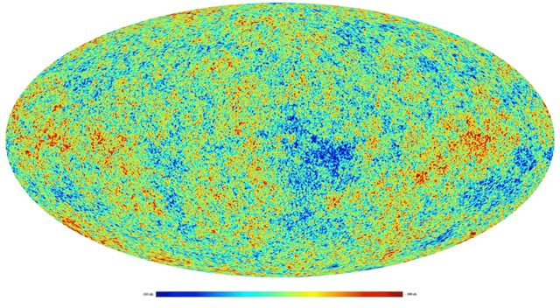
CMB: picture of our universe at 380000 years

Slide 3
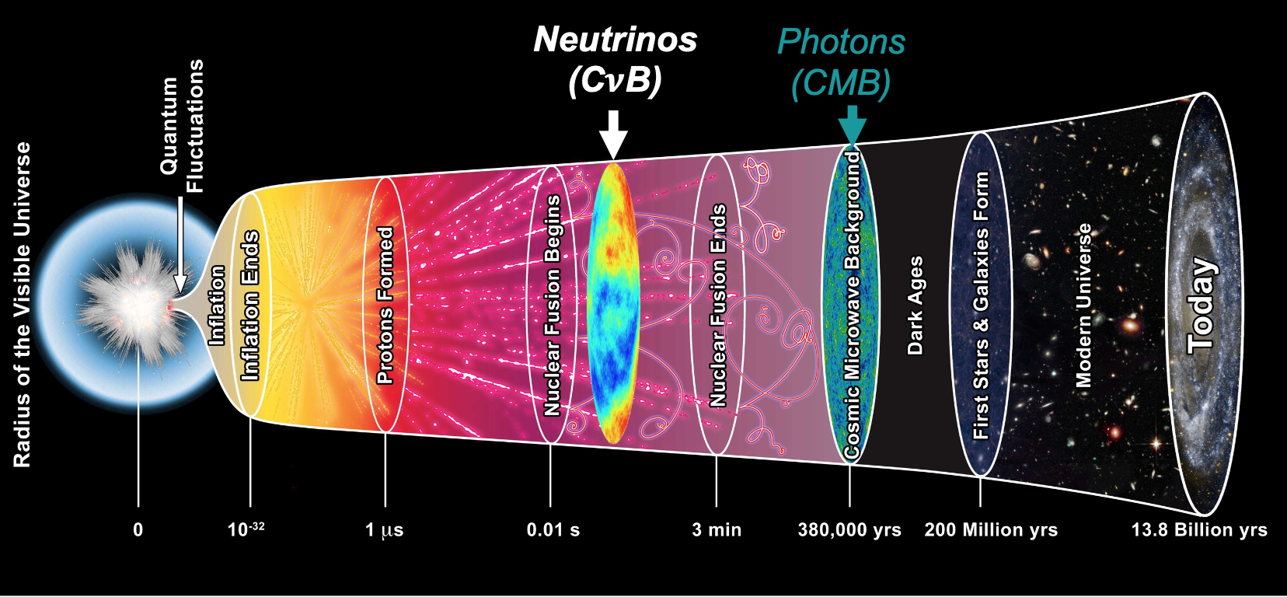
1 second after the Big Bang
~1 s: neutrinos decouple
Ptolemy

Slide 4
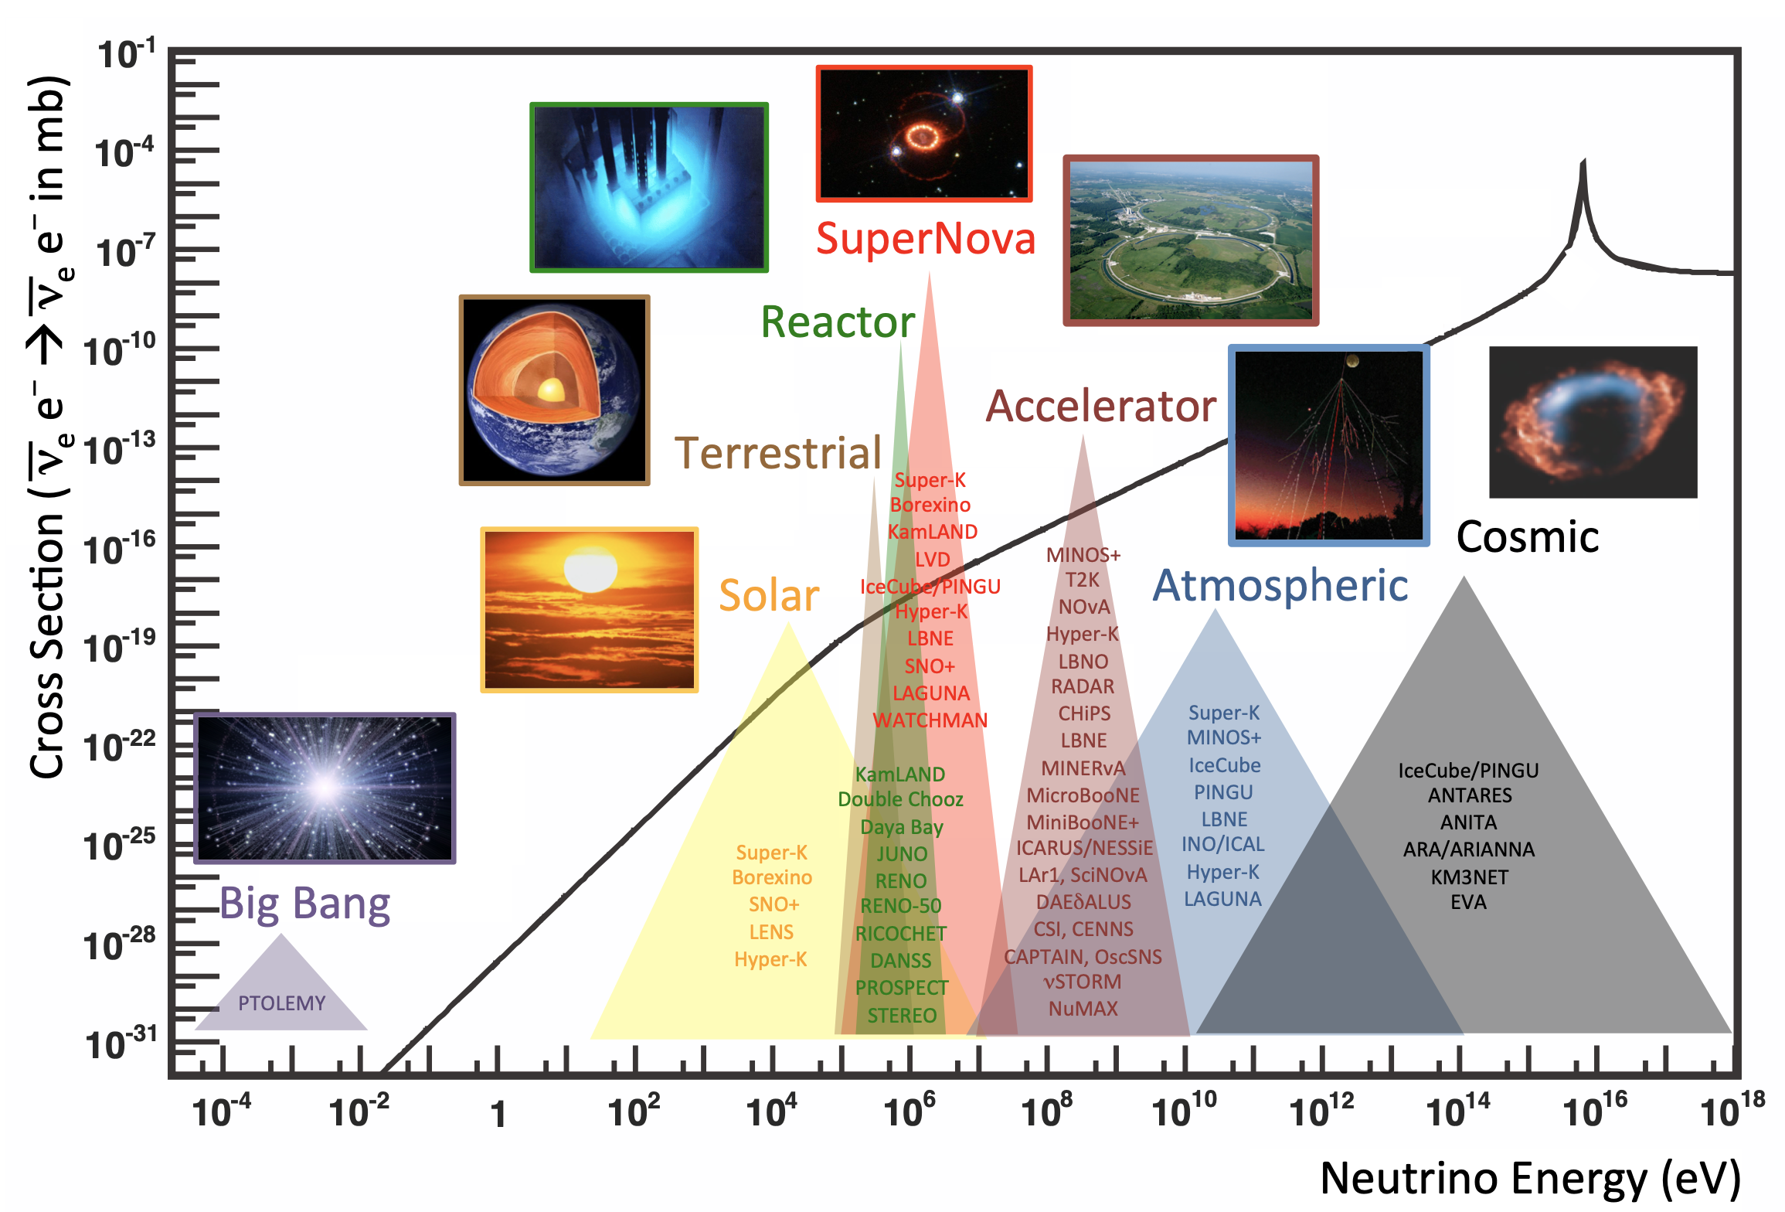
Neutrinos sources across the Cosmos

Slide 5
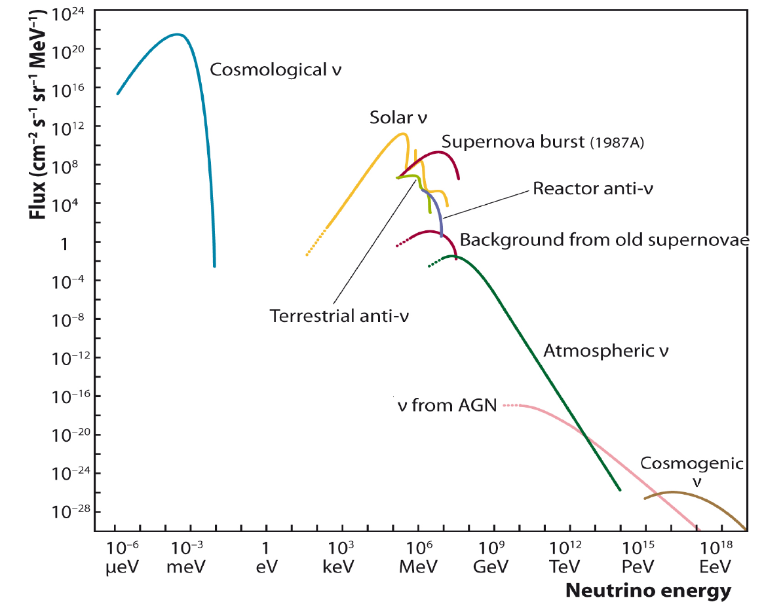
Relic Neutrino Background
Number density:
n_{ν} = 112/cm³
Temperature:
T_{ν} ~ 1.95K
p ~ 0.17 meV
K = 0.3 meV
(for 50 meV m_{ν})
Ultra Cold
Velocity distribution:
<v_{ν}> ~T_{ν}/m_{ν}
Notes:
How can we directly detect the relic neutrinos today.
Edward Witten – joke H->D->T
It’s not as crazy as it seems – the neutrinos have very little kinetic energy, so you need to capture them on nuclei that are have no energy barrier transform into a lighter element – which means they are unstable to beta-decay.

Slide 6
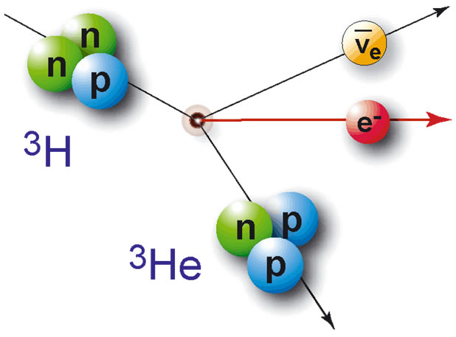
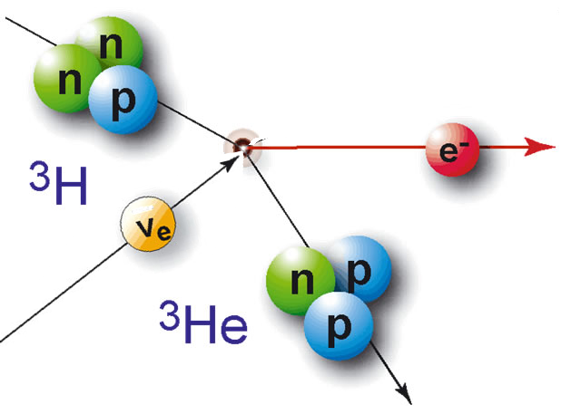
Relic Neutrino Capture
S. Weinberg [Phys. Rev. 128:3, 1457 (1962)]
A.G.Cocco, G.Mangano and M.Messina. [JCAP 06(2007)015 DOI: 10.1088/1475-7516/2007/06/015]
E_{K} = 18.6 keV
Tritium β-decay
(12.3 yr half-life)
Gap (2m) constrained to
m ≲ 120meV
from precision cosmology
Neutrino flavor expected with m ≳50meV
from oscillations
Ptolemy aim: <50meV
100g of T
M.G. Betti et al
JCAP 07(2019)047
Notes:
How can we directly detect the relic neutrinos today.
Edward Witten – joke H->D->T
It’s not as crazy as it seems – the neutrinos have very little kinetic energy, so you need to capture them on nuclei that are have no energy barrier transform into a lighter element – which means they are unstable to beta-decay.

Slide 7
Relic neutrino detection
Can we do it? Depends on:
Energy resolution
Scalability to get 100g tritium
Neutrino mass
We need to measure neutrino mass first!
Phase 1 for PTOLEMY

Slide 8
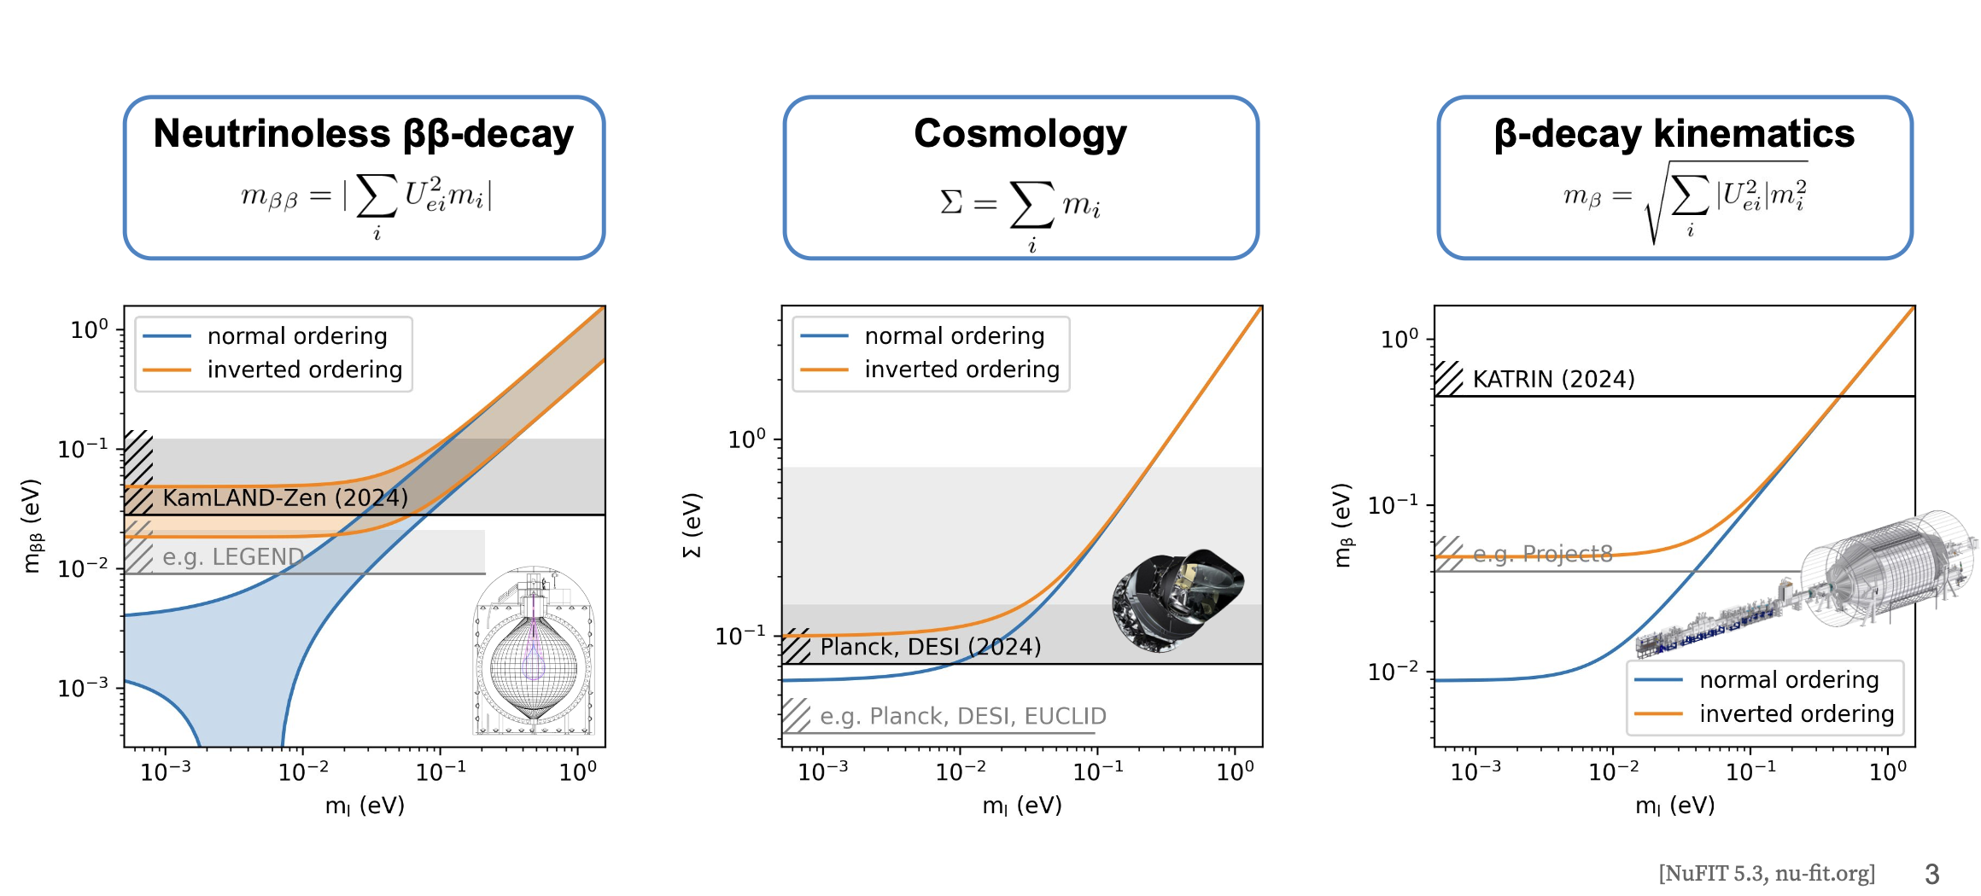
Which mass?

Slide 9
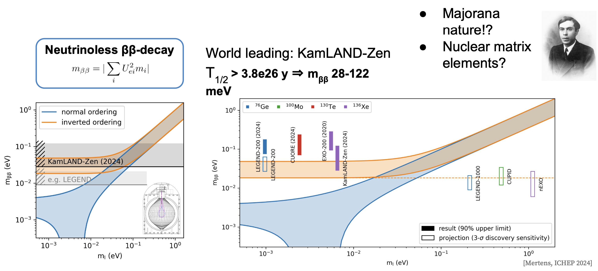
Neutrinoless ββ-decay
Only if neutrino is a majorana fermion

Slide 10
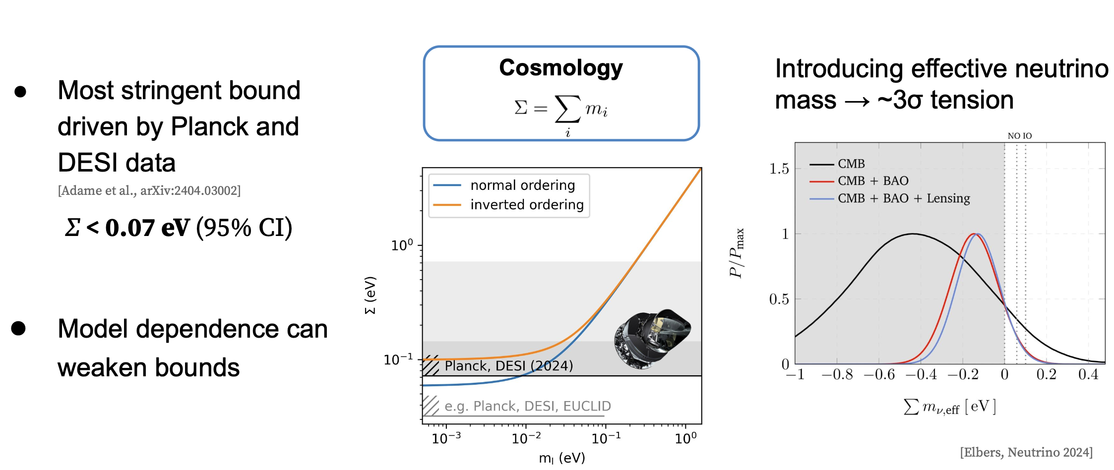
Cosmology

Slide 11
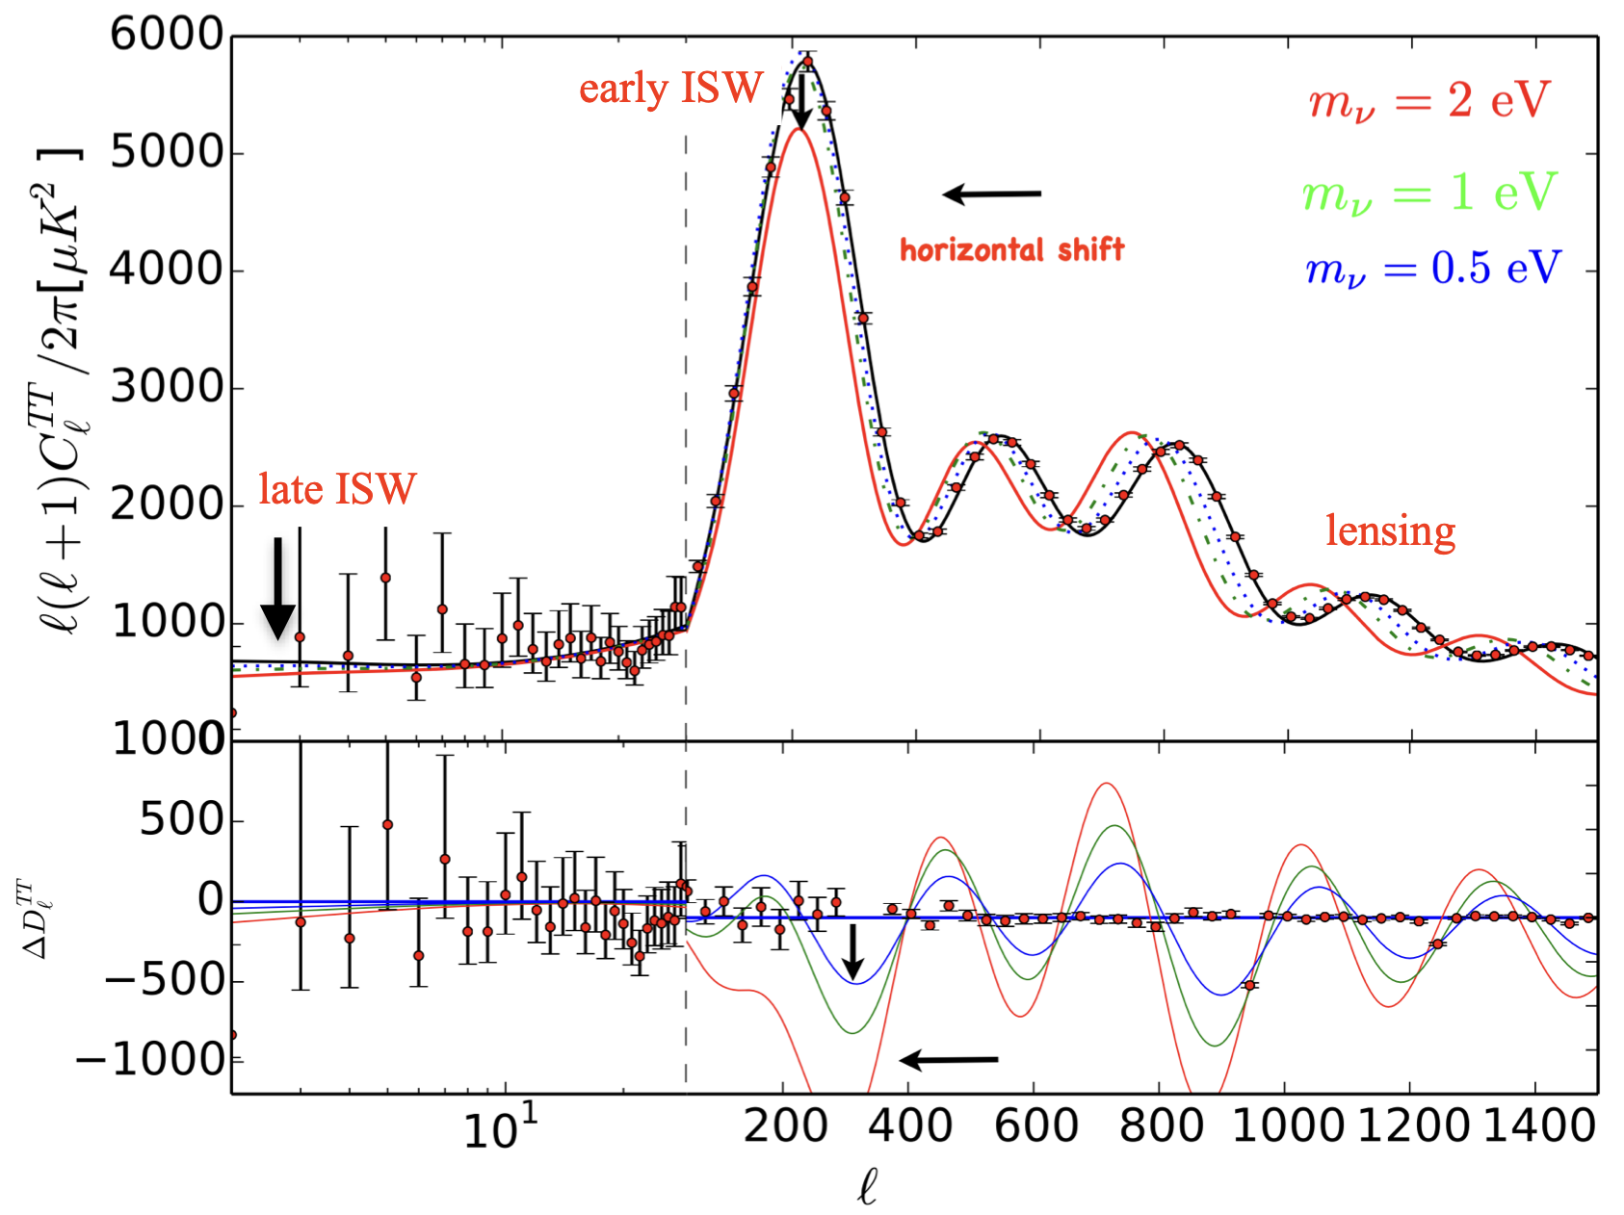
CMB and Σm_{νi}
Credit: Olga Mena

Slide 12
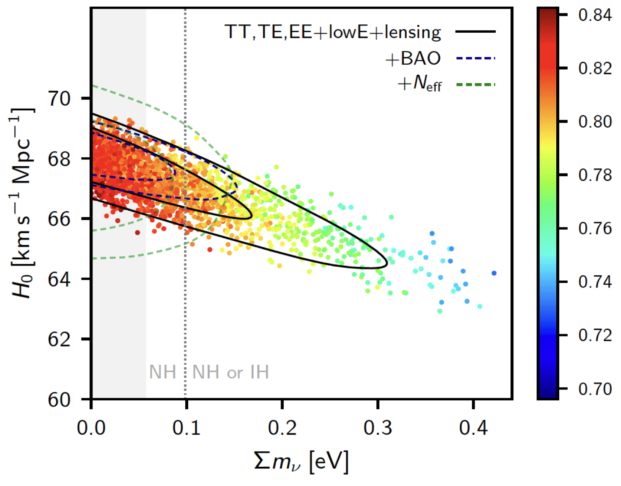
CMB and Σm_{νi}
Planck 2018

Slide 13
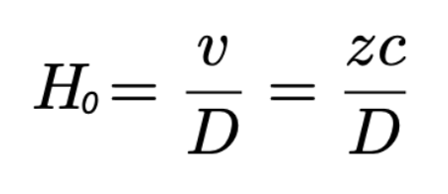
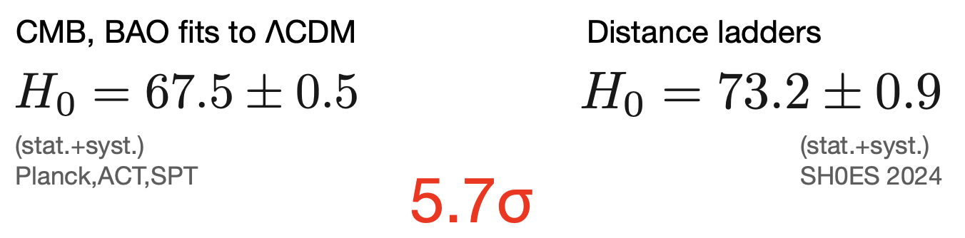
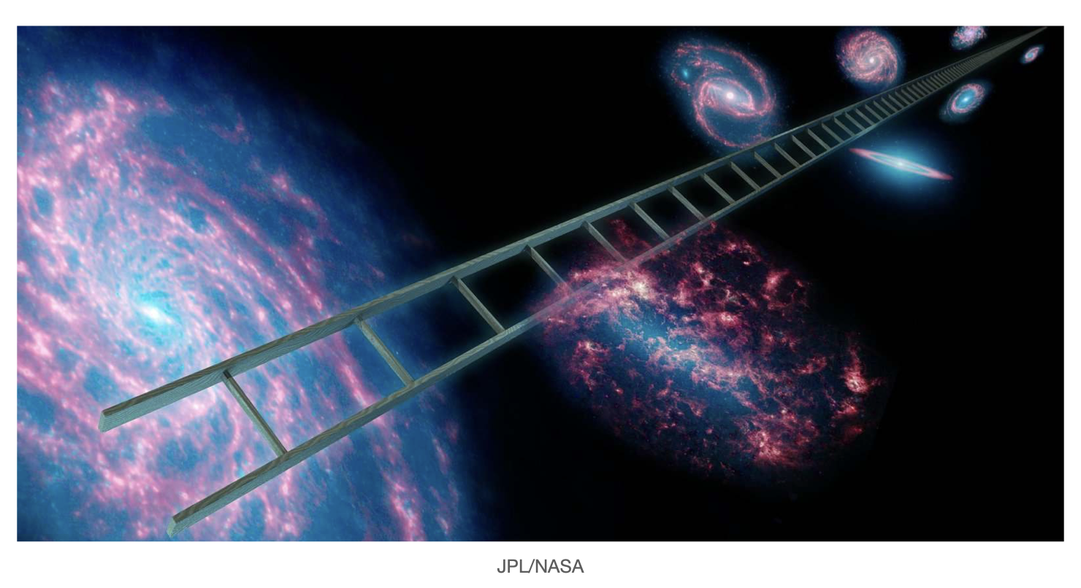
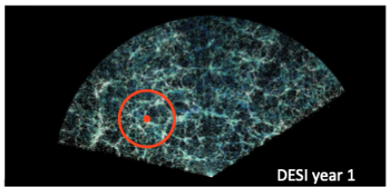
Hubble constant tension
Hubble constant (H₀) describes expansion rate of universe (km/s/Mpc)
“Early universe measurements”, fitting the CMB and BAO data to ΛCDM (dark energy cold dark matter), the “standard model” of cosmology, H₀ can be derived
BAO: “Baryon Acoustic Oscillations” - remnants of CMB “freeze-frame” of density fluctuations
“late universe measurements”, measure distance of “nearby” objects and their redshift

Slide 14
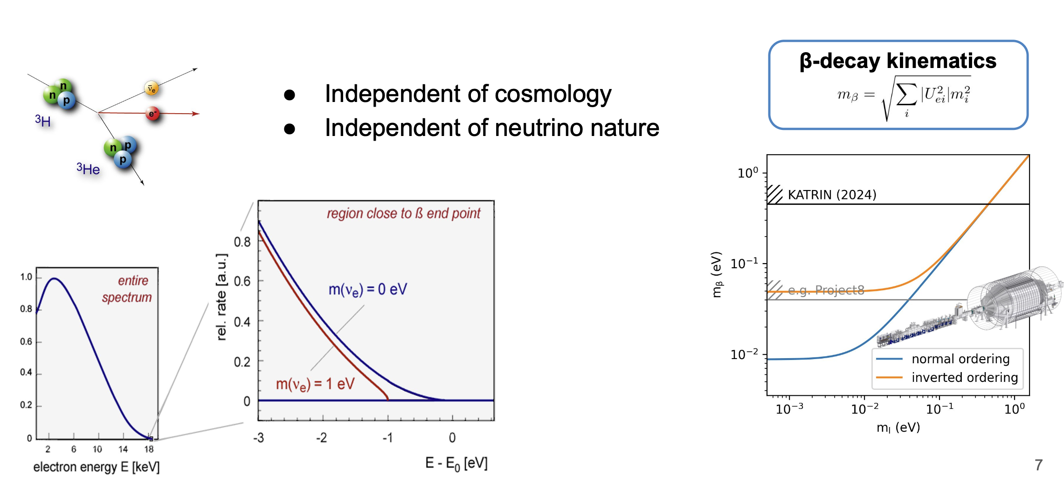
Beta decay and electron capture

Slide 15
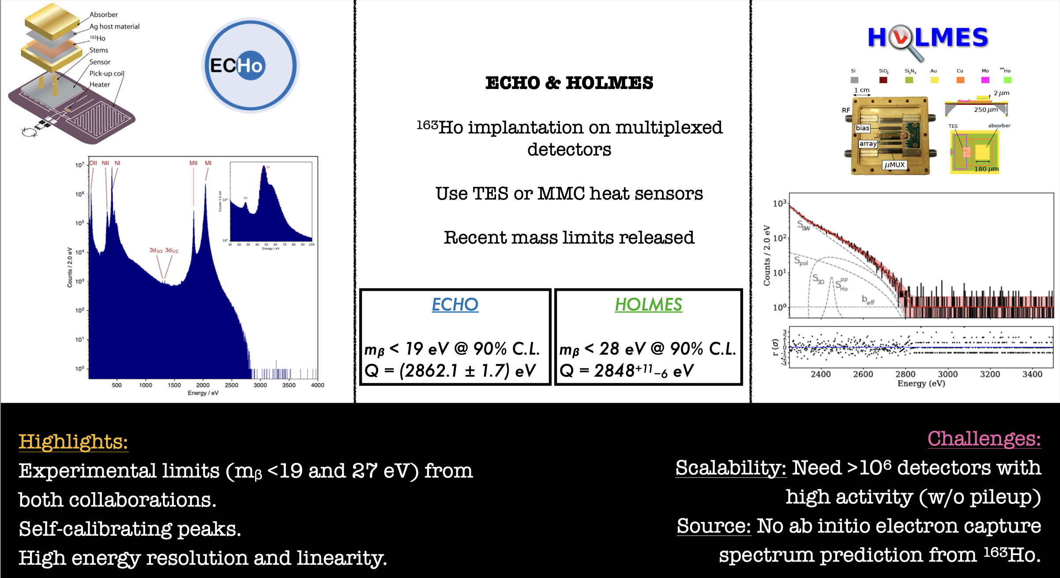
Electron Capture
J. Formaggio (MIT) – ESPPU 2025

Slide 16
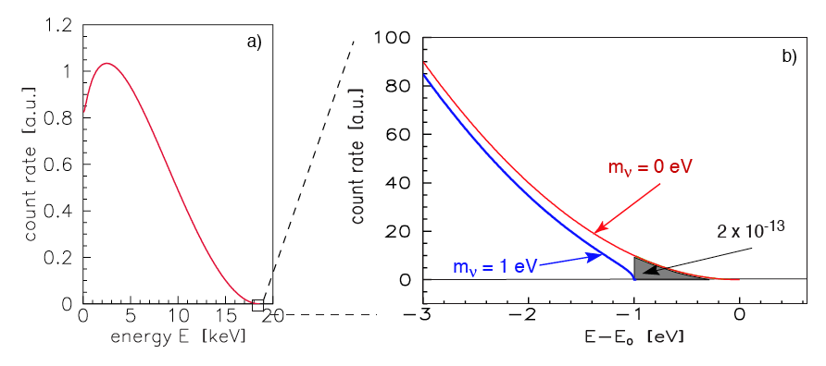
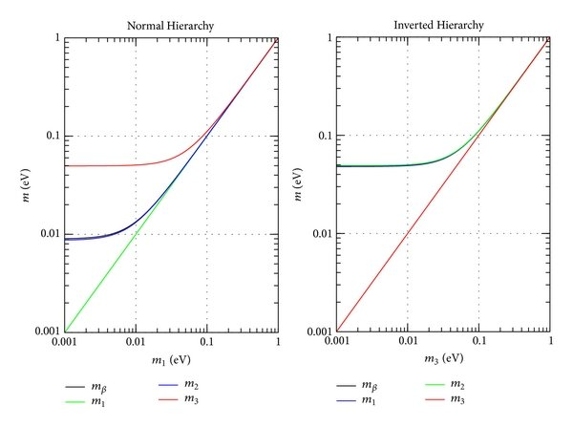
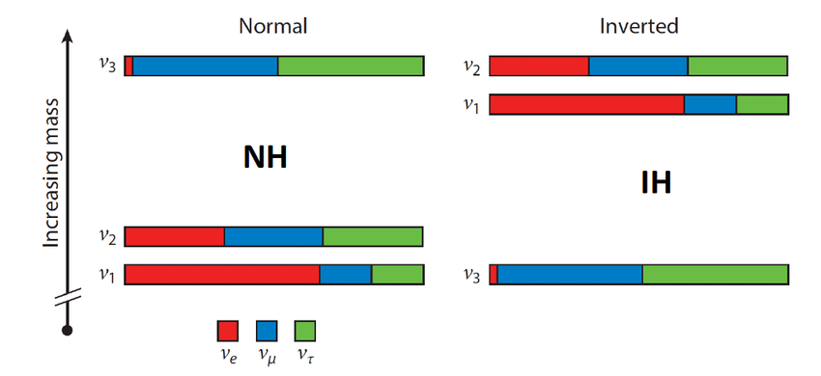
Absolute mass
m_{ν} = Σ_{ι}|U_{ei}|²m_{νi}^{2<} 0.45 eV (KATRIN 2024)
Neutrinoless double beta decay: m_{ββ} = |Σ_{i}U_{ei}²m_{ν1}|<0.2-1.0 eV
Σm_{i} < 0.064-0.56 eV (Cosmology)
m_{α} > 50 meV (oscillations)

Slide 17
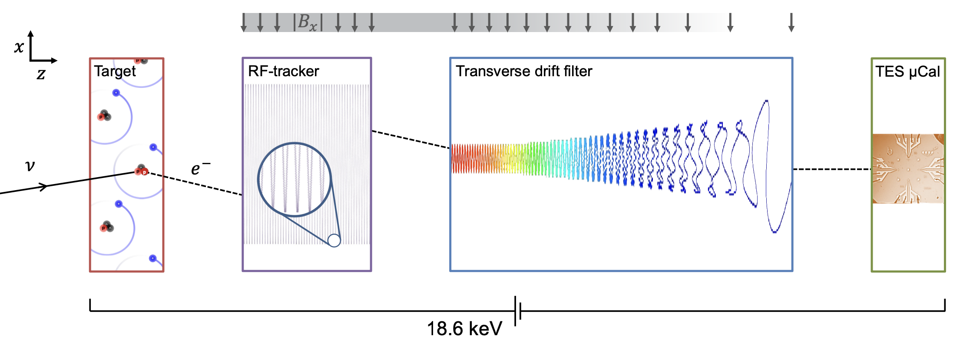

PTOLEMY Basic concept
10⁻⁴
10⁻²
$$E_{total}=q\left(V_{TES}−V_{target}\right)+E_{RF}+E_{cal}$$

Slide 18
On the Shoulders of giants
Neutrino mass measurement: KATRIN and Project8

Slide 19

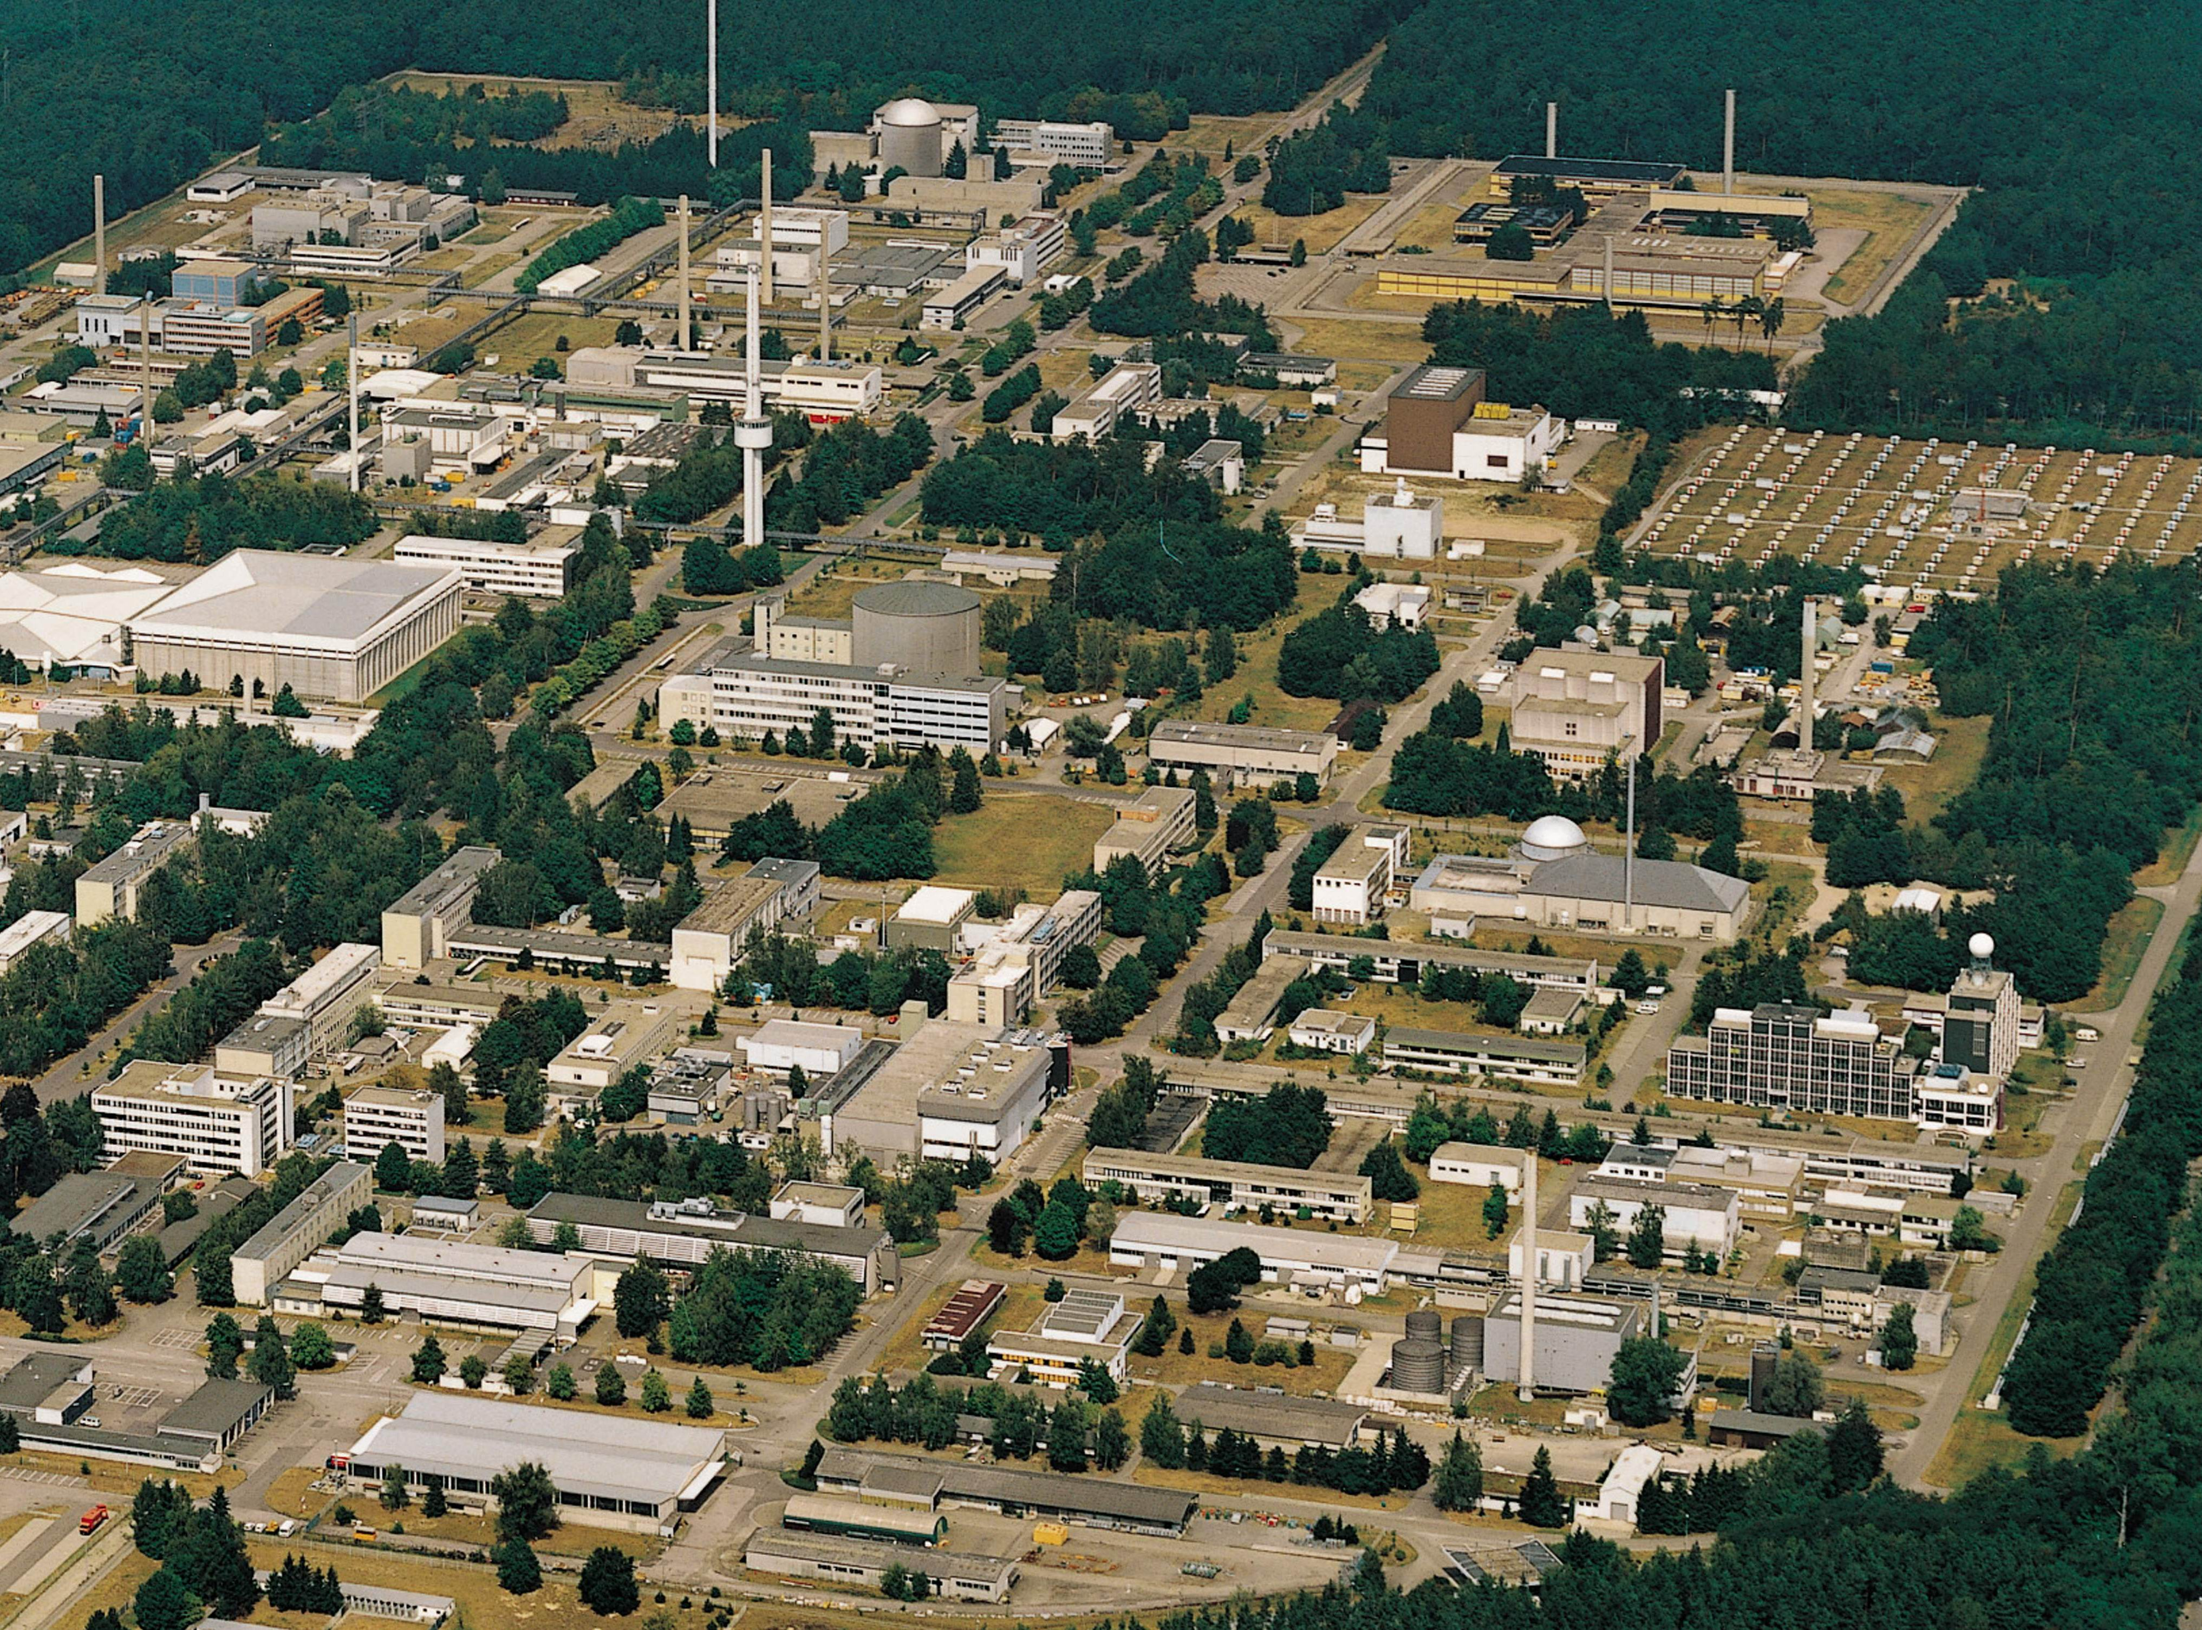
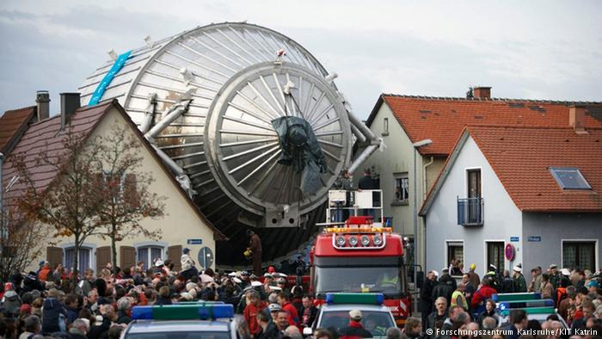
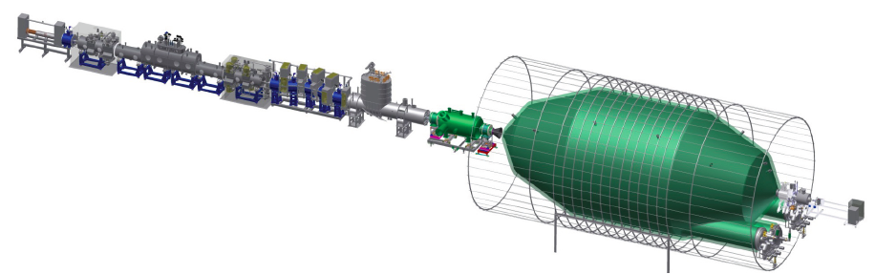
KATRIN
At Karlsruhe Institute of Technology
unique facility for closed T₂ cycle:
Tritium Laboratory Karlsruhe
TLK
A direct, model-independent, kinematic method, based on β decay of tritium.
~ 75 m long with 40 s.c. solenoids

Slide 20
KATRIN MAC-E Filter

Slide 21
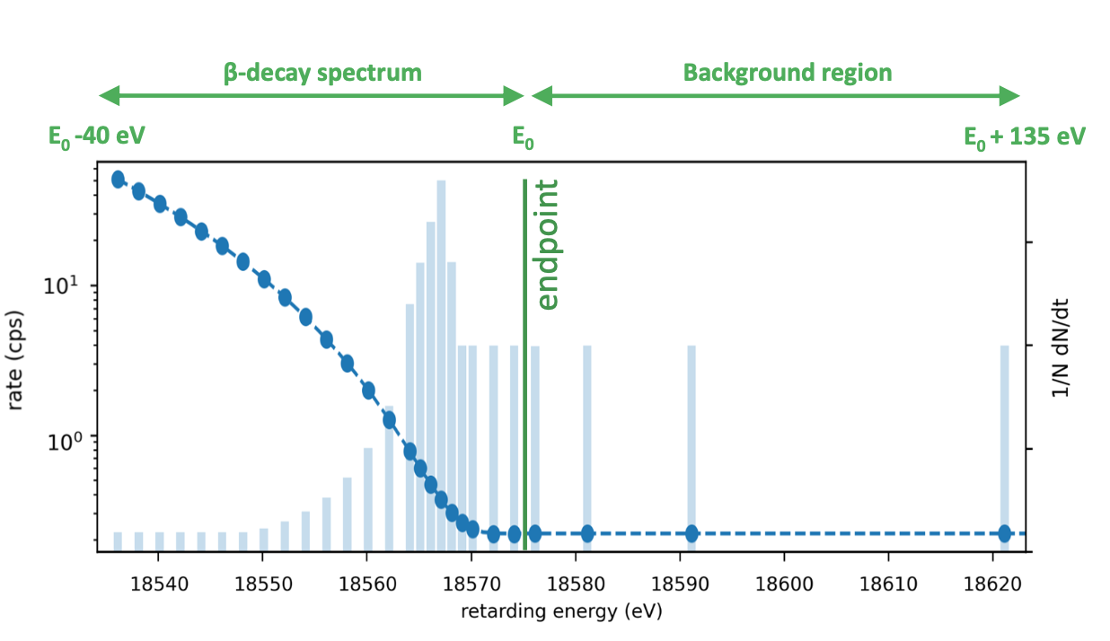
Katrin data taking
30 scan steps, 2h scans: ΔE = 2.8 eV @18.6 keV

Slide 22
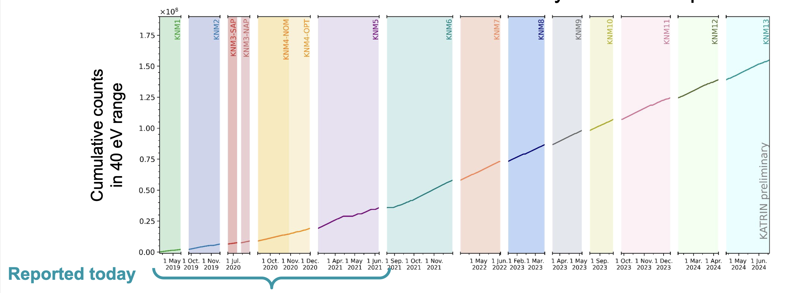
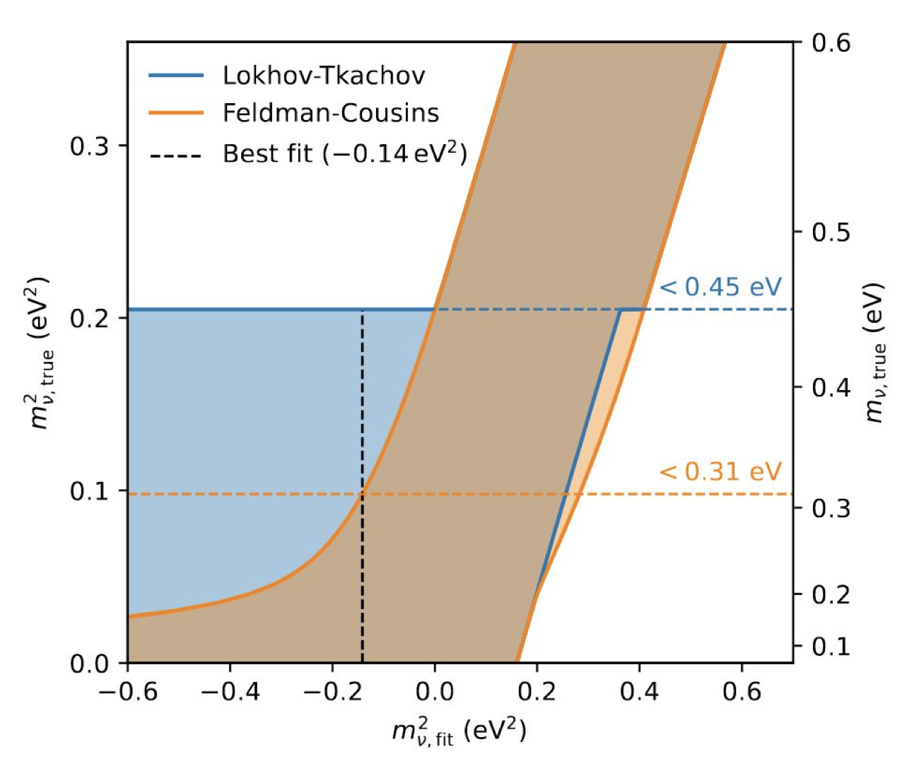
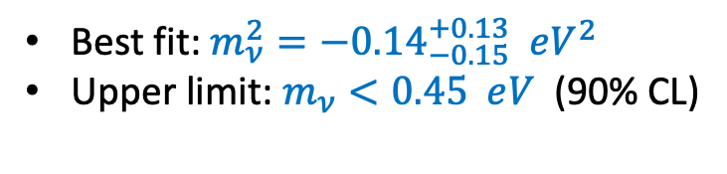
Katrin results 2024
A Lokhov @ Neutrino2024
Best fit: $m_{ν}^{2}={−0.14}_{−0.15}^{+0.13} eV^{2}$
Upper limit: $m_{ν}<0.45 eV^{ }$ (90% CL)
M. Aker et al. 2024
https://arxiv.org/abs/2406.13516

Slide 23
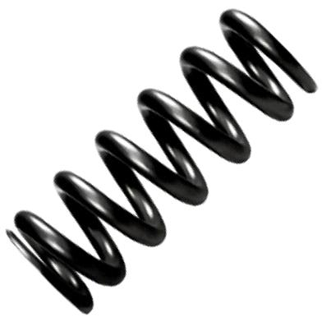
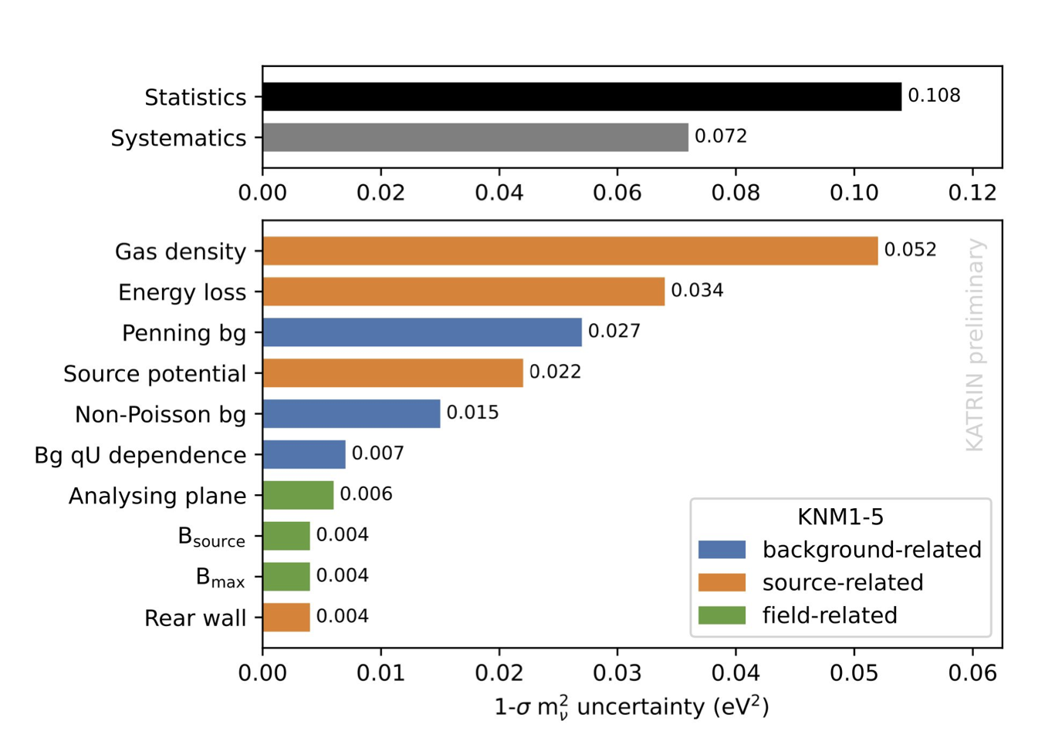
Katrin final reach
rotation
The g.s. has rms width of 0.436 eV (FWHM 1.02 eV), which limits the neutrino mass reach of any molecular experiment
e⁻
vibration
translation
T₂ molecule
Final goal:
0.2-0.3 eV limit

Slide 24

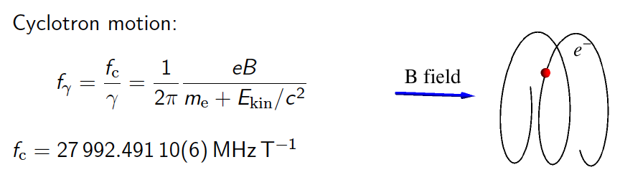
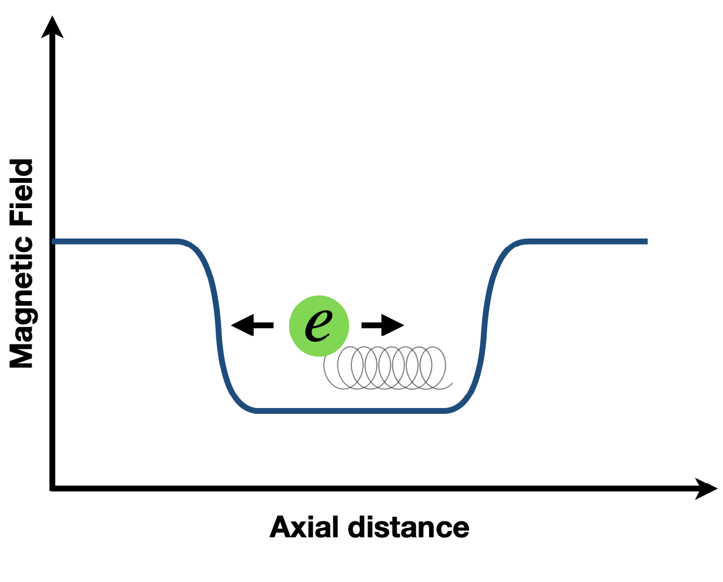
Cyclotron radiation emission spectroscopy (CRES)
(B. Monreal and J. Formaggio, PRD 80:051301, 2009)
“Never measure anything but frequency.”
A. Schawlow
Energy resolution
For 1 eV energy resolution, you
need about 2 ppm frequency.
For 2 ppm frequency, you need
500,000 cycles, or 15 μs.
Electron travels 2 km.
You need a trap!
~30

Slide 25
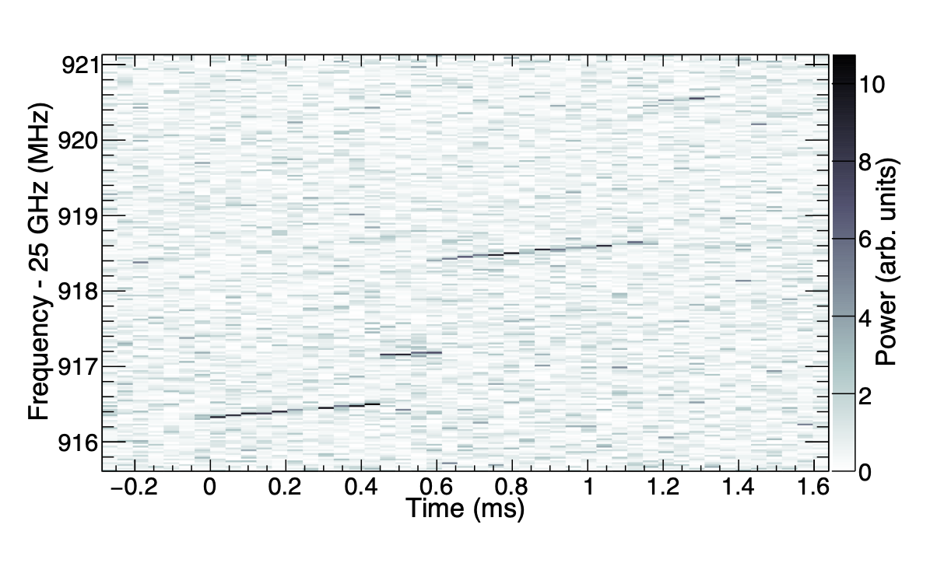
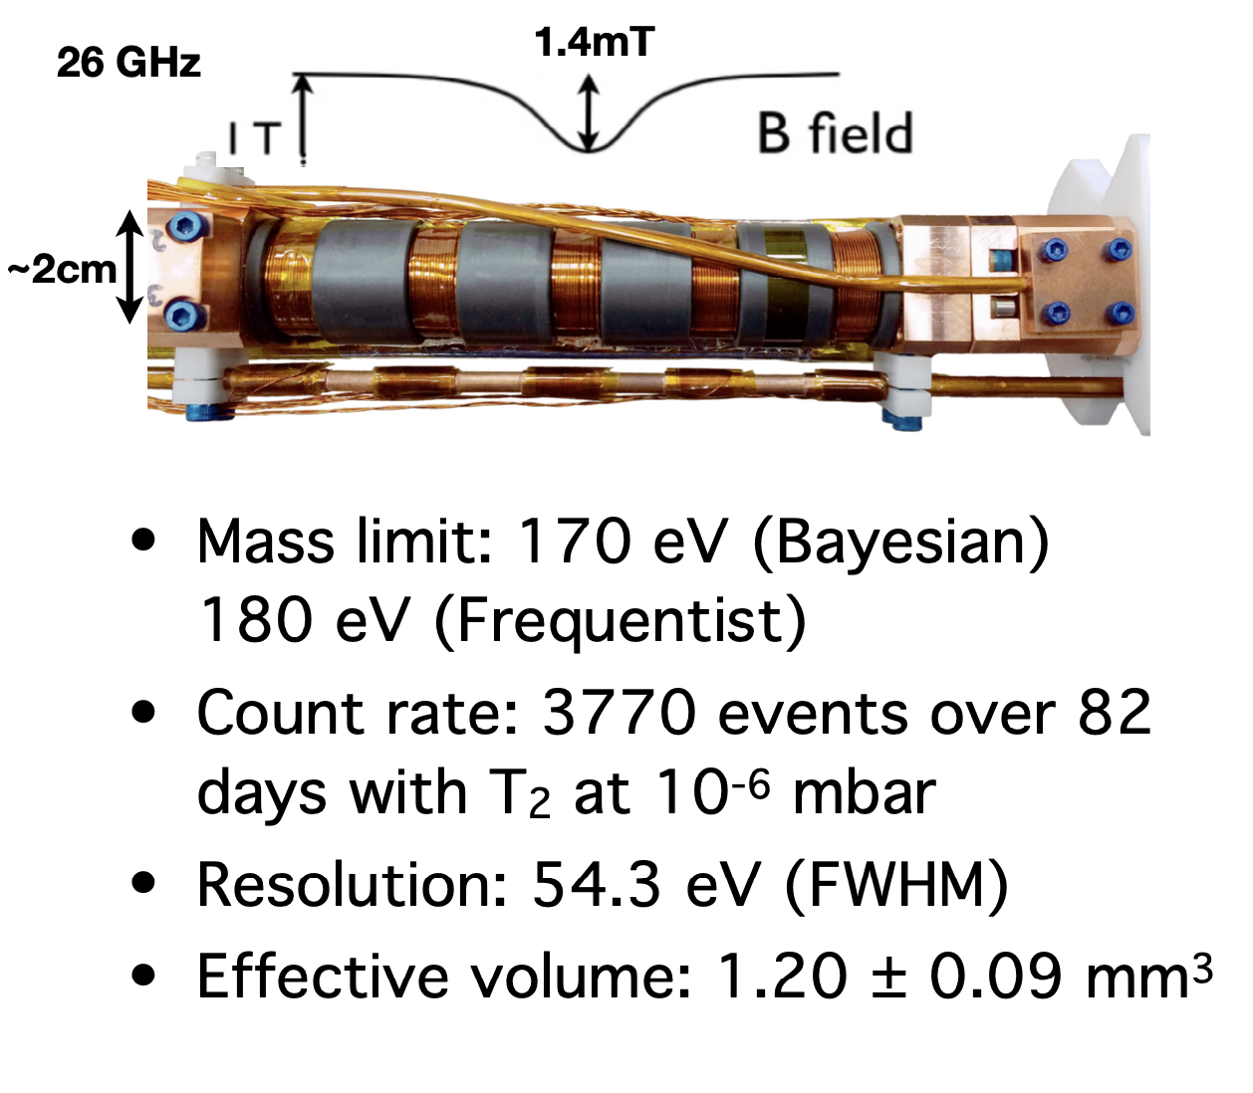
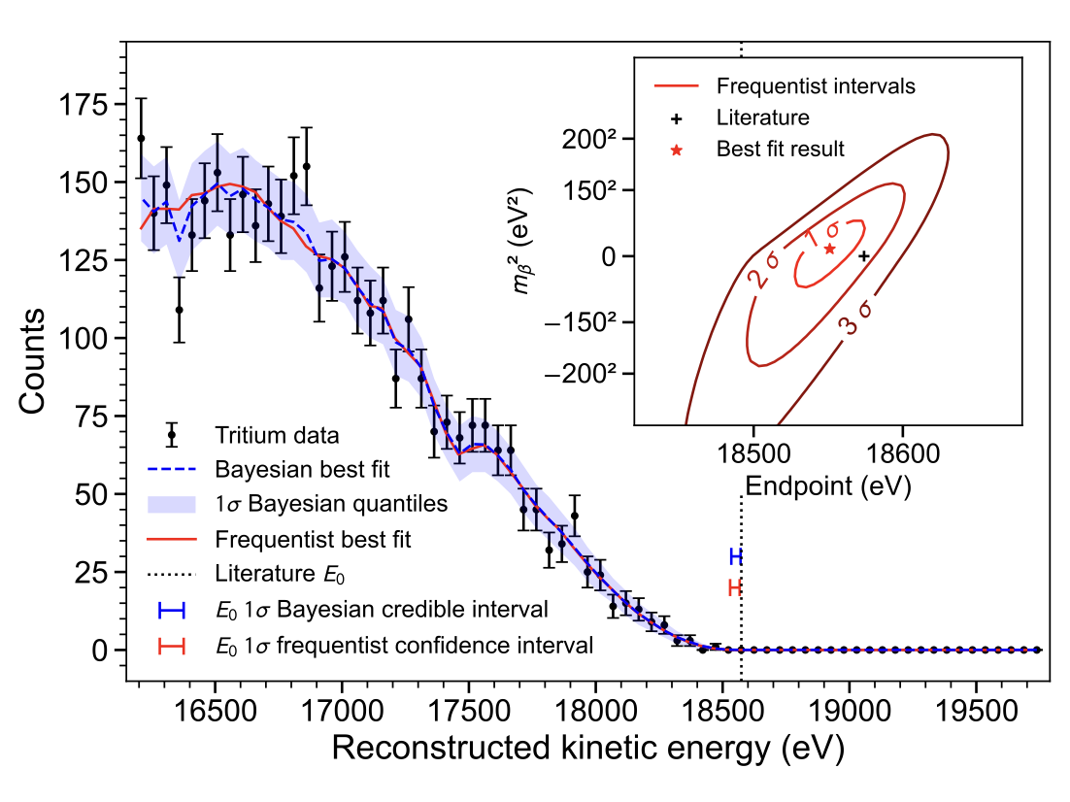
Project 8 – Phase 2
Project8 collaboration,
arXiv:2212.05048
Phase II (tritium)

Slide 26
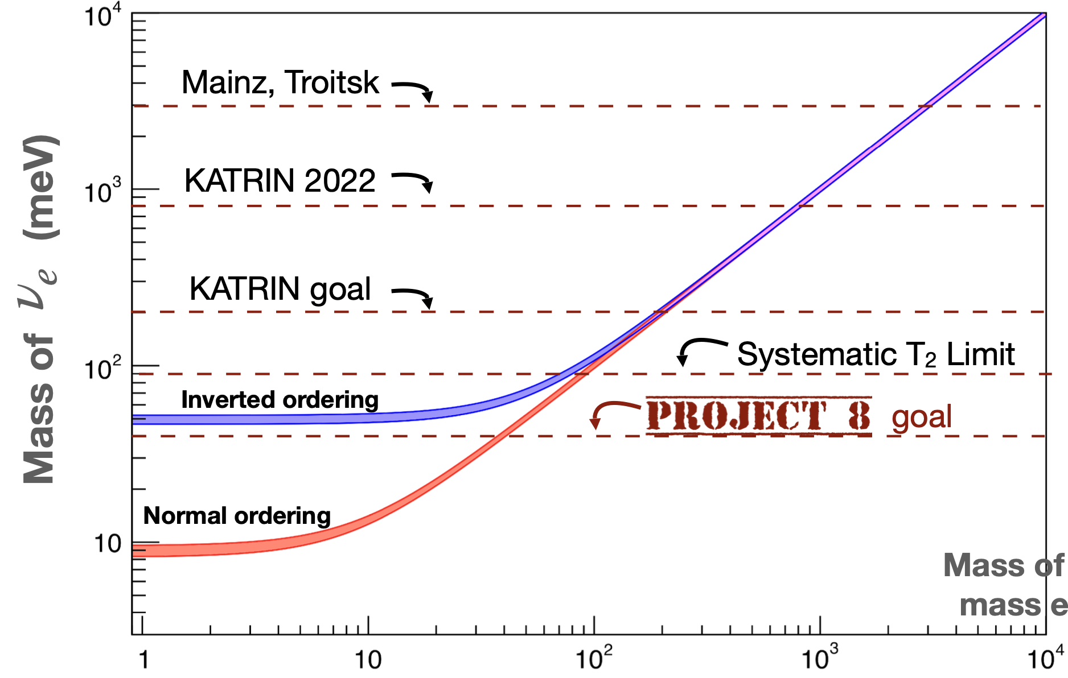
Mass limits projections
Arina Telles @ Lake Louise 2023

Slide 27
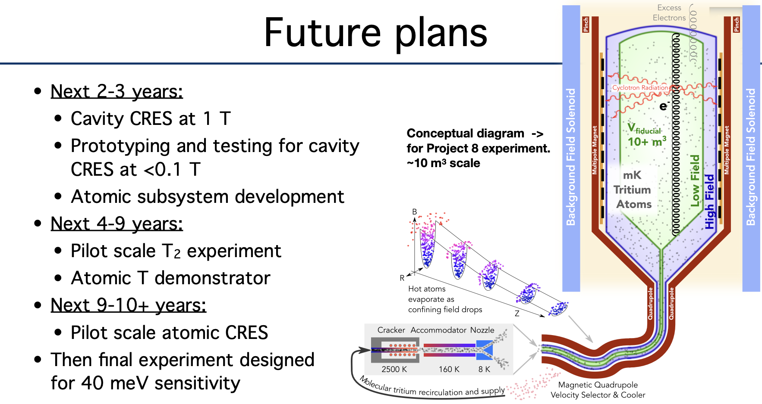
Project 8 challenges and timeline
1 aW power!
Arina Telles @ Lake Louise 2023

Slide 28
Back to ptolemy

Slide 29
PTOLEMY Basic concept
10⁻⁴
10⁻²
$$E_{total}=q\left(V_{TES}−V_{target}\right)+E_{RF}+E_{cal}$$

Slide 30
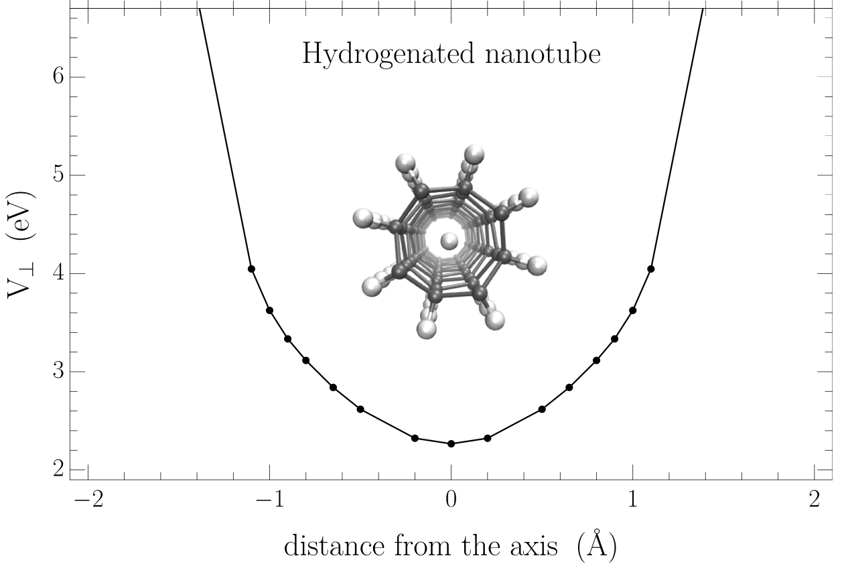

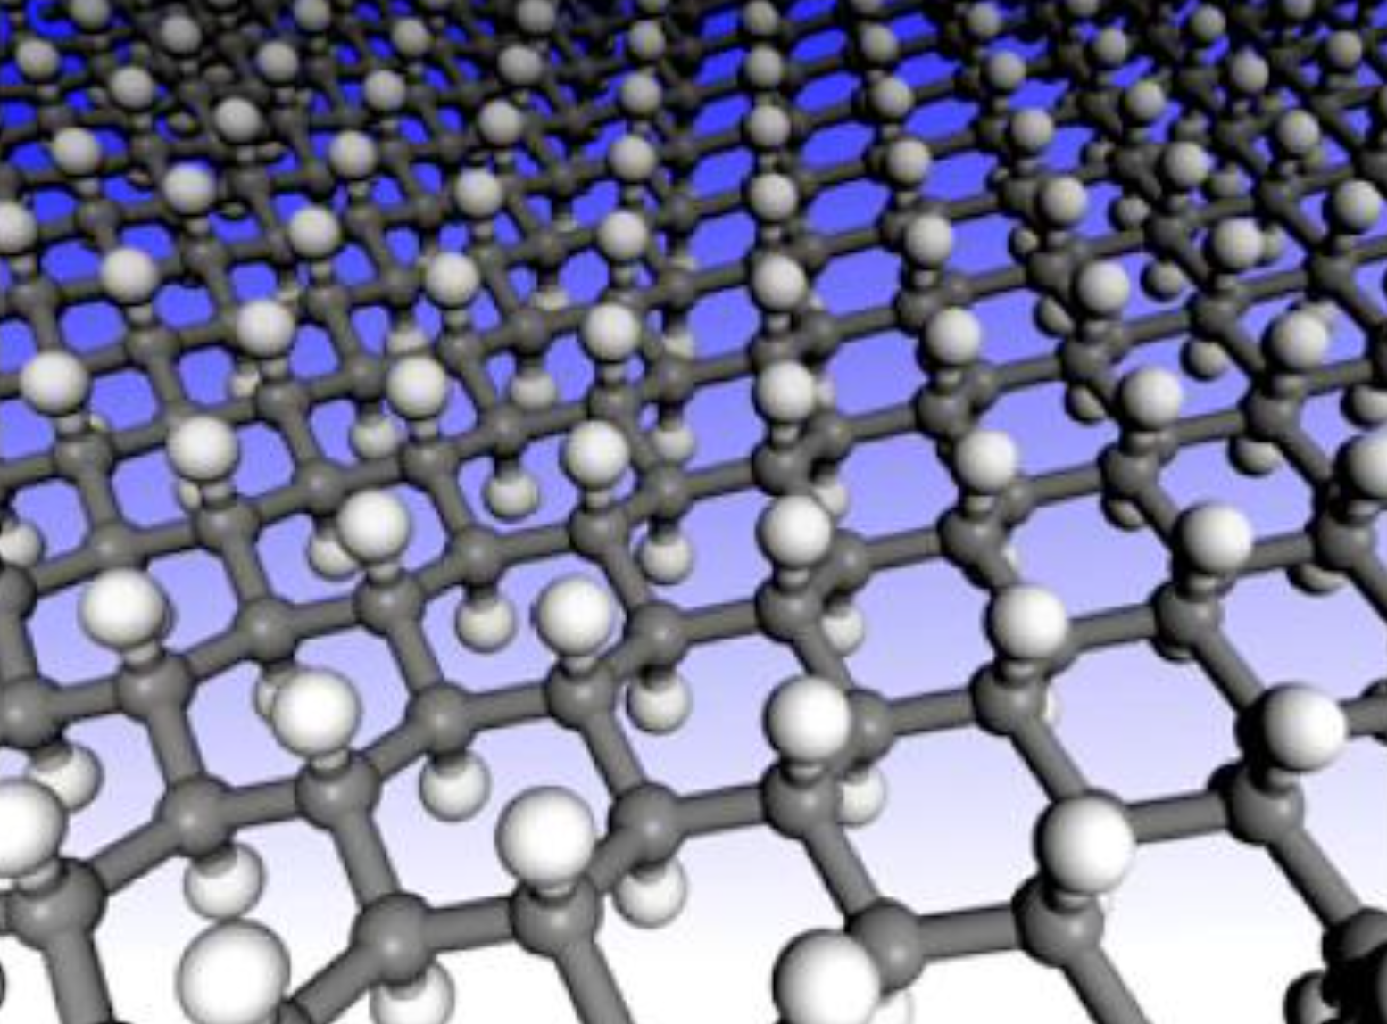
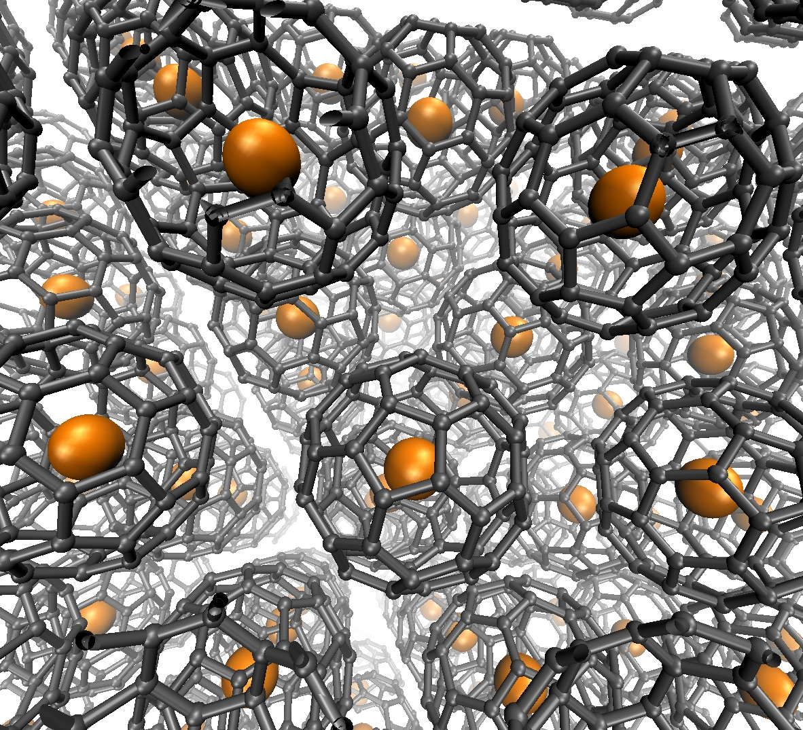
PTOLEMY: Atomic T target
PTOLEMY has to deal with large instrumented mass. Distribute atomic tritium on a solid state substrate (e.g. graphene)
Other solution are under study
Nano tubes
Fullerene
Marcello Messina INFN-LNGS, LHC Days 2024 in Split, Hvar

Slide 31
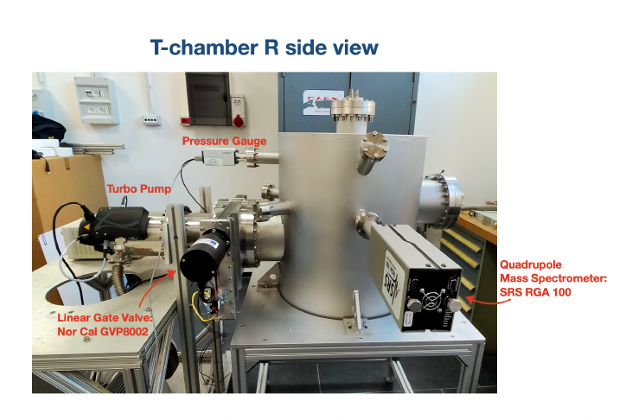
Loading chamber
T loading chamber designed and built in Rome in the framework of the PTOLEMY R&D. Loading technique tested up to 90 % loading efficiency measured with H and D.
1 MG Betti et al, Dielectric response and excitations of hydrogenated free-standing graphene, Carbon Trends, September 2023, 100274;
2 MG Betti et al, Homogeneous Spatial Distribution of Deuterium Chemisorbed on Free-Standing Graphene, Nanomaterials 2022, 12(15), 2613;

Slide 32
Heisenberg effect

Slide 33
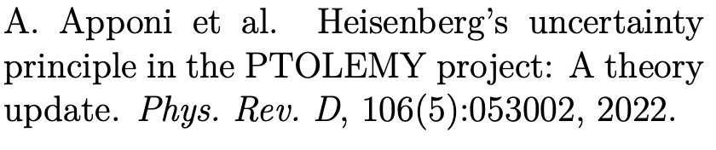
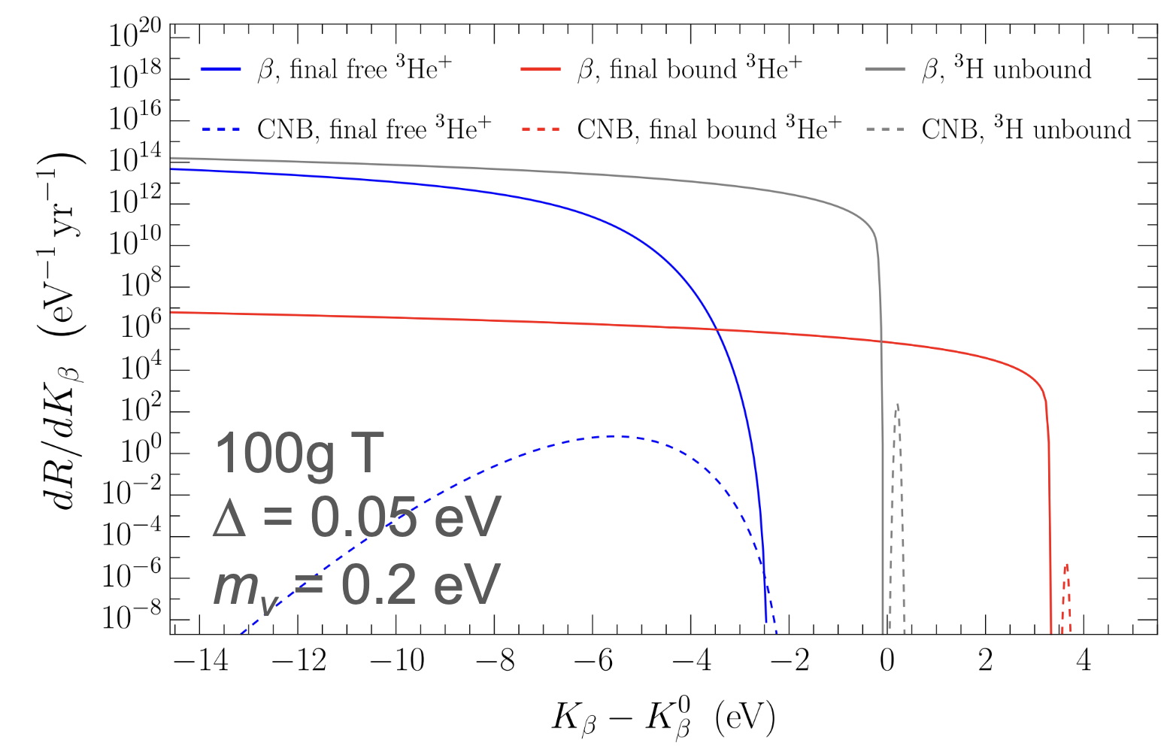
Zero point motion and binding

Slide 34
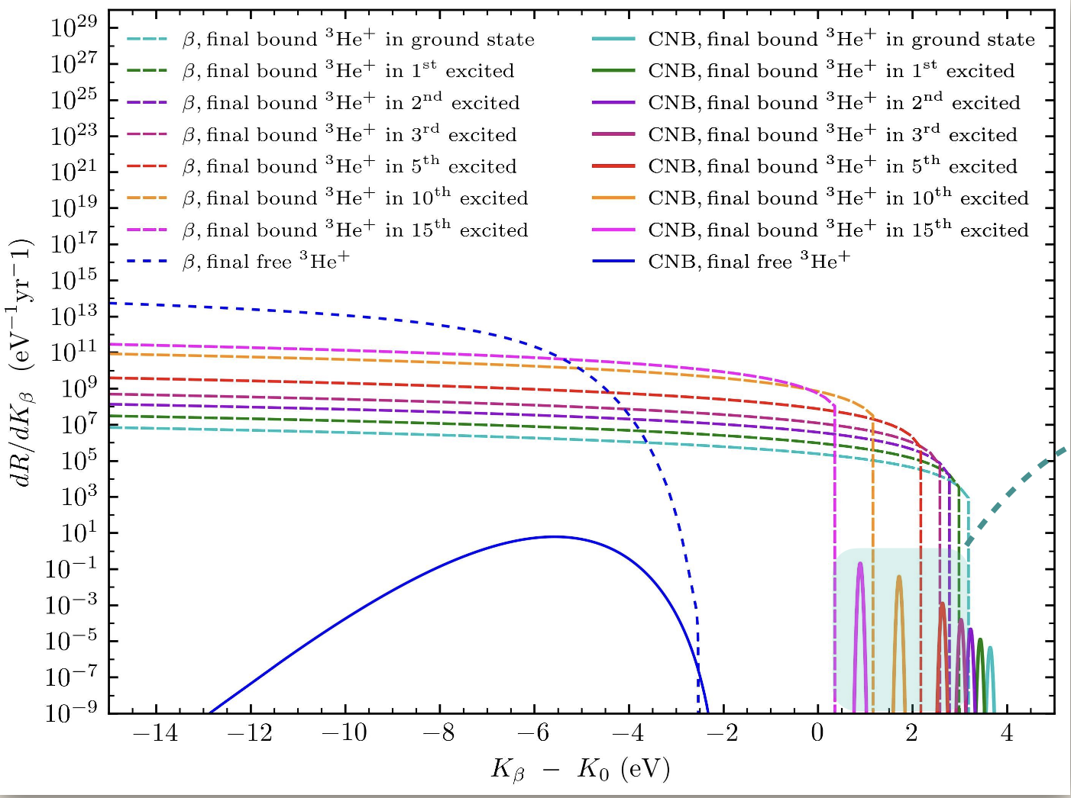
A tool for mass measurement
A.Casale,Princeton 2023

Slide 35
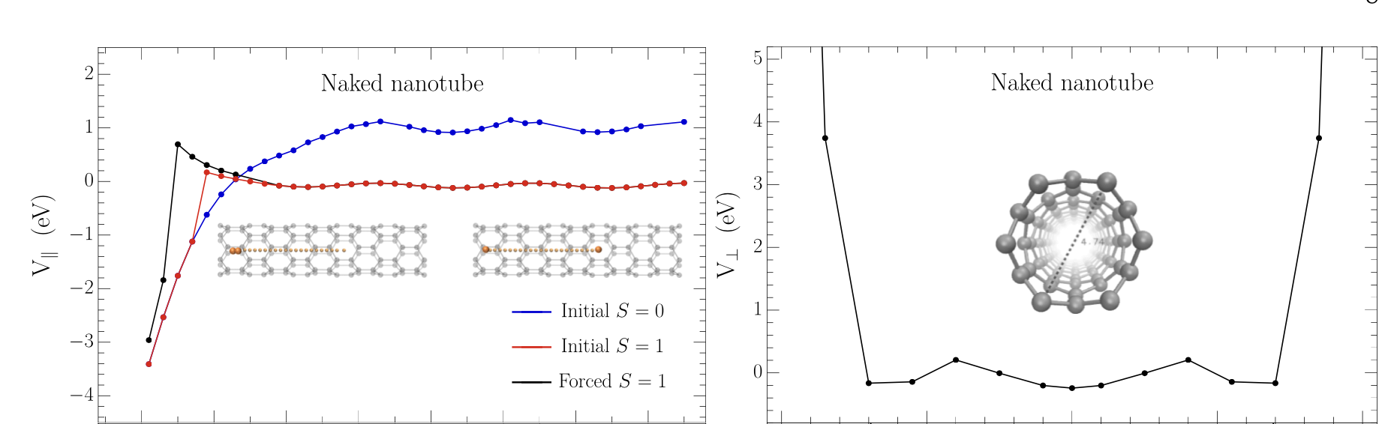
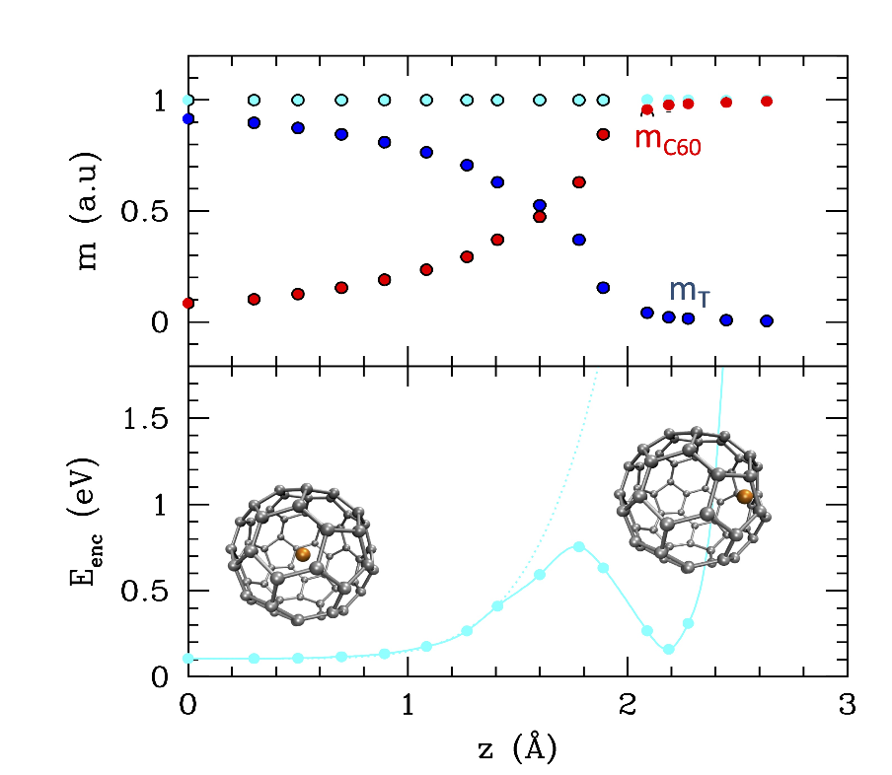
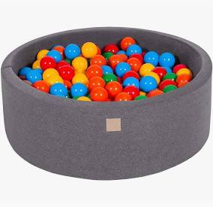
Alternative substrates
Concave substrate: flatter potential
Carbon nanotubes
X and Y different
Recombination in the tubes
Fullerenes
V. Tozzini (I. Nanoscienze)

Slide 36
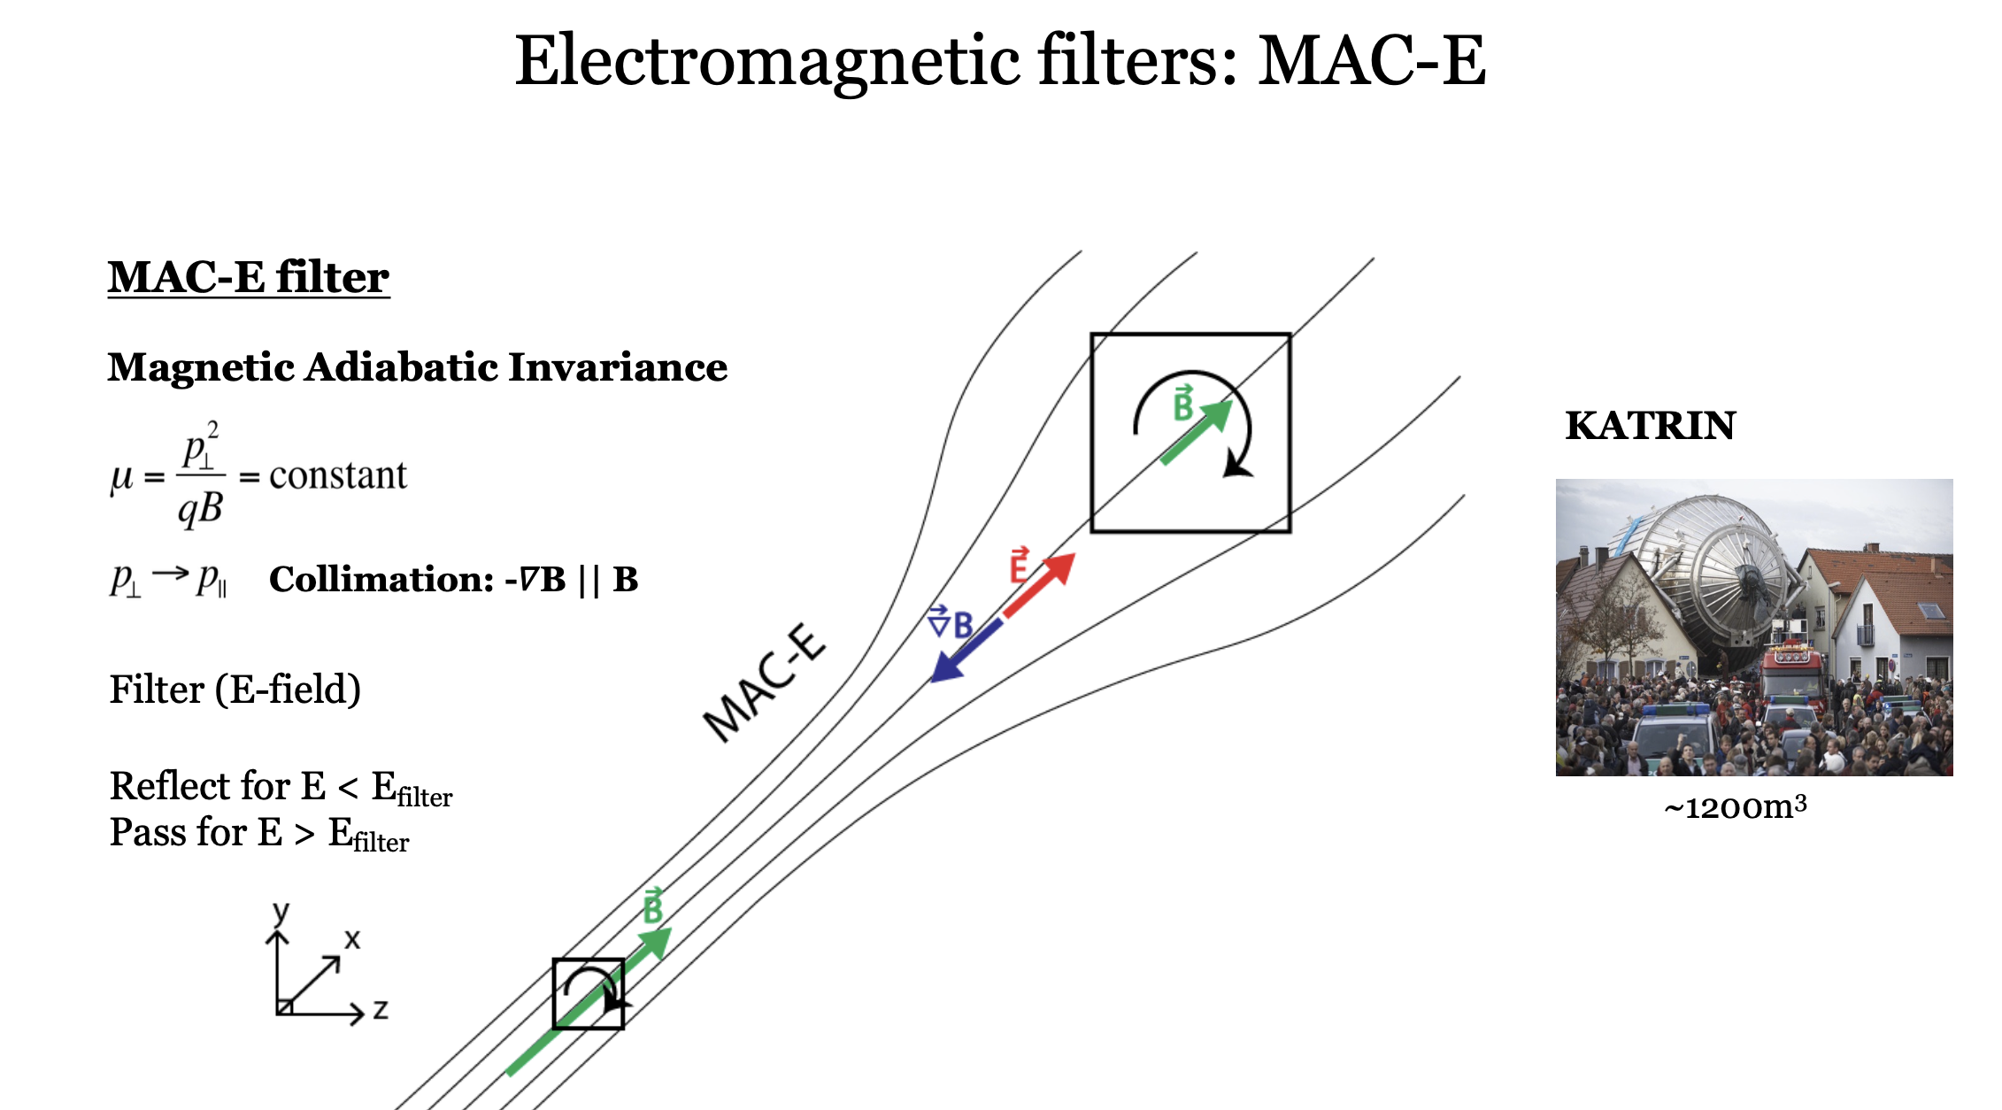
EM filter: KATRIN

Slide 37
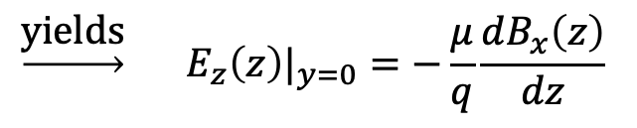
Ptolemy filter concept
y
x
x
z
Enforce zero drift in y (rotate E)
$$\underset{→}{\text{yields}} {E_{z}\left(z\right)|}_{y=0}=−\frac{μ}{q}\frac{dB_{x}\left(z\right)}{dz}$$
A.P Colijn, (PATRAS2019)

Slide 38
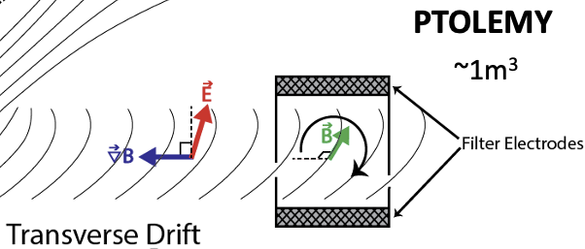



Ptolemy filter
Simulations with KASSIOPEIA
code (KATRIN) and Lorentz4
(N. Rossi, M. Messina, LNGS)
https://github.com/gkrossi/lorentz4
FOCUSING with Einzel lens
Microcalorimeter

Slide 39
Filter Performance
Improves as B² for a fixed filter dimension
18.6 keV @ 1T → ~10eV (in 0.4m)
18.6 keV @ 3T → ~1eV (in 0.6m)
PTOLEMY Collaboration,
“Implementation and Optimization of the PTOLEMY Electromagnetic Filter”
https://arxiv.org/abs/2108.10388
https://iopscience.iop.org/article/10.1088/1748-0221/17/05/P05021

Slide 40



Demonstrator Magnet
Andi Tan
Wonyong Chung
PTOLEMY
filter@Princeton
RF pickup region
Filter region
Zero field (location for
TES microcalorimeter)

Slide 41




RF pick-up
inspired
Andi Tan (Princeton)

Slide 42


RF detection
Carrier frequency f_{c}:
Cyclotron motion in potential well
Information on K
Sidebands: 1/T_{b}
T_{b}=O(10ns)
1/Tb
1/Tb
P
Information on K_{T}
How much time do we need
What about the energy resolution?
f_{c}
Δf
f

Slide 43


RF electronics
FPGA for online signal processing (online FFT)
Downconverter
Input: RF signal (26 GHz)+high precision oscillator
Output: down-sampled signal at around 1 GHz
Nikhef

Slide 44







Calorimeter: TES μCal
e⁻
C
Thin sensors:
~1 eV electron can be stopped with very small C
E
τ =
G
C
50x50 µm
10x10 µm
20x20 µm
100x100 µm
Mauro Rajteri, Eugenio Monticone and others, https://doi.org/10.1007/s10909-019-02271-x
“TES Microcalorimeter for PTOLEMY”, J. Low Temp. Phys. 199 (2020) 138-142.

Slide 45


Hemispherical electron energy analyzer
Commercially available
Transition from filter with Einzel lens

Slide 46
Ptolemy Progress
Target:
Loading 40% → 100%
Stability of T-graphene bond established (4m)
Transmission of electrons through graphene measured
Extensive theory work on binding of T to graphene
Facility for T loading identified

Slide 47

Target
Valentina Tozzi

Slide 48

Target
Valentina Tozzi

Slide 49

Target
Valentina Tozzi

Slide 50

Target
Valentina Tozzi

Slide 51
Ptolemy Progress
RF:
First spectrum measured using CRES by Project8
Electronics development
Filter:
Dynamical filter design
Magnet design, zero field region for TES
TES:
Energy measurement shows feasibility, 0.3eV

Slide 52

1ug Tritium Configuration and Transmission for LNGS Demonstrator
Wonyong Chung
Princeton University
July 2025
Nijmegen

Slide 53






Permanent Magnet Target
Unconstrained trajectories follow field lines
Transverse momentum collimated into longitudinal
Linear “collimation factor” in B via adiabatic invariant
Effectively a pitch range compression (90 → 27)

Slide 54






Collimated Injection
Shape electrodes to follow the magnetic field lines
Well-parameterized by ellipse equation
Aligns potential gradient against path of electron
Drains parallel momentum
Once electrons enter central channel
Apply fast drift in z
Contain bounce motion
Accelerate to uniform region
Tranmission studies
1mm radius (0.0314 cm²)
18.6 keV electrons
pitch 5, 25, 45, 65, 85

Slide 55





1ug Tritium Target Size
1.5 T permanent magnet
1ug ~ 50 cm² (at 50% loading)
5 cm radius -> 78.5 cm²
Usable area: 3cm radius -> 28.25 cm²
Double sided: 56.5 cm²
Single- or double-sided?
2x single-sided: start at fringes
1x double-sided: start at center
Depends on:
z-spread of trajectory envelope
y-drift target clearance
Which is more advantageous for transport?
Pick a drift direction (x or y)
Choose center (for this study)
Magnetic field only
x
z
z = -1.75m
R = 5cm
x
y
R = 5cm
R = 5cm
z = -1.50m
z = -1.30m

Slide 56



More Attempts
Established that it is possible to move 1ug of phase space volume in a systematic way
To do: Fine tune acceptance and voltages

Slide 57

PTOLEMY
J. Formaggio (MIT) – ESPPU 2025

Slide 58

Neutrino mass future
J. Formaggio (MIT) – ESPPU 2025

Slide 59

Sensitivity as a function of tritium mass
Remarks:
- the sensitivity is weakly dependent upon the energy resolution (500 meV is already a good starting point)
- 1 μg is potentially comparable or even better than the projection of the best technology on the market
- 100 μg (0.5 m²) can potentially probe the neutrino mass down to the IO scenario

Slide 60
2026: Key Year
Magnet comissioned and demonstration of filter
Target material
Target-to-RF interface
RF-to-Filter
Filter-to-analyzer
End-to-end demonstration
Timeline for spectrum and mass measurement: 5 years

