Slide 1
CNB Temperature and Neutrino Cosmology from First Principles
Bachelor thesis: Ruben Bartelet
Supervisor: prof. dr. Wim Beenakker

Slide 2
The Goal
A clear picture of the properties of the Cosmic Neutrino Background (CNB), particularly its temperature, from first principles
Using simple approximations to understand CNB cosmology with massive neutrinos
Notes:
Possibly using approximations to keep things simple

Slide 3
Outline
Basics Early Universe, Basics UR Temperature
Distribution at decoupling and evolution
Neutrino Temperature
The approximate energy density of CNB
Relative energy density of the universe with massive neutrinos
Conclusion
Notes:
[nice to have: legend]
[Footer]

Slide 4
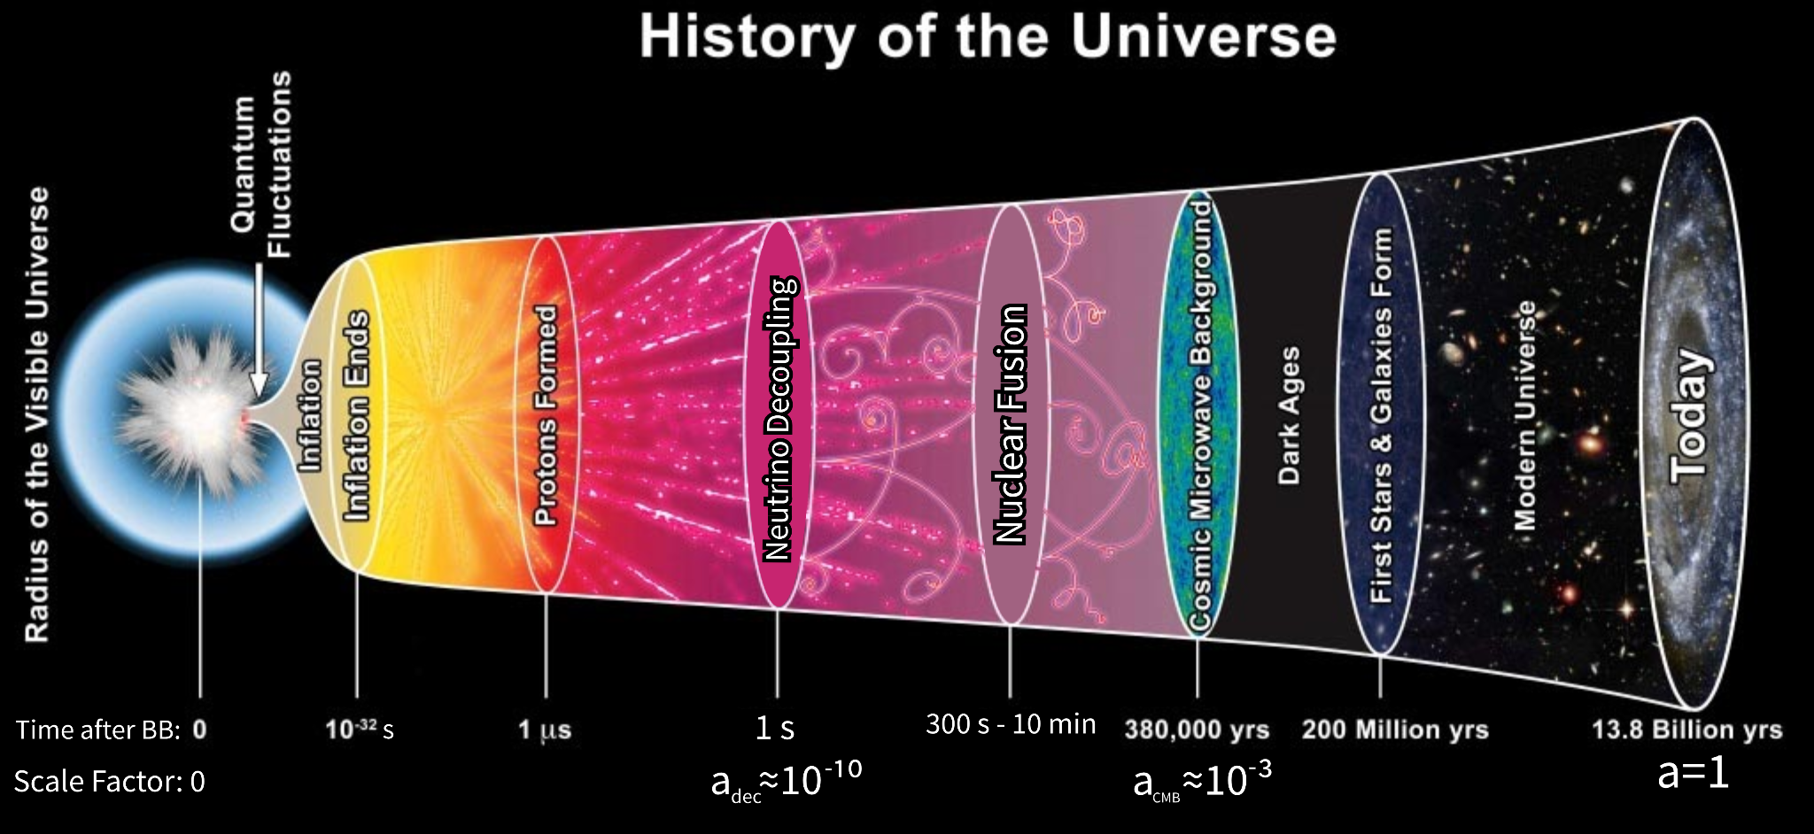


The Early Universe
First everything in equilibrium
Universe expanded and cooled
Neutrino decoupling:
We assume instantaneous neutrino decoupling
From looking at CMB we know:
Simple Calculation
Image modified from: BICEP2 Collaboration/CERN/NASA
Notes:
Zeg wat decoupled is

Slide 5

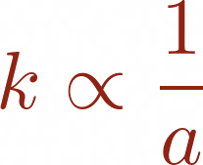
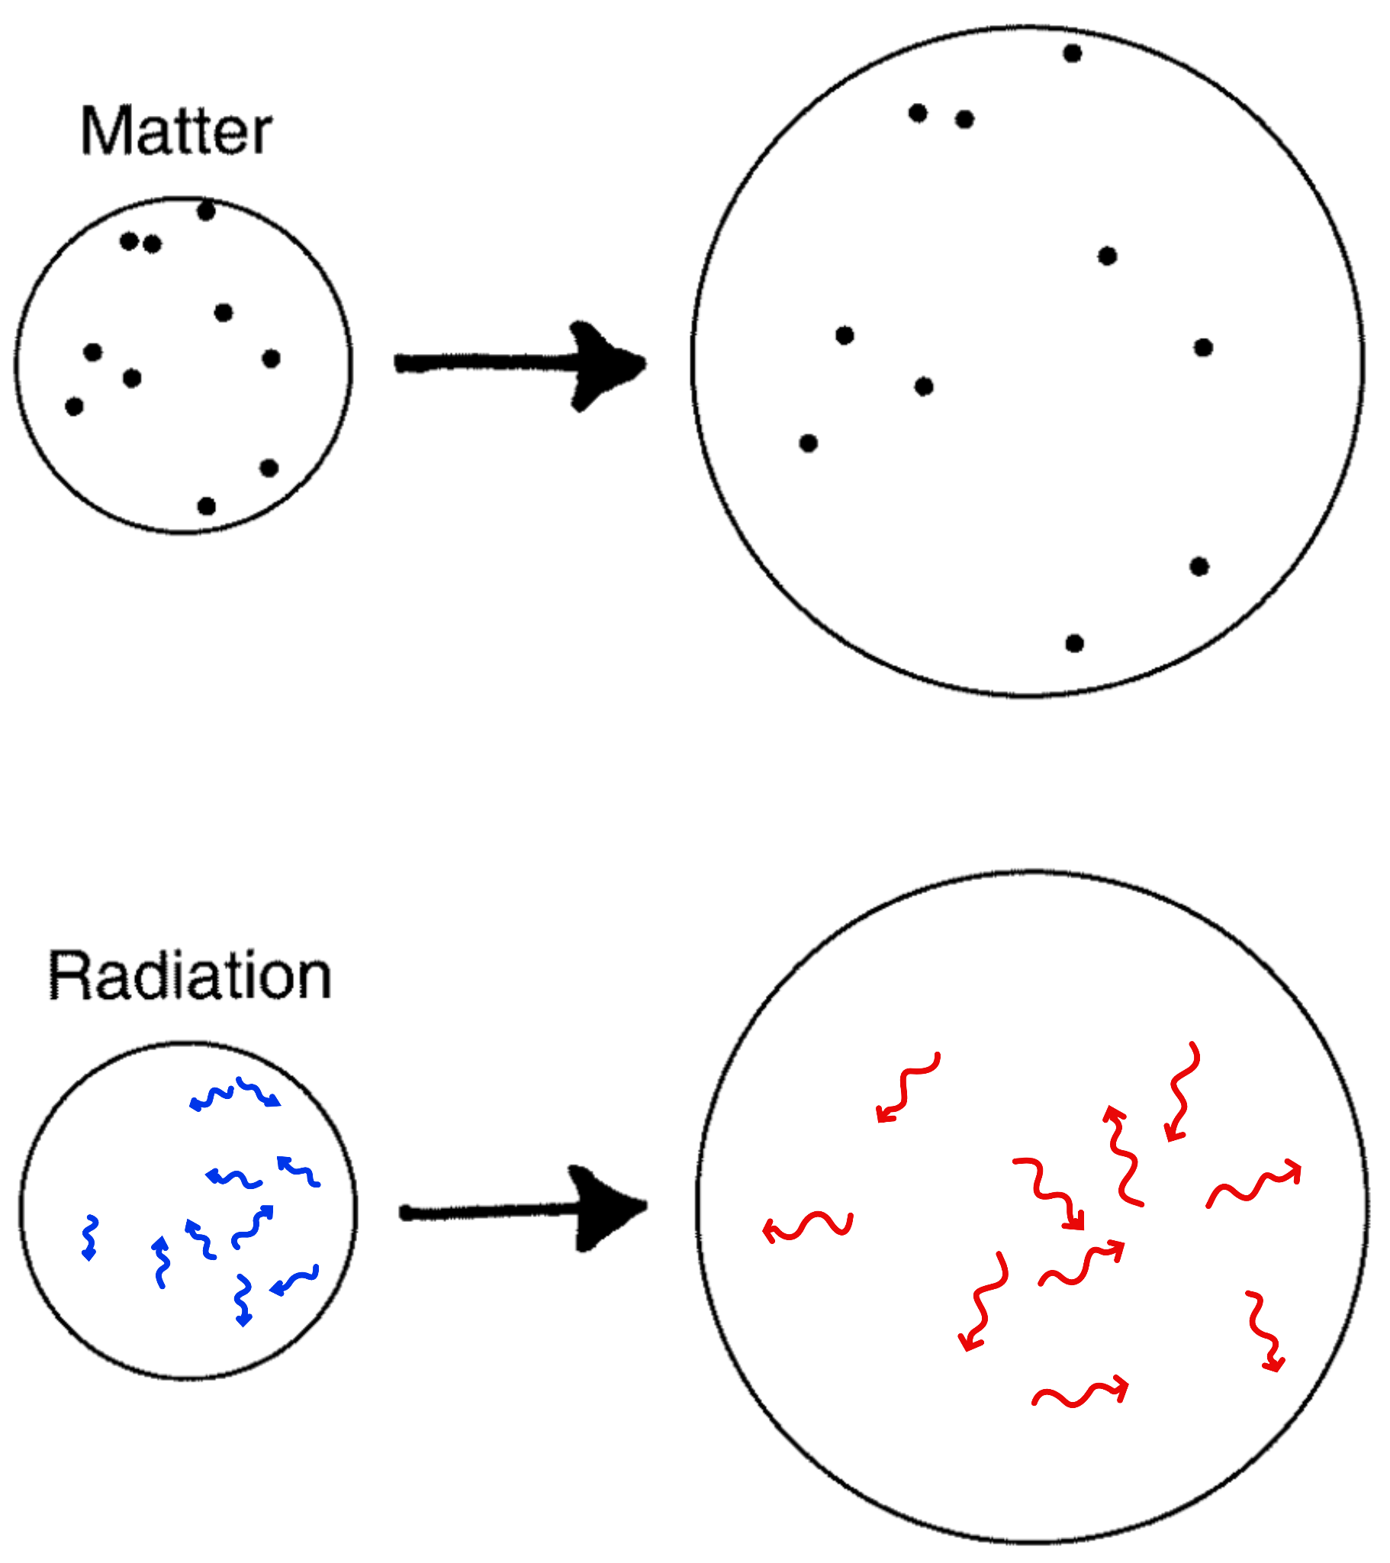
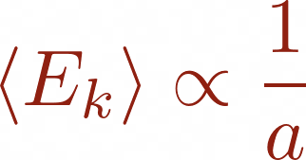

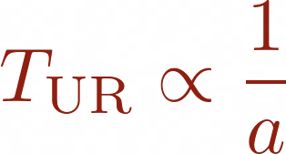
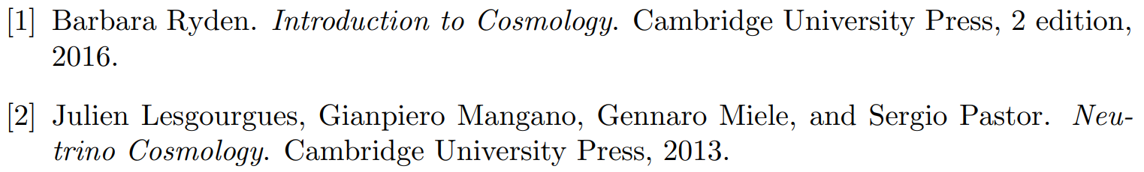
UR Matter Temperature Evolution
Ultra-Relativistic (UR) matter kinetic energy
Redshift
Average kinetic energy:
Also:
Temperature of UR matter
modified from:
Notes:
Zeg: golflengte wordt opgerekt met a dus k met 1/a. Hint alvast naar neutrinos eerst radiation dan matter.

Slide 6
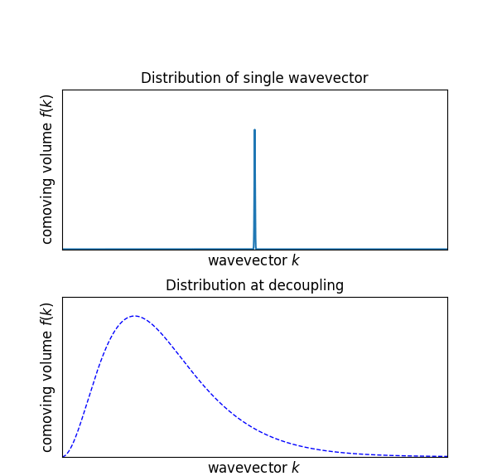
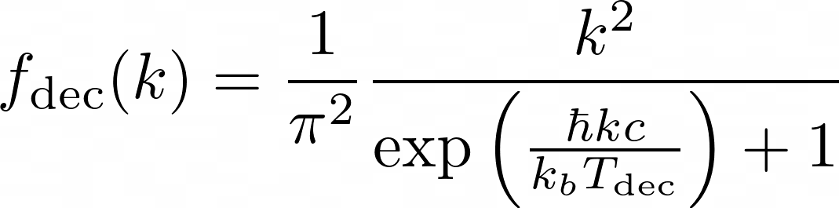
Distribution at Decoupling
Before decoupling, neutrinos in thermal equilibrium
Described by UR Fermi-Dirac (FD) gas
We expand in Dirac delta functions and use cosmological redshift
Notes:
zet formule redshift erop

Slide 7
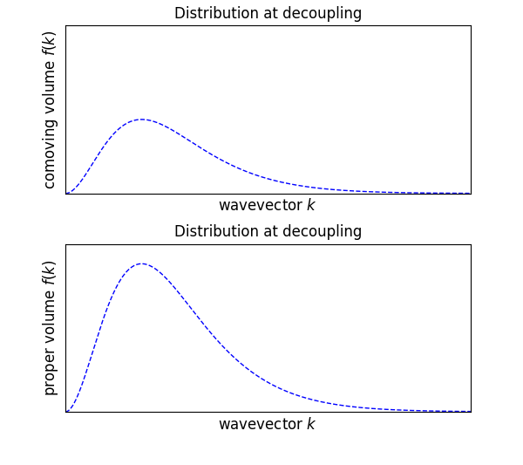
Distribution at Decoupling
Before decoupling, neutrinos in thermal equilibrium
Described by UR Fermi-Dirac (FD) gas
We expand in Dirac delta functions and use cosmological redshift

Slide 8
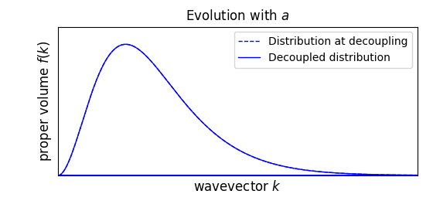
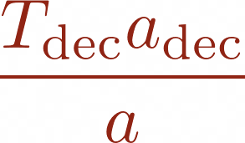
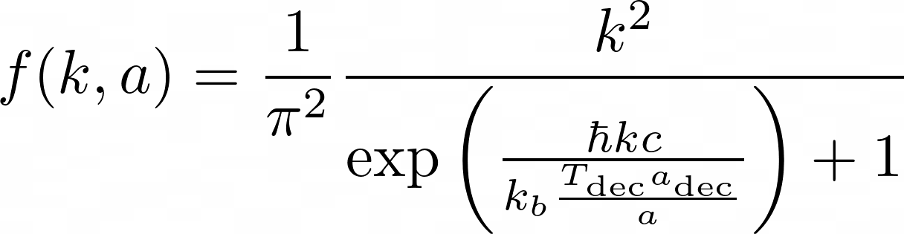
Evolution of Decoupled Distribution
Same as a UR Fermi-Dirac gas with temperature
But this 'temperature' does not correspond to kinetic properties
The CNB distribution has the form of an ultra-relativistic FD gas
Notes:
Zeg: niet in equilibrium
Zeg: distribution at decoupling is frozen in, the shape stays conserved.

Slide 9
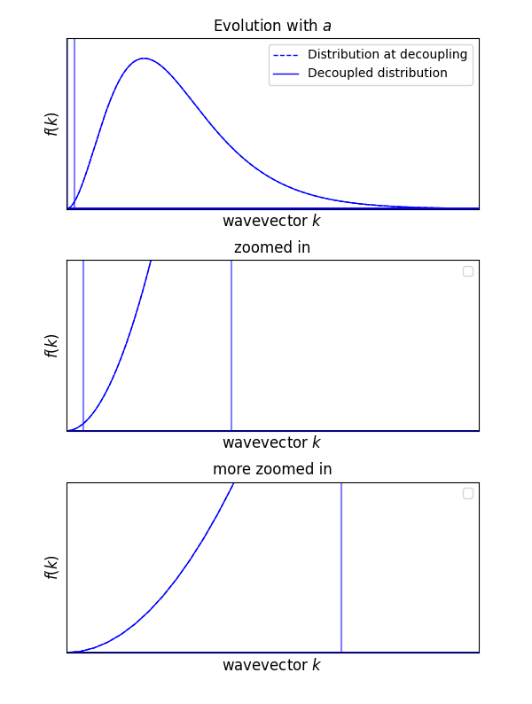
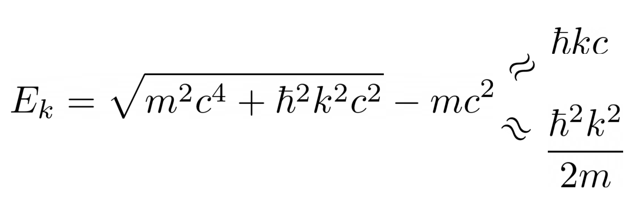
Domains
Intermediate domain
UR domain
UR and Non-Relativistic (NR) domains
Defined by E kin = UR or NR
We can find exact expressions for kinetic energy density and pressure in two regimes
NR domain
UR domain
Intermediate domain
NR domain
Note: regimes not to scale
Notes:
Zeg: niet in equilibrium
Zeg: distribution at decoupling is frozen in, the shape stays conserved.

Slide 10
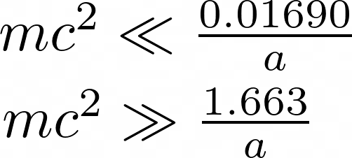
Transition
Intermediate domain
UR domain
Looking at relevant k-values give transition points:
UR:
NR:
At least 2 neutrino 9 meV:
at least 2 out of 3 neutrino NR
NR domain
UR domain
Intermediate domain
NR domain
Note: regimes not to scale
Notes:
Zeg: niet in equilibrium
Zeg: distribution at decoupling is frozen in, the shape stays conserved.

Slide 11
UR Matter Temperature Evolution
UR matter kinetic energy
Redshift
Average kinetic energy:
Also:
Temperature of UR matter
modified from:
Notes:
Zeg: golflengte wordt opgerekt met a dus k met 1/a. Hint alvast naar neutrinos eerst radiation dan matter.

Slide 12
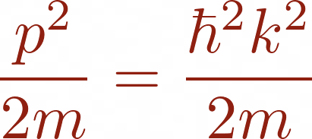
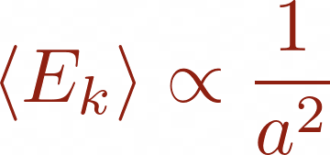
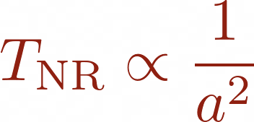
NR Matter Temperature Evolution
NR matter kinetic energy
Redshift
Average kinetic energy:
Also:
Temperature of NR matter
Image from:
Notes:
Zeg: golflengte wordt opgerekt met a dus k met 1/a. Hint alvast naar neutrinos eerst radiation dan matter.

Slide 13
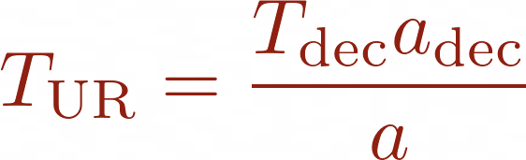
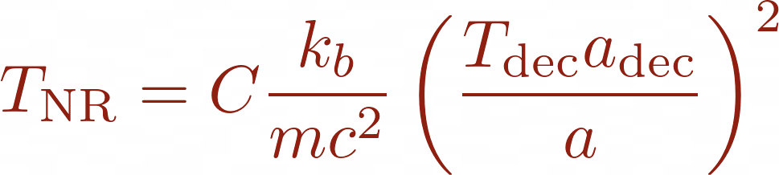
CNB 'Temperature'
neutrinos UR: good temperature description is
neutrinos NR: several definitions exist all of the of the form
For example, - temperature gives C ≈ 3.806
Notes:
Zeg: niet in equilibrium
Zeg: distribution at decoupling is frozen in, the shape stays conserved.

Slide 14
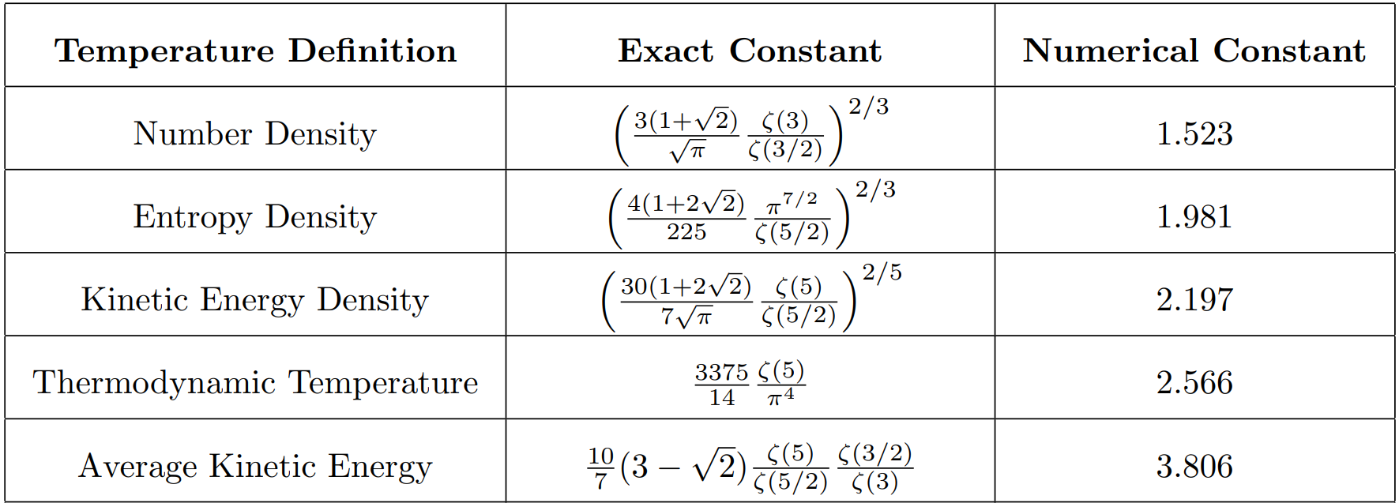

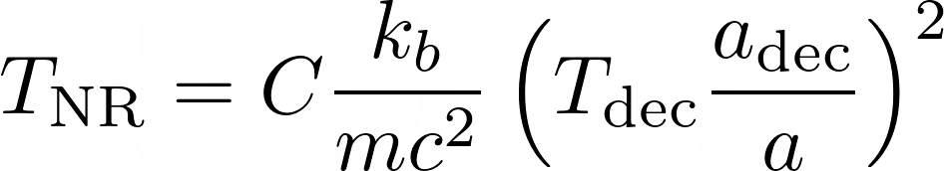
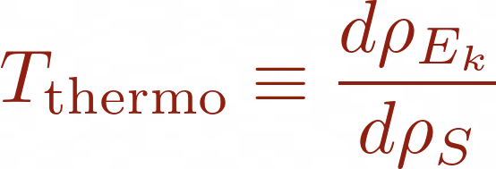
T-Constants
Several definitions
Densities and are matched to FD gas with this temperature.
For example number density
Thermodynamic Temperature:

Slide 15
Constants

Slide 16
Temperature Values
Example for lowest mass spectrum:
0, 9, 50 meV
0 meV: 1.95 K
9 meV: 0.06 to 0.14 K
50 meV: 0.01 to 0.02 K
Significantly lower than 1.95 K !
The CNB does not have a temperature of 1.95 Kelvin. But a significantly lower temperature for at least 2 of the 3 neutrino mass-eigenstates.

Slide 17



Evolution of Energy Density
NR Matter energy is rest mass
Radiation (UR) energy is
Redshift
modified from:
Notes:
Zeg: golflengte wordt opgerekt met a dus k met 1/a. Hint alvast naar neutrinos eerst radiation dan matter.

Slide 18
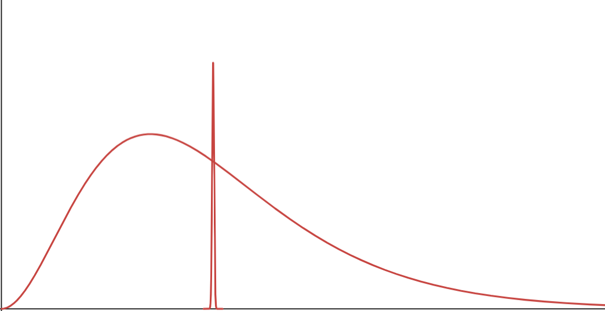

δ-approximation
CNB energy density not solvable
We approximate the distribution as represented by a single average wave-vector
Same number density
Max relative error of 3%

Slide 19
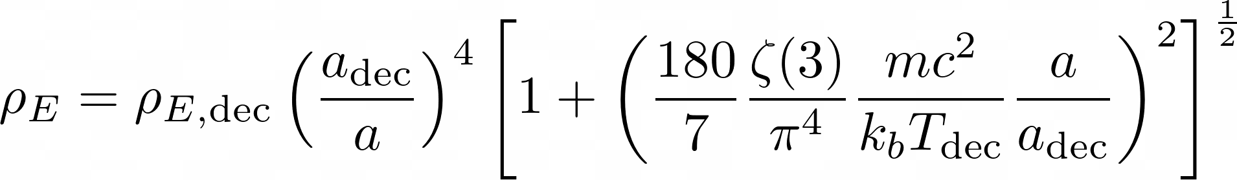
δ-approximation
CNB energy density not solvable
We approximate the distribution as represented by a single average wave-vector
Same number density
Max relative error of 3%

Slide 20
δ-approximation
CNB energy density not solvable
We approximate the distribution as represented by a single average wave-vector
Same number density
Max relative error of 3%

Slide 21
δ-approximation
CNB energy density not solvable
We approximate the distribution as represented by a single average wave-vector
Same number density
Max relative error of 3%

Slide 22
δ-approximation
CNB energy density not solvable
We approximate the distribution as represented by a single average wave-vector
Same number density
Max relative error of 3%

Slide 23
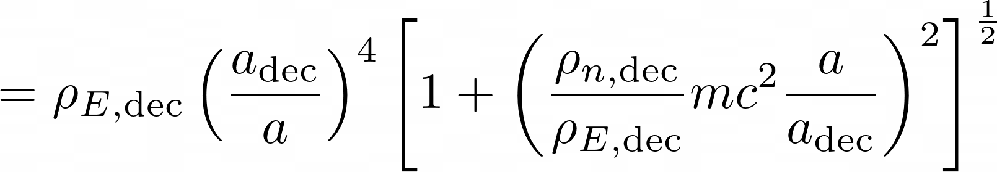
δ-approximation
CNB energy density not solvable
We approximate the distribution as represented by a single average wave-vector
Same number density
Max relative error of 3%

Slide 24
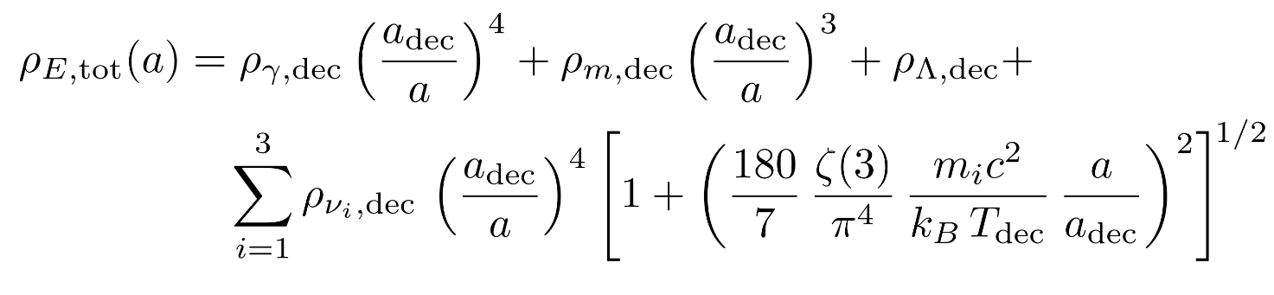
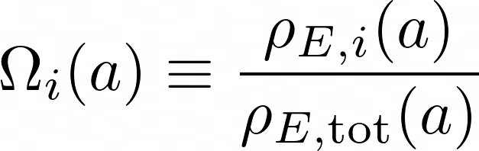
Energy Density Revisited
Relative Energy Density:

Slide 25
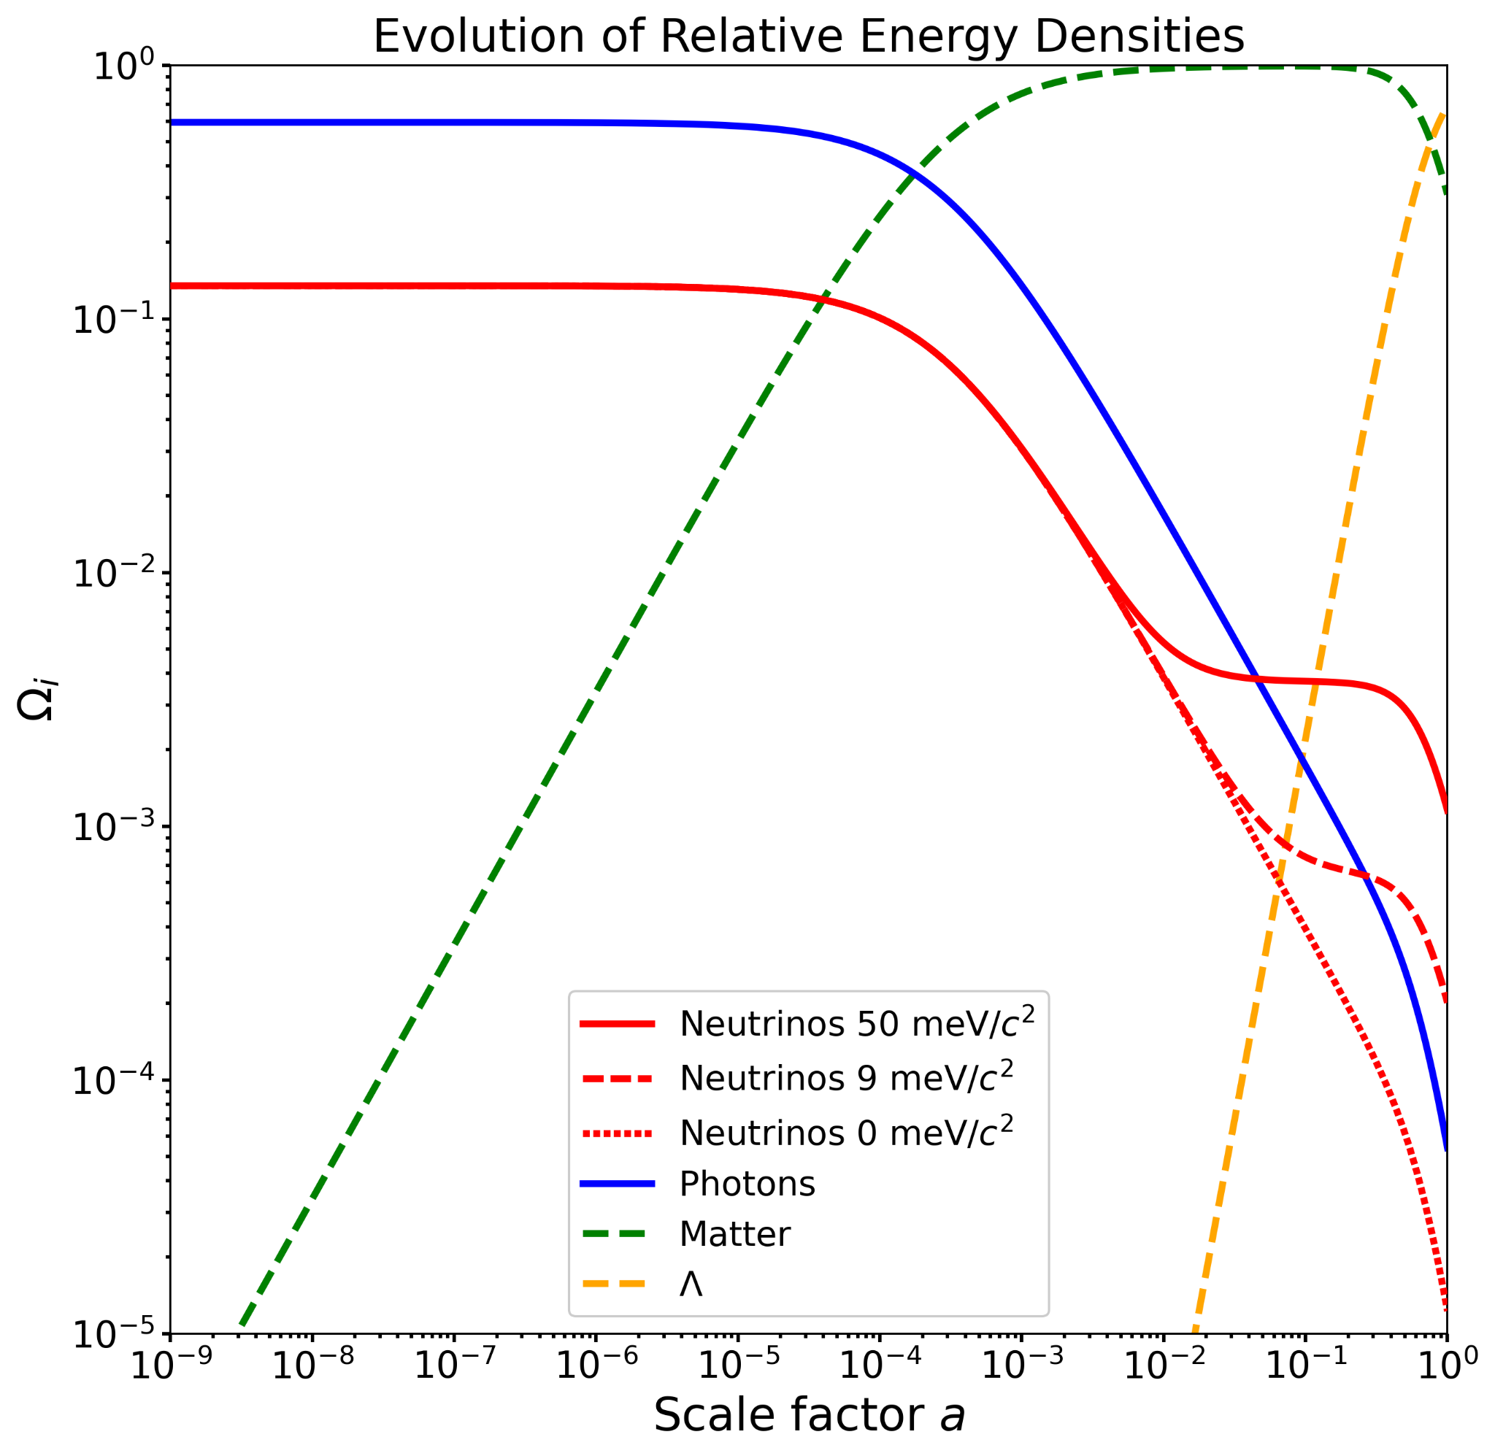
Figure is in agreement with:

Slide 26
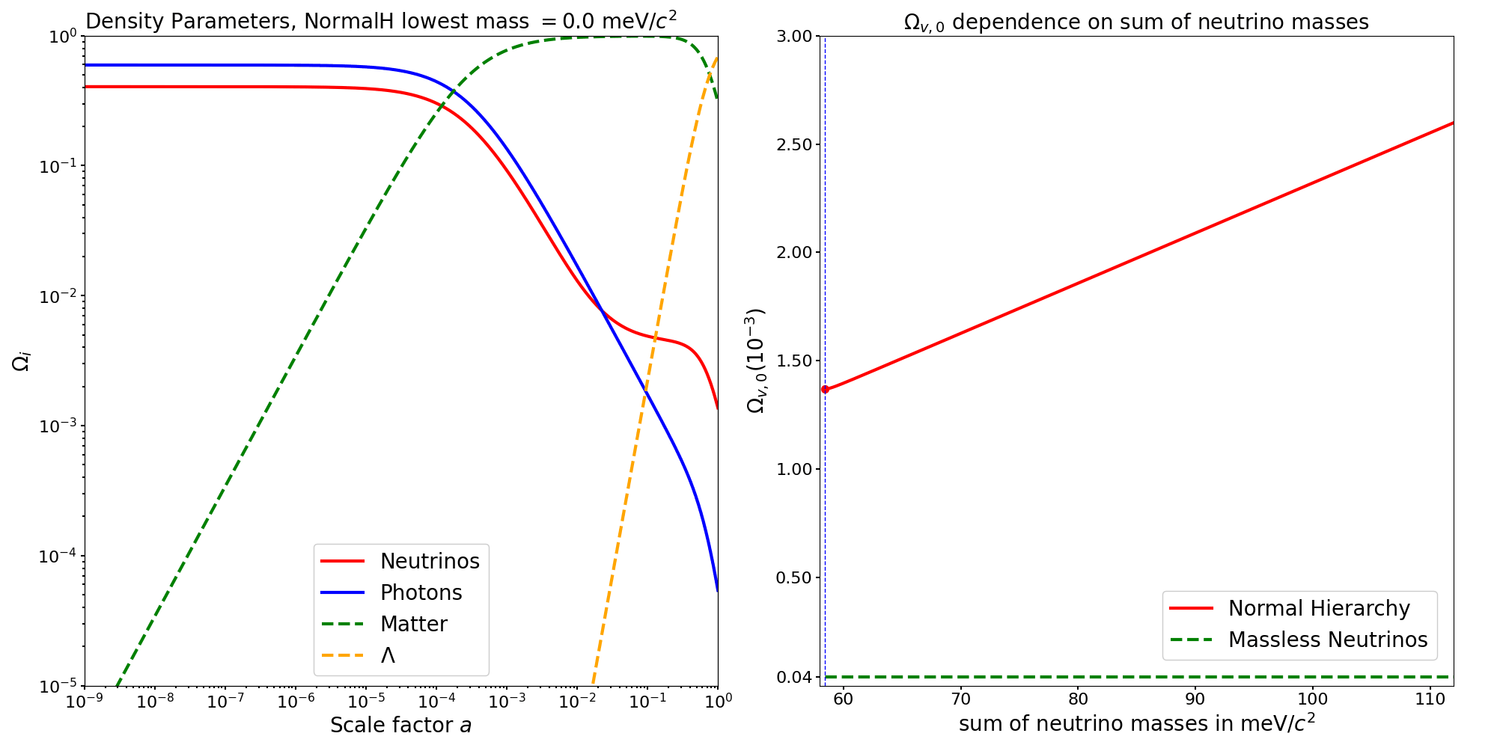
Notes:
Baryonic matter: Ωbary,0 = 0.048 Nonbaryonic dark matter: Ωdm,0 = 0.262 Total matter: Ωm,0 = 0.31 from Ryden, Hubble Tension: Observed: 73 - 75 km/s/Mpc from The Hubble Constant: A Historical Review
R. Brent Tully

Slide 27
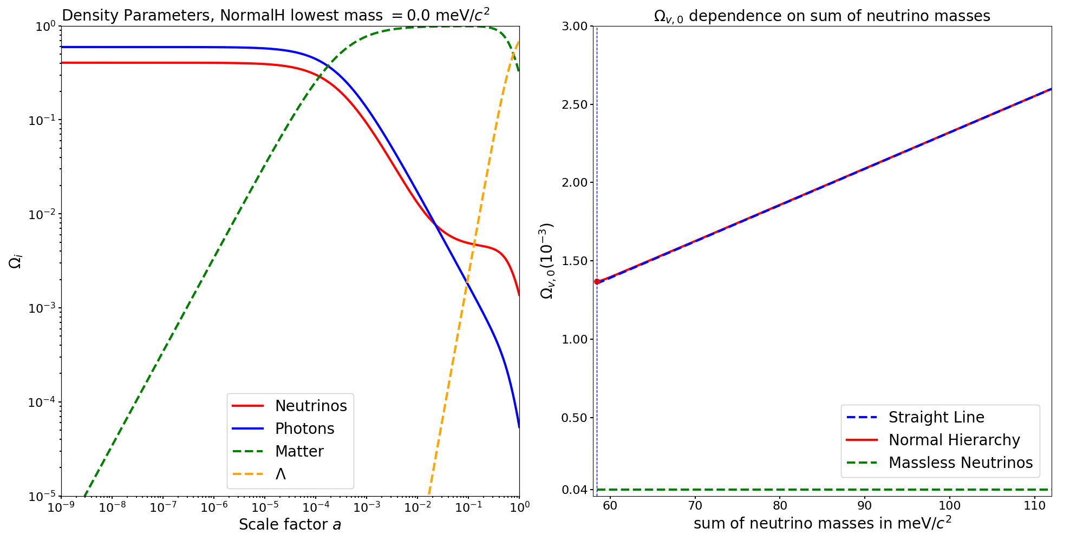
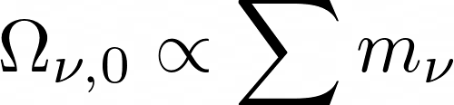
For all mass spectra (except the lowest):
Notes:
Baryonic matter: Ωbary,0 = 0.048 Nonbaryonic dark matter: Ωdm,0 = 0.262 Total matter: Ωm,0 = 0.31 from Ryden, Hubble Tension: Observed: 73 - 75 km/s/Mpc from The Hubble Constant: A Historical Review
R. Brent Tully

Slide 28
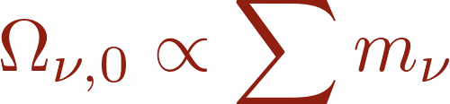
Conclusion
Conclusion:
The CNB has the form of a ultra-relativistic FD gas, but relativistic 'temperature' does not describe kinetic properties when NR
The CNB does not have a temperature of 1.95 Kelvin. But the temperature is significantly lower for at least 2 of the 3 neutrino mass-eigenstates
Using the δ-approximation a simple expression for the energy density can be obtained
For all but the lowest mass spectra we have
Notes:
[dynamisch = kinetisch?]

Slide 29
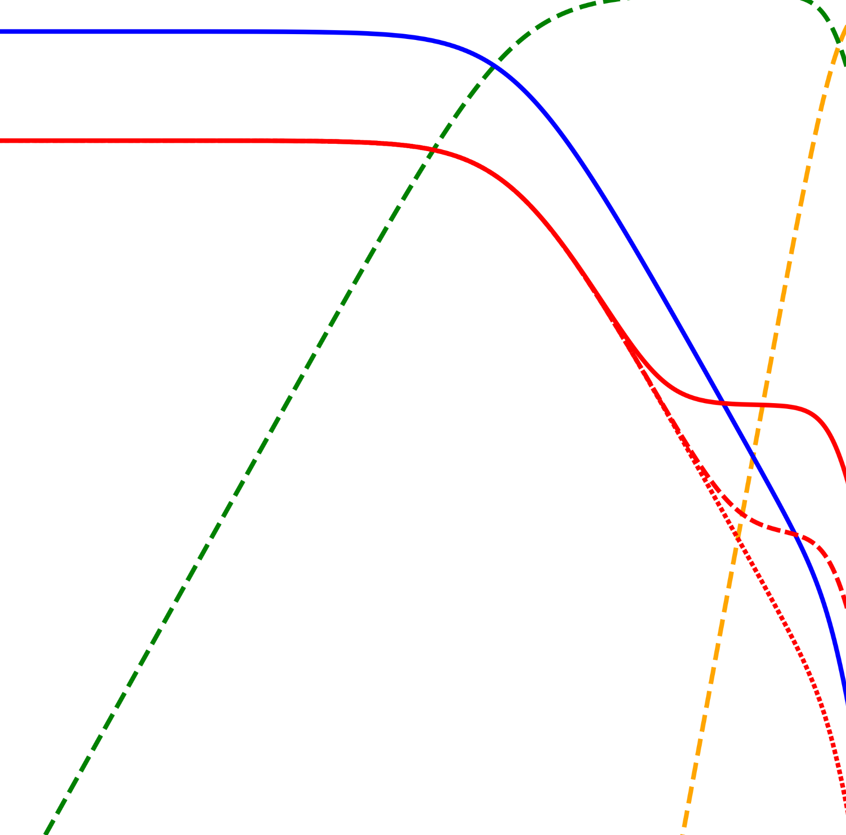
Thank you for your attention!
More Questions? or want to read my thesis? Feel free to mail me: ruben.bartelet@ru.nl
LinkedIn: Ruben Bartelet

Slide 30
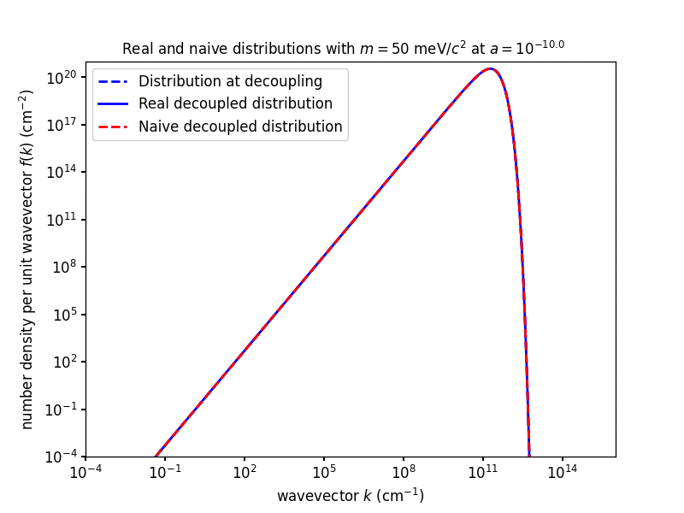

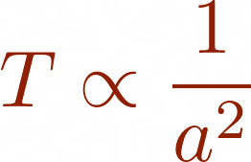

Transition
Massive FD gas with temperature is shown (red curve)
When neutrino become NR:
naive distribution cannot 'keep up'
transition from radiation to matter at
Today at least 2 out of 3 neutrinos matter
Notes:
Here the blue dashed line is again the distribution at decoupling. The real decoupled distribution is the solid blue line, this distribution is mass independent, since it always has the form of a relativisitc FD gas. Also a fermi dirac gas in equilibrium with a mass of 50 mev and temperature of T_dec a_dec / a is plotted, this distribution depends on the mass, and would naively describe the kinetic properties of the gas. As can be seen at the beginning they agree but as the CNB transitions from radiation to matter, they disagree. For 50 mev here the transition point is around 0.01. And in gener

Slide 31
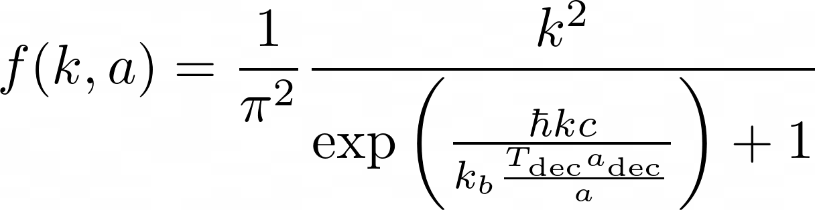
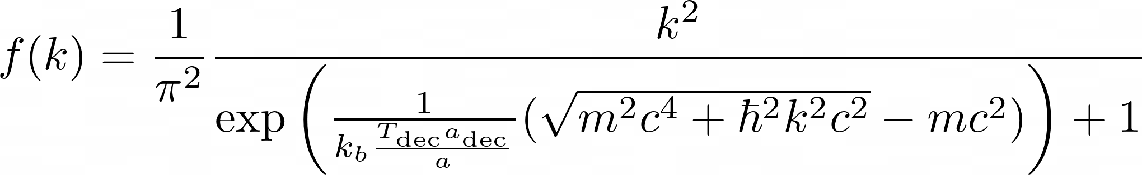
Massive FD gas with temperature is shown (red curve)
Real Decoupled Distribution
Naive Decoupled Distribution

Slide 32
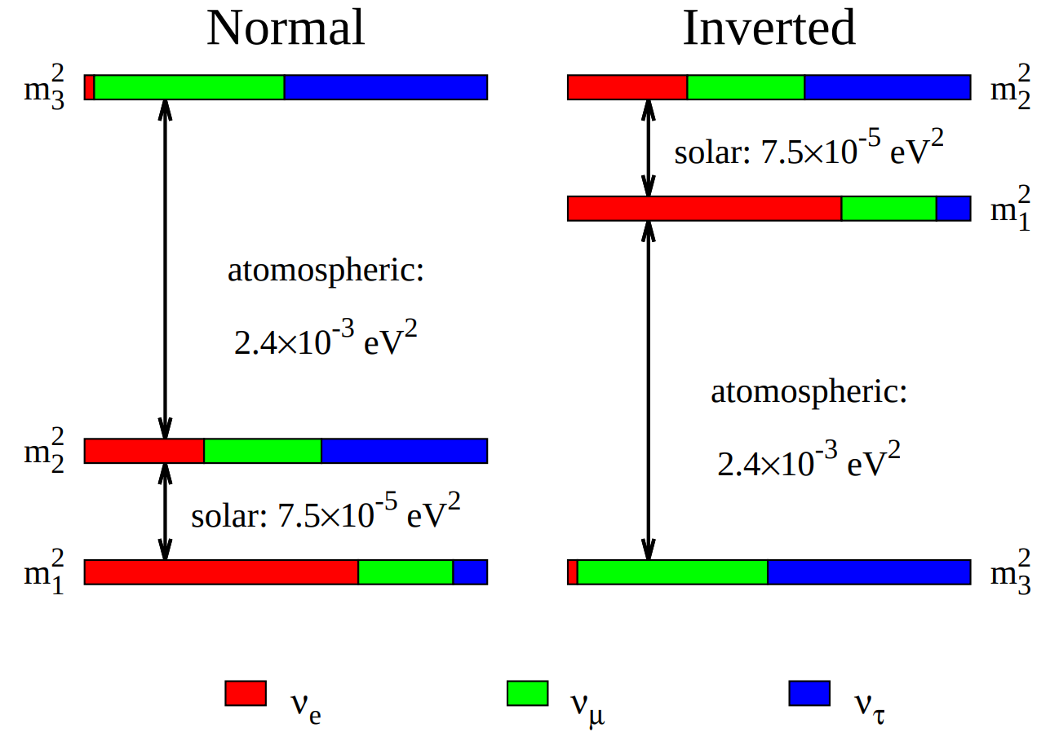
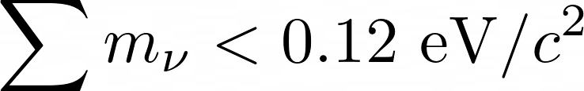
Why m1 < 27 meV/c^2?
CMB (+extra) data gives:
Which means:
m1 < 27 meV/c^2 for Normal Hierarchy
m3 < 11 meV/c^2 for Inverted Hierarchy

Slide 33
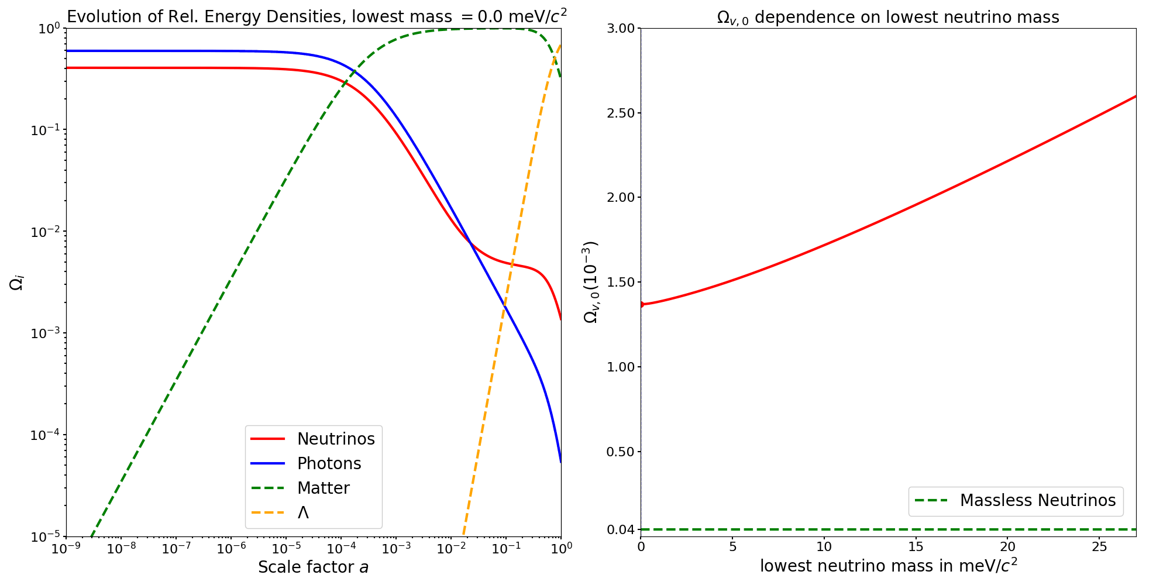

Current Dark Matter value:
Dark matter value from :
Notes:
Baryonic matter: Ωbary,0 = 0.048 Nonbaryonic dark matter: Ωdm,0 = 0.262 Total matter: Ωm,0 = 0.31 from Ryden, Hubble Tension: Observed: 73 - 75 km/s/Mpc from The Hubble Constant: A Historical Review
R. Brent Tully

Slide 34
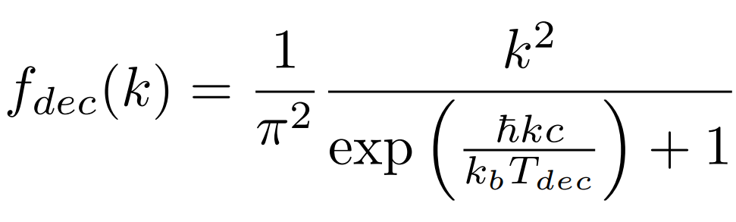

Slide 35
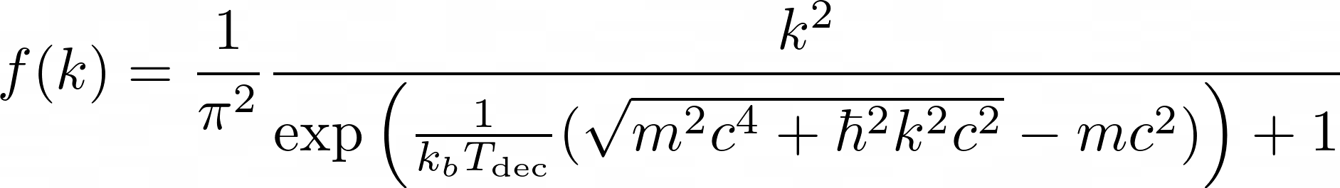
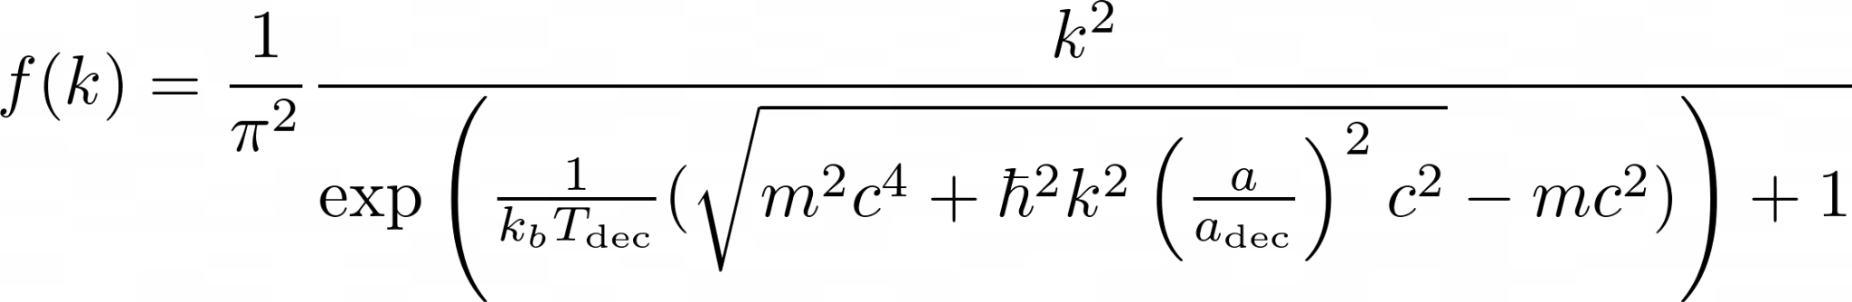
Notes:
Zeg: niet in equilibrium

Slide 36


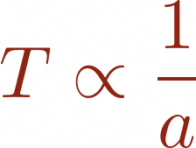


Real vs Naive distribution
Stefan Boltzmann law
Temperature of radiation
For matter
'Temperature' of matter
behaviour is needed to keep up with the decoupled distribution

Slide 37
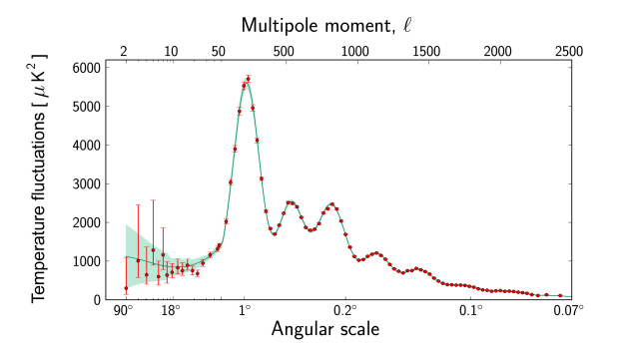
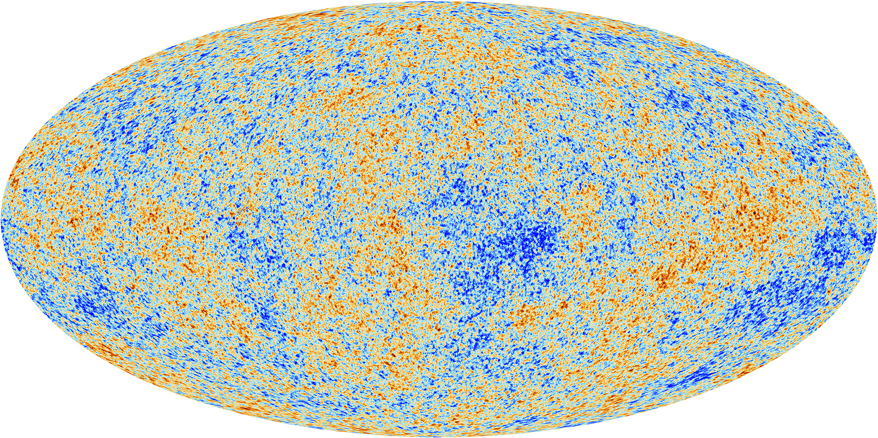
Cosmic Microwave Background (CMB)
Images from: ESA

Slide 38
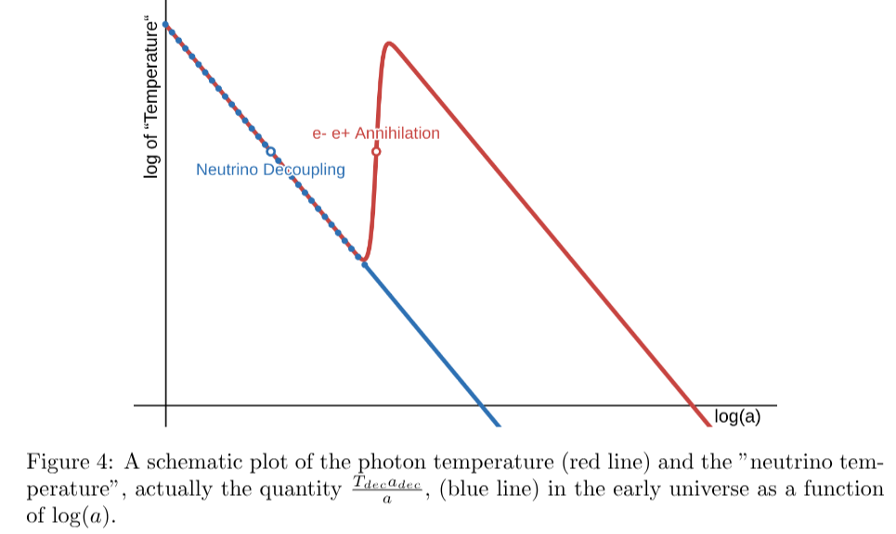
CNB 'temperature' from CMB
Stefan Boltzmann law
Temperature of radiation
CMB creation
Simple Calculation

Slide 39
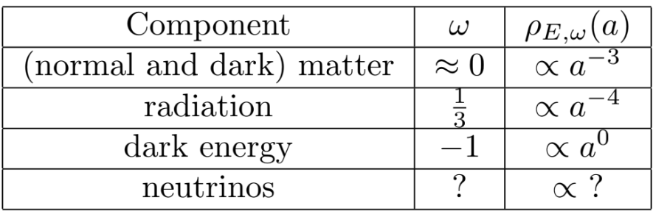
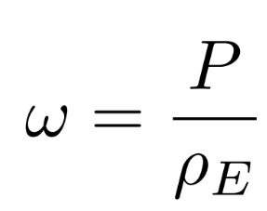



Equation of State

Slide 40


Series Expansion Approximation

Slide 41


Energy Density Integral

Slide 42



Transition point and NR 'temperature'

Slide 43



δ-approximation

Slide 44


