Slide 1
Update on hydrogenated graphene in Nijmegen
1 July 2025
Inge van Rens
Radboud University Nijmegen, the Netherlands

Slide 2
Hydrogenated graphene - progress
Sequential hydrogen exposure
Stability study
Temperature dependence
Quantum Hall effect
Raman spectroscopy
Simulations
Radiation response

Slide 3
Hydrogenated graphene - progress
Sequential hydrogen exposure
Stability study
Temperature dependence
Quantum Hall effect
Raman spectroscopy
Simulations
Radiation response

Slide 4
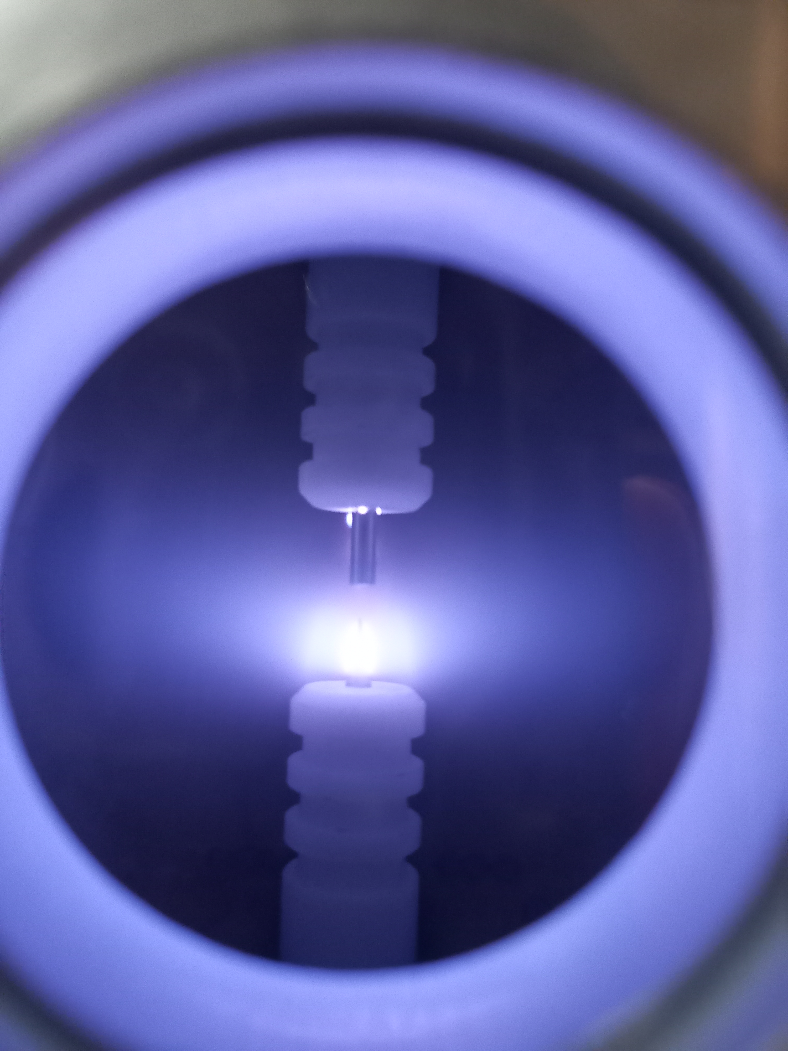
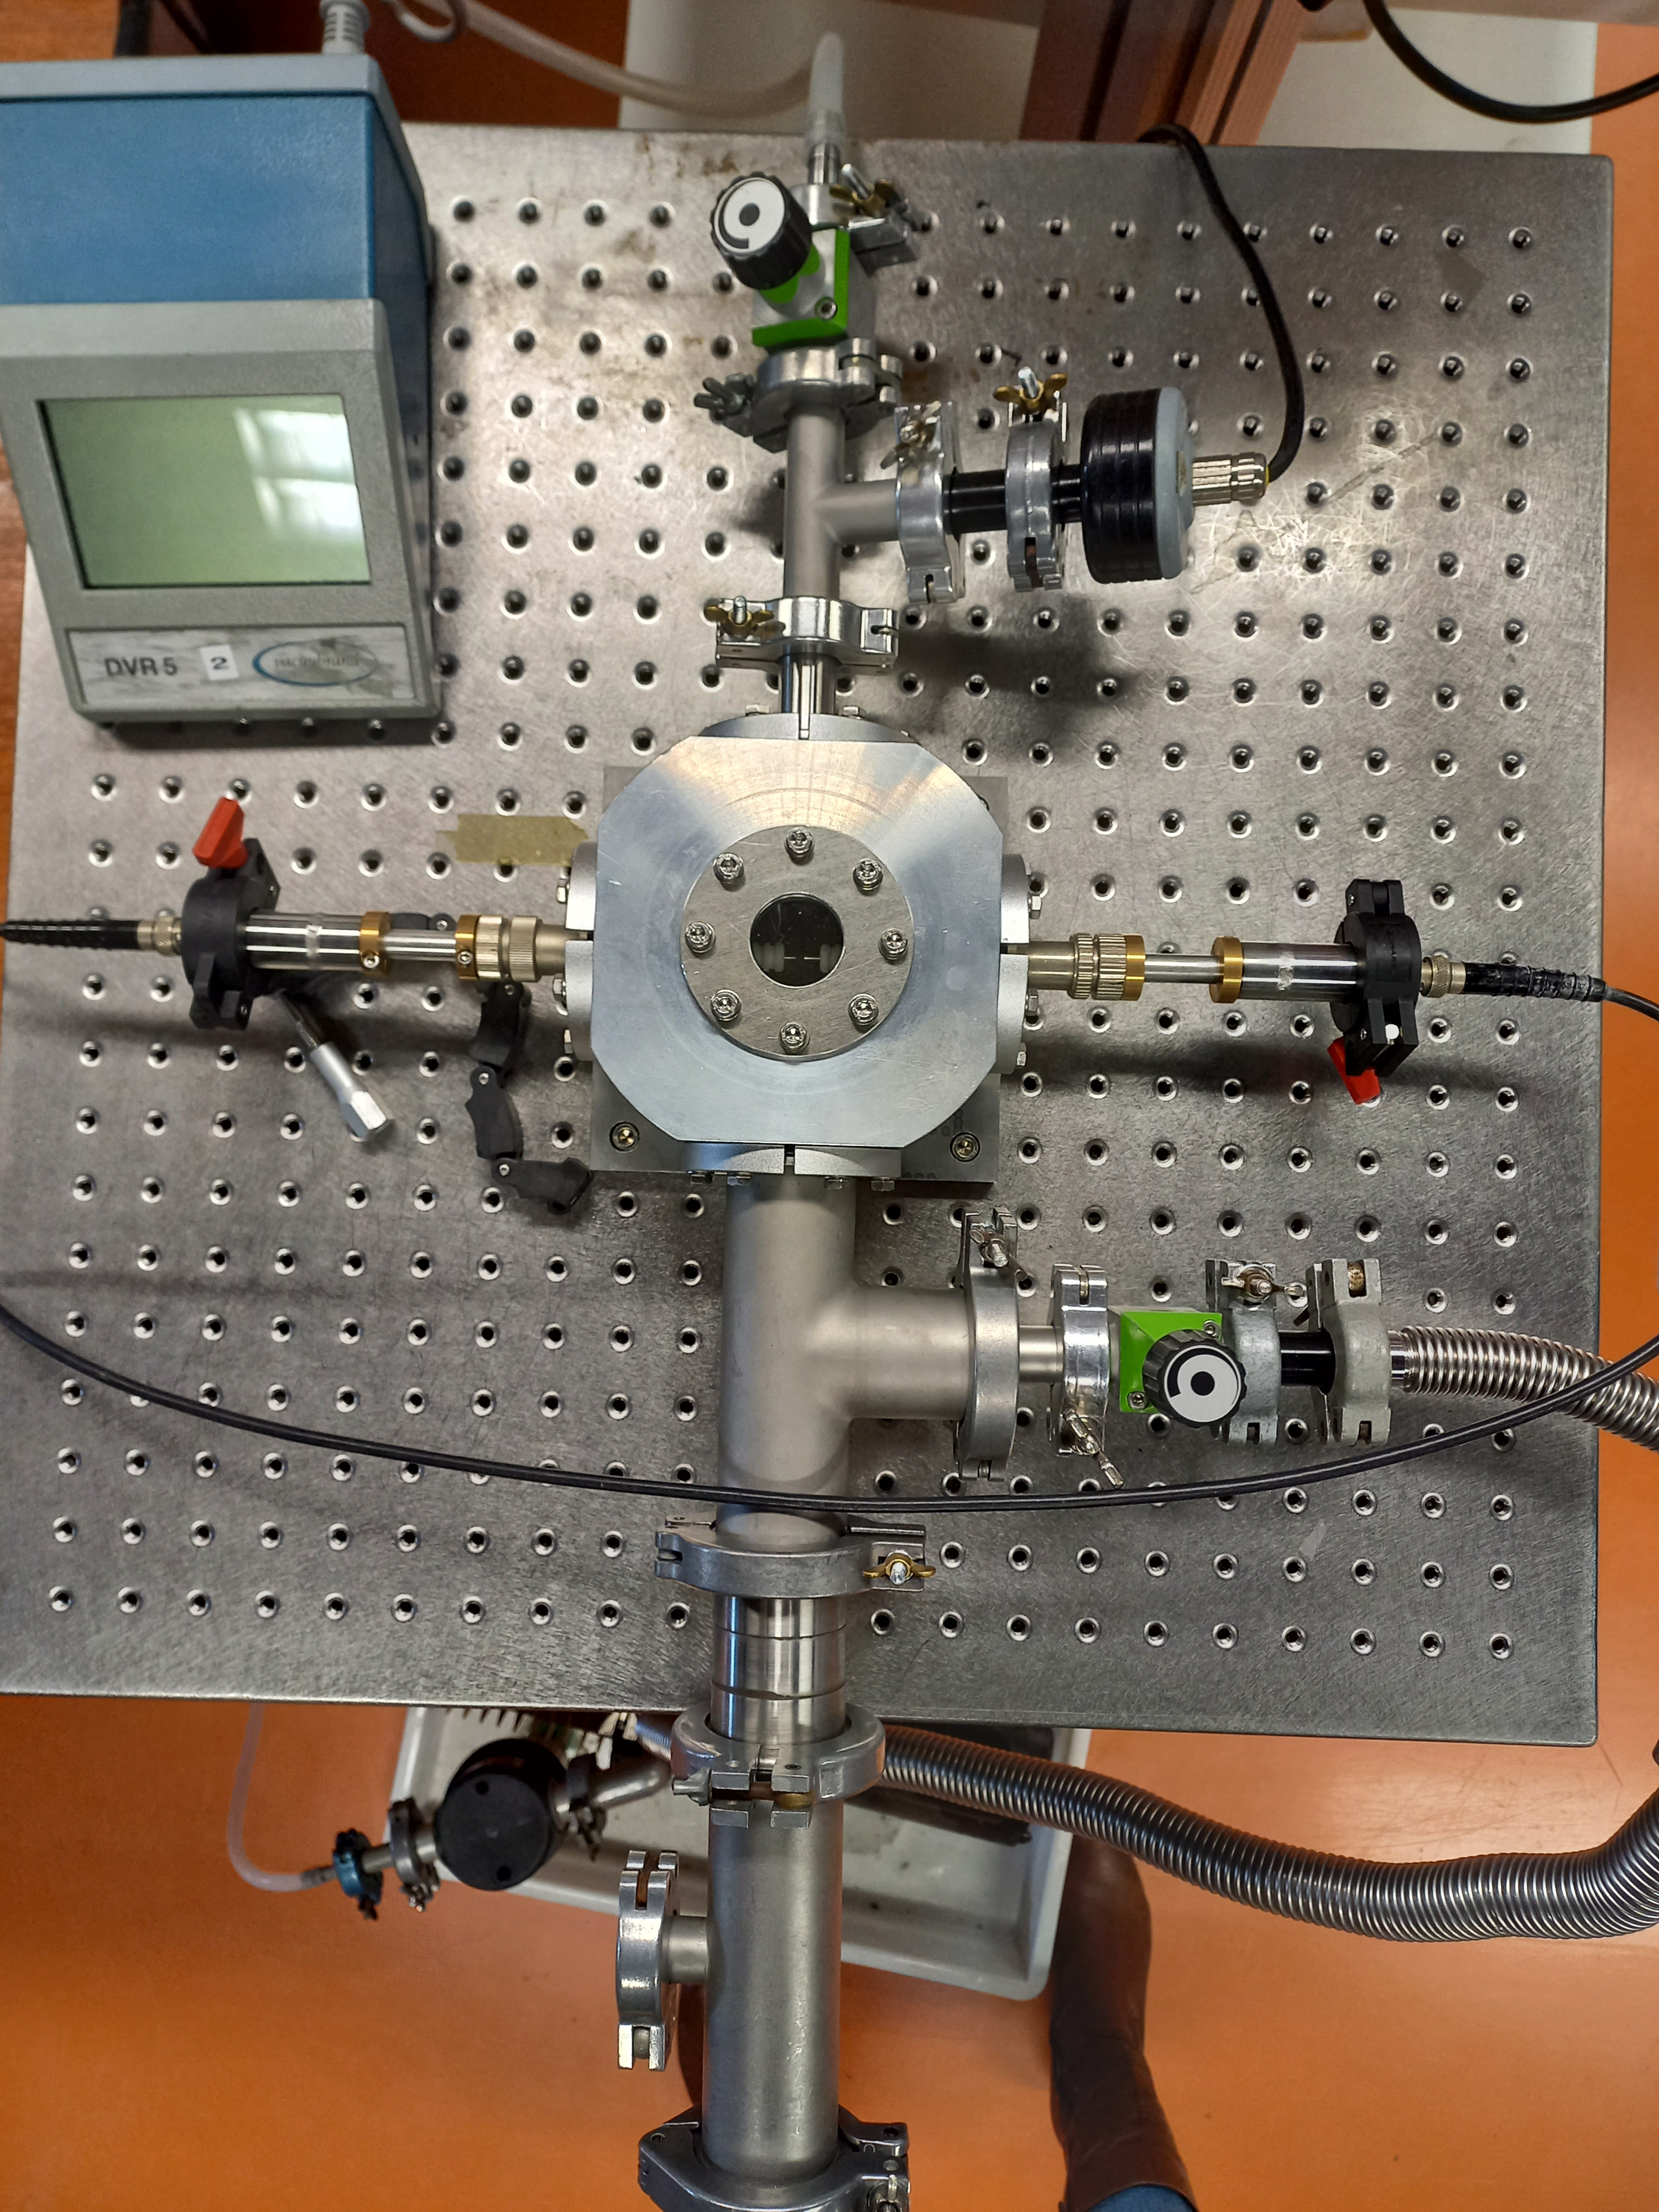
Hydrogen plasma exposure
H inlet
electrodes
Sample location
Vacuum pump

Slide 5
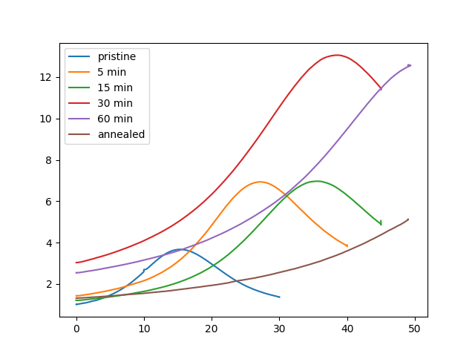
Hydrogenation process
Start with annealed sample
Exposed 1 mbar hydrogen plasma for 5 minutes
Exposed to air for 10 minutes
Repeat until we reach an interesting state
Result looks similar to earlier samples
Notes:
Hydrogenated both samples, meanwhile cooling them with liquid nitrogen to check when the band gap starts to open -> 80s for first sample, 25 min for second

Slide 6
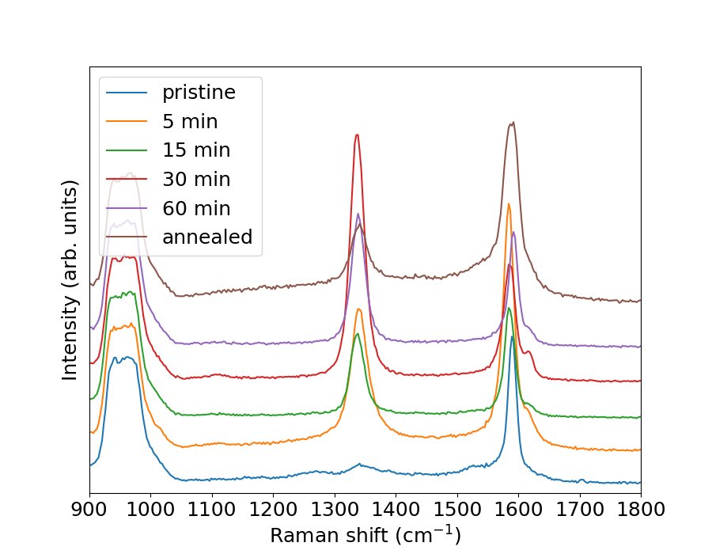
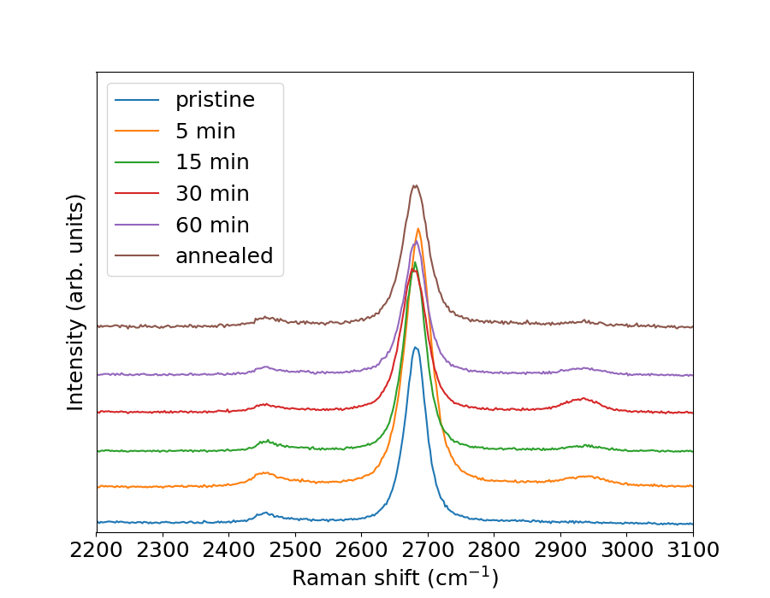
Raman spectroscopy
D
G
2D
D+D’
Notes:
D peak is measure for impurities, appears after hydrogen exposure
Also D’ as shoulder to G

Slide 7
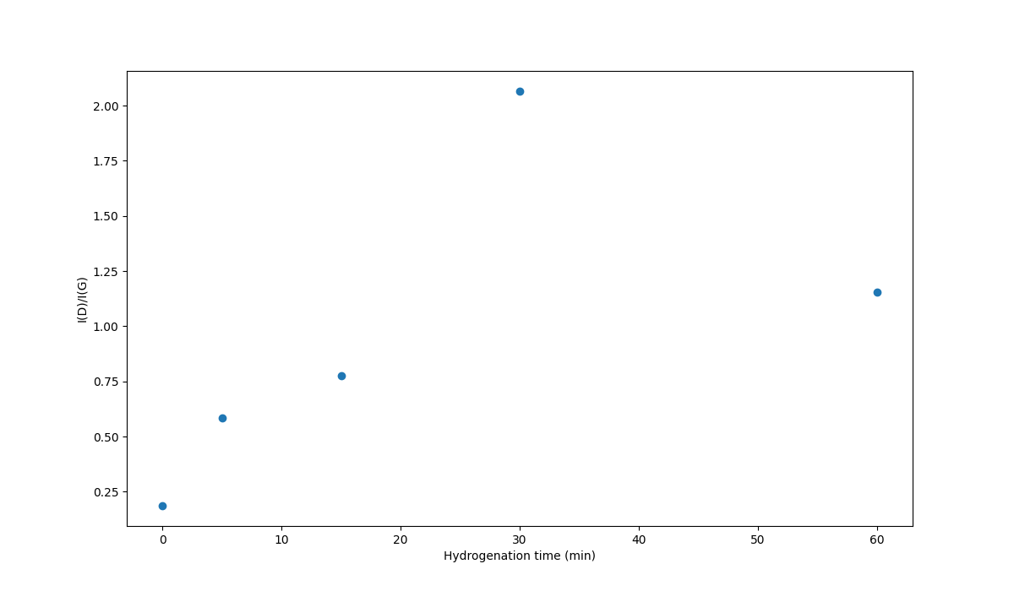
Relative size of the Raman peaks
Notes:
Relative size of D and G peaks is often used to determine level of disorder in graphene, ours is not very high, but cannot be easily compared quantitatively

Slide 8
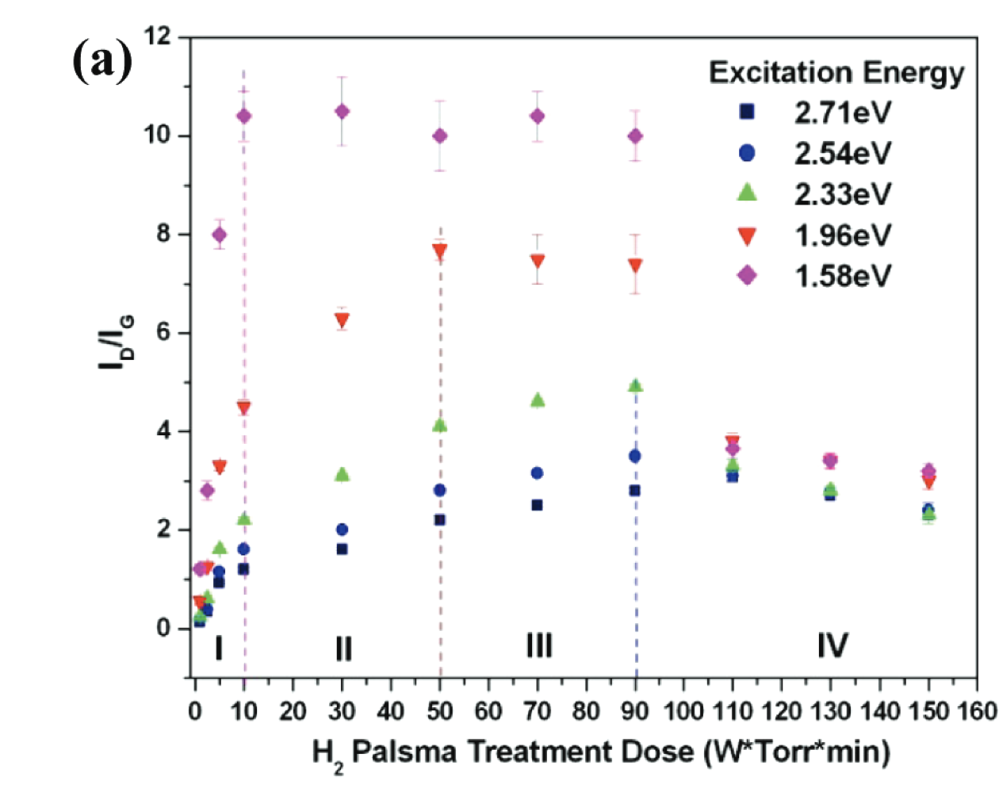
Relative size of the Raman peaks
J. Phys. Chem. C 2011, 115, 5, 1422–1427
Notes:
Our laser was at 532 nm or 2.33 eV/photon, corresponding to the green triangles. In literature the D/G goes up to 5, but we only see it go to 2 in an outlier

Slide 9
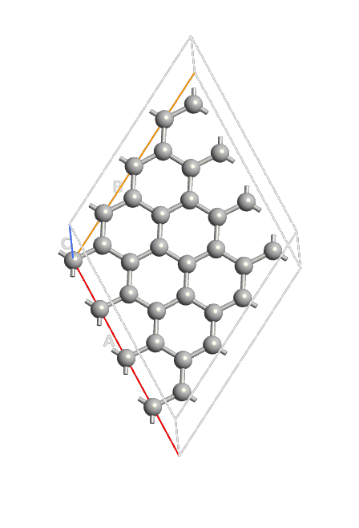
Simulation method
Scaling the size of the graphene sheet

Slide 10
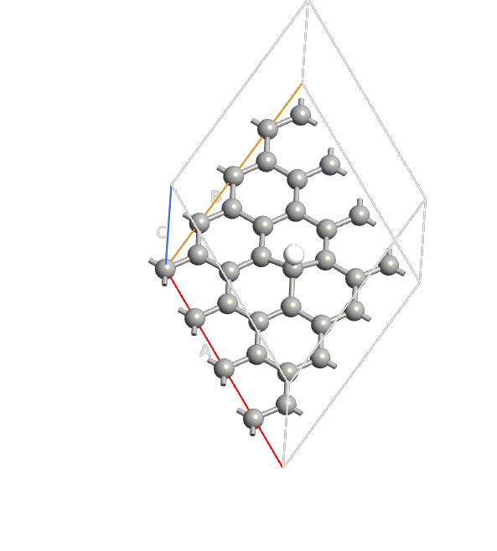
Simulation method
Scaling the size of the graphene sheet
Add 1 hydrogen atom

Slide 11
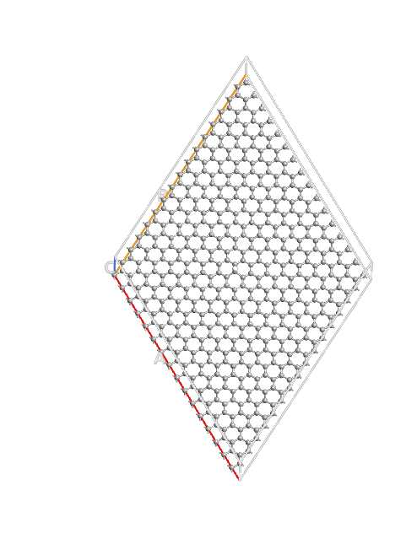
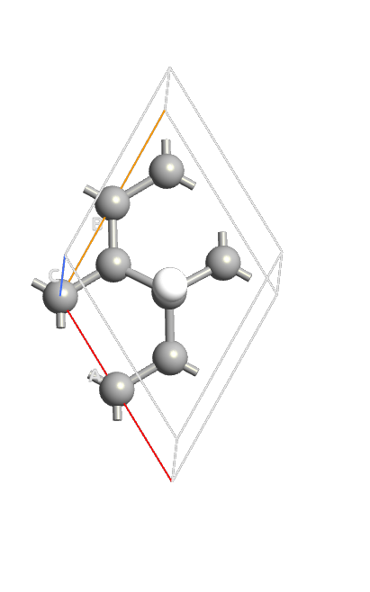
Simulation method
Scaling the size of the graphene sheet
Add 1 hydrogen atom
Calculate effective band structure
Get effective electron mass from second derivative of the dispersion

Slide 12
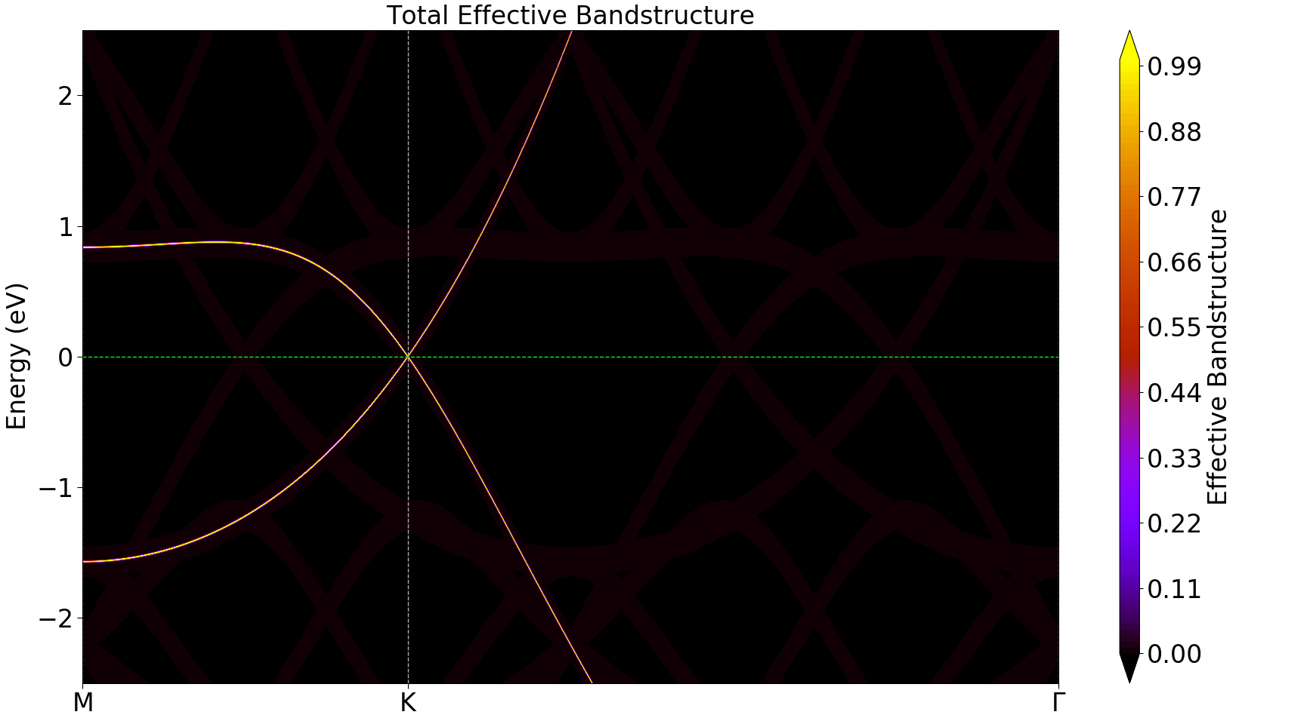
Simulations
Pristine graphene
No band gap
Linear dispersion near K

Slide 13
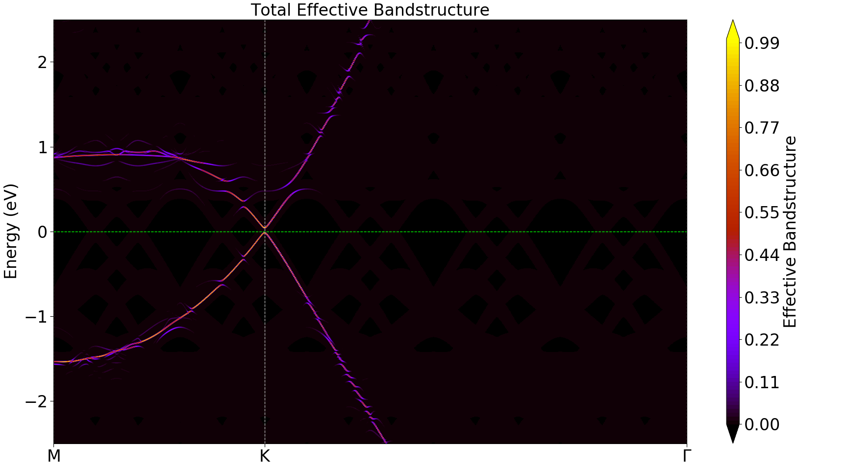
Simulations
0.5% hydrogen coverage
Small band gap
Band structure nearly linear
near K

Slide 14
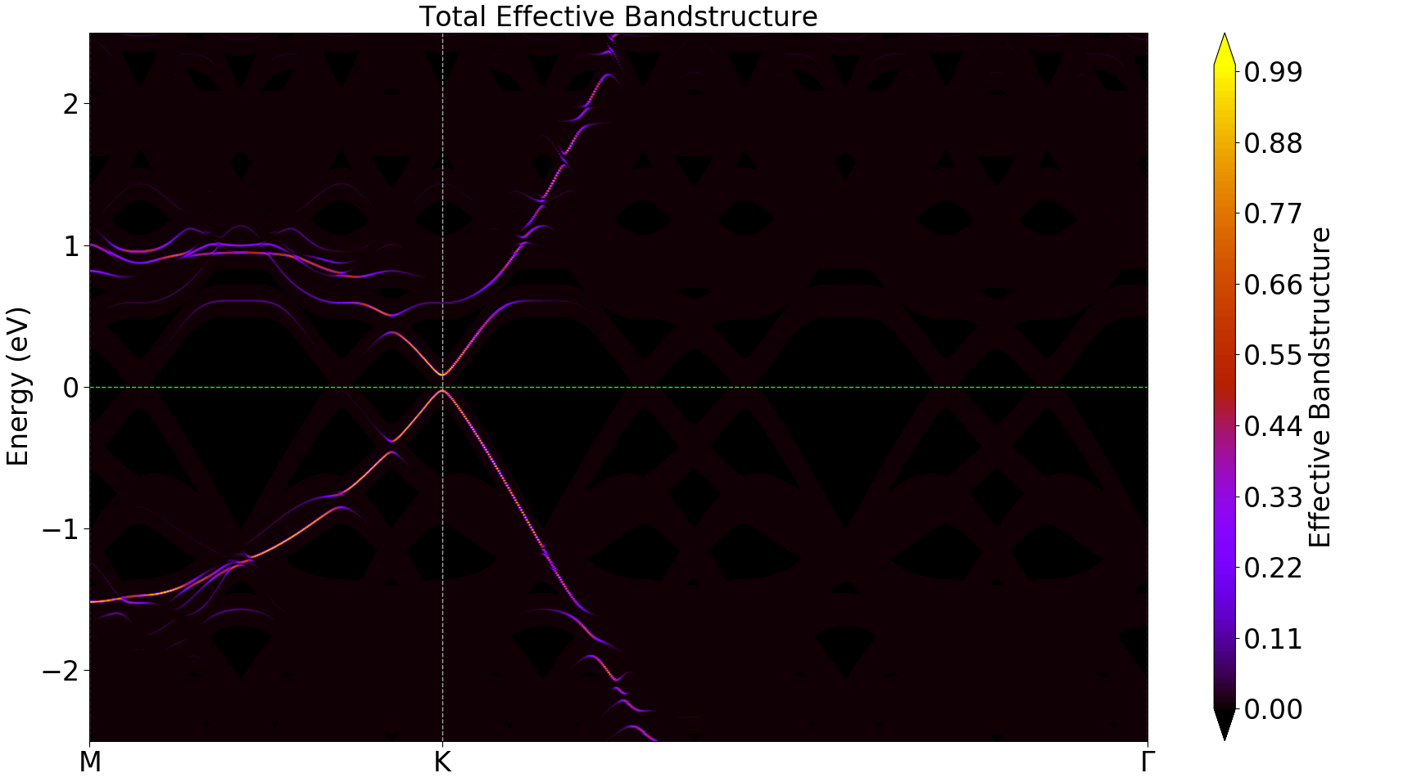
Simulations
1% hydrogen coverage
Small band gap
Strongly curved band
structure near K

Slide 15
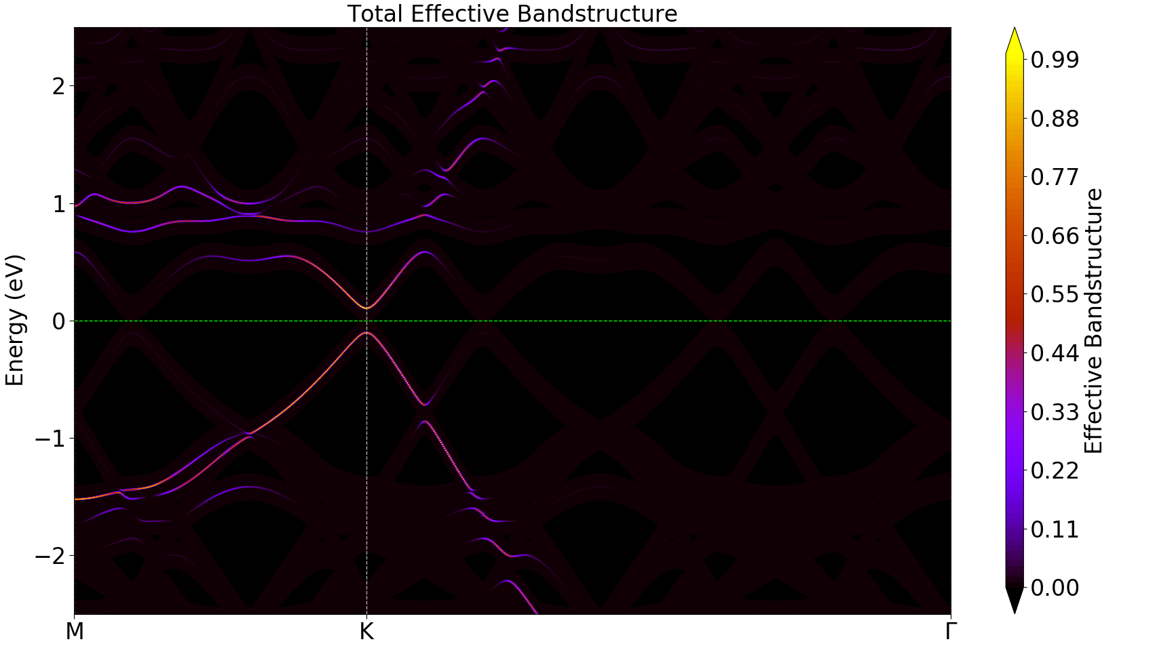
Simulations
2% hydrogen coverage
Band gap increases
Curvature decreases

Slide 16
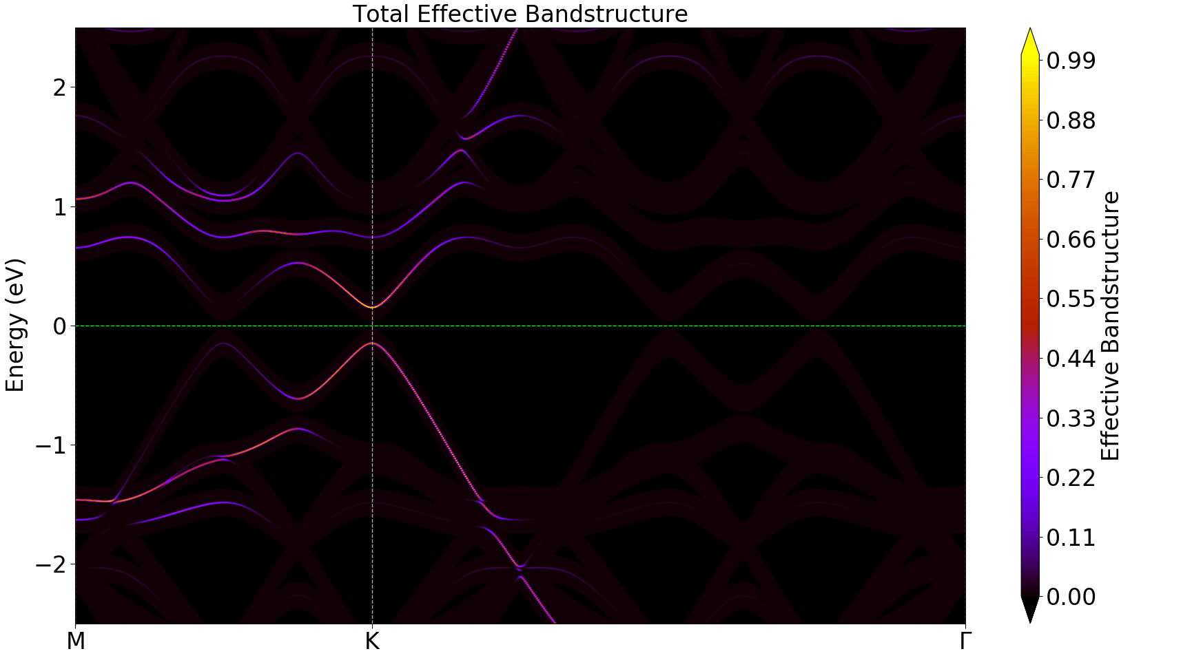
Simulations
3% coverage

Slide 17
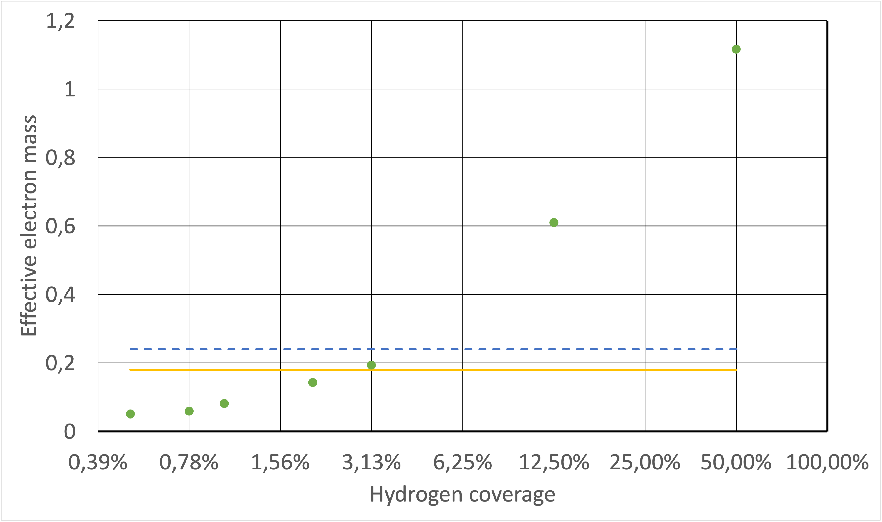
Simulations summary

Slide 18
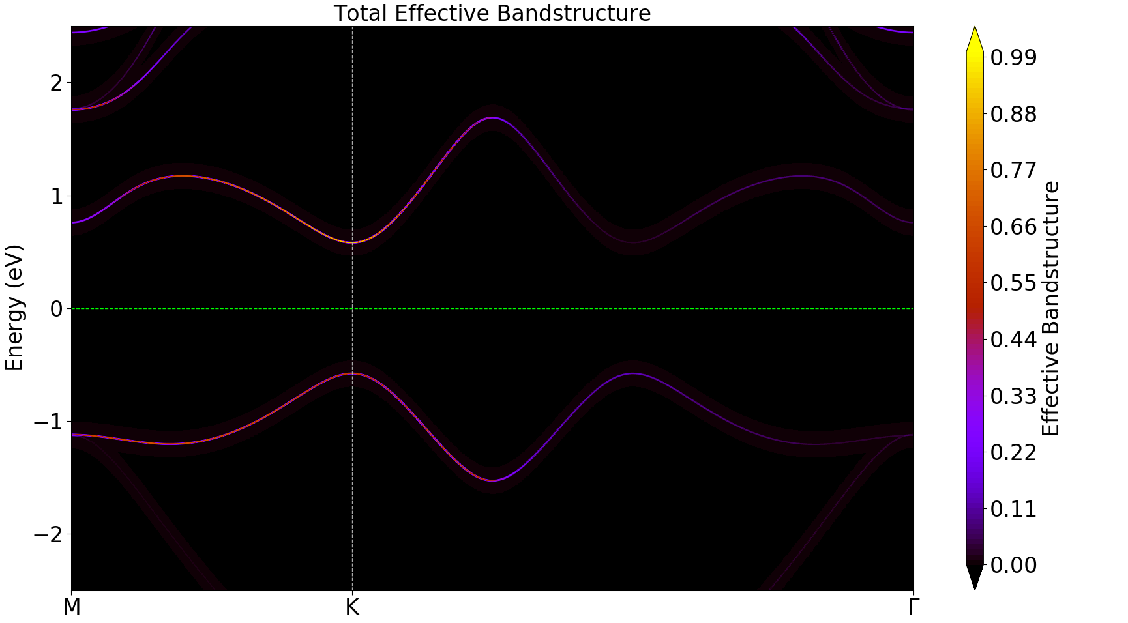
Simulations
12.5% coverage
Insulating material

Slide 19
Conclusions
We have exposed graphene to a hydrogen plasma
Raman spectroscopy confirms the presence of hydrogen
A band gap starts to open
The Landau level distance becomes linear in B
Simulations show that our hydrogen coverage is around 3-4%

Slide 20
Ptolemy implications
Hydrogenation impacts resistance
Temperature dependence: will the target be cryogenic?
Can we dope the target to reduce resistance at higher hydrogenation?

Slide 21
Backup slides

Slide 22



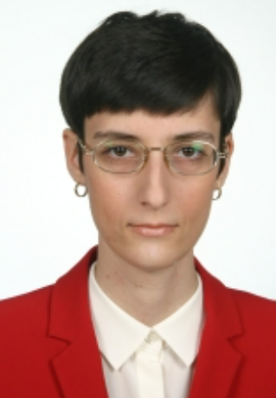



The Nijmegen Group
Uli Zeitler
(RU HFML-FELIX)
Oleksandr Zheliuk
(RU HFML-FELIX)
Nicolo de Groot
(RU IMAPP)
Nicoleta Cucu-Laurenciu
(RU IMAPP)
Inge van Rens
(RU IMAPP)
And our students:
Martijn Velders
(RU IMAPP)
Bram Breugelmans
(RU HFML-FELIX)
Thomas Derks
(RU HFML-FELIX)

Slide 23
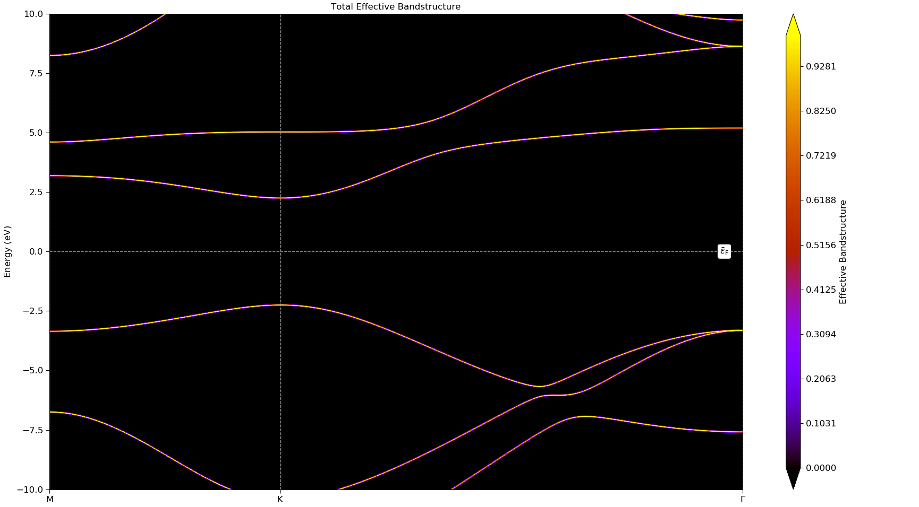
Simulations – 50% coverage
1 hydrogen per 2 carbon

Slide 24
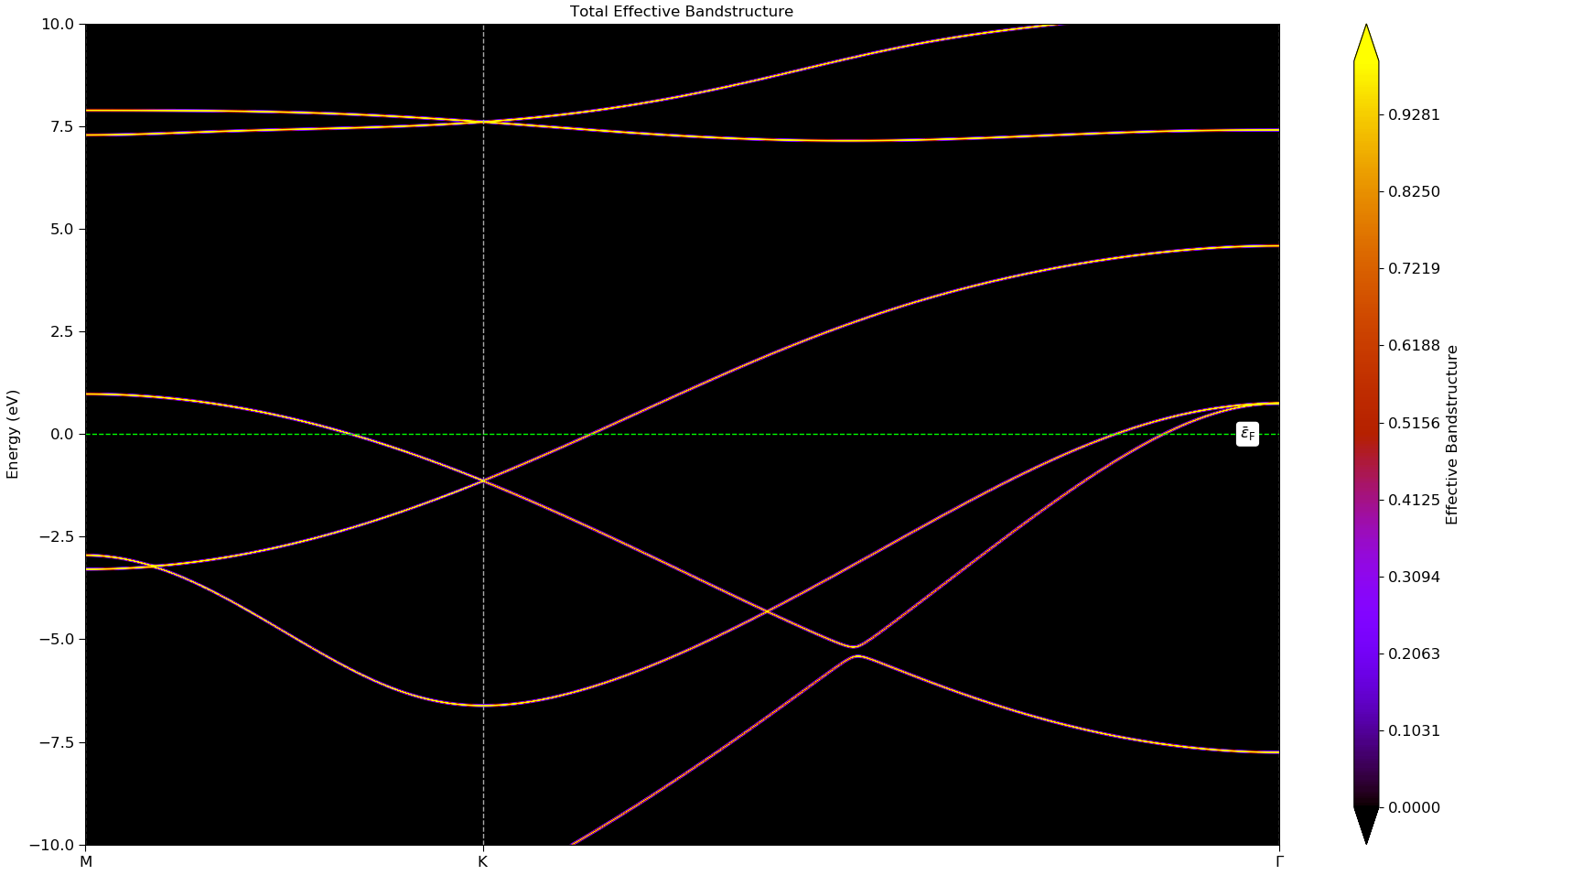
Simulations – 100% coverage
2 hydrogen per 2 carbon

Slide 25
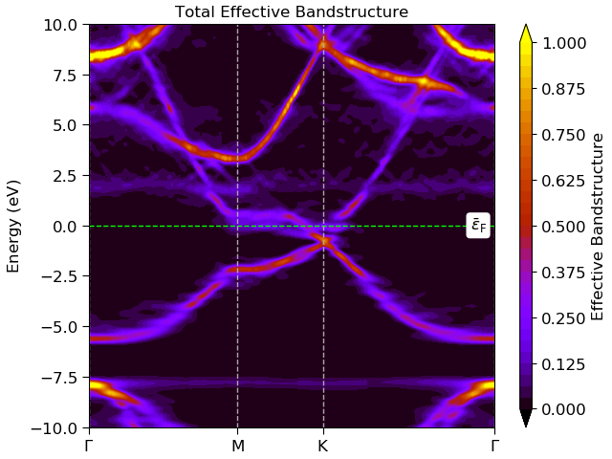
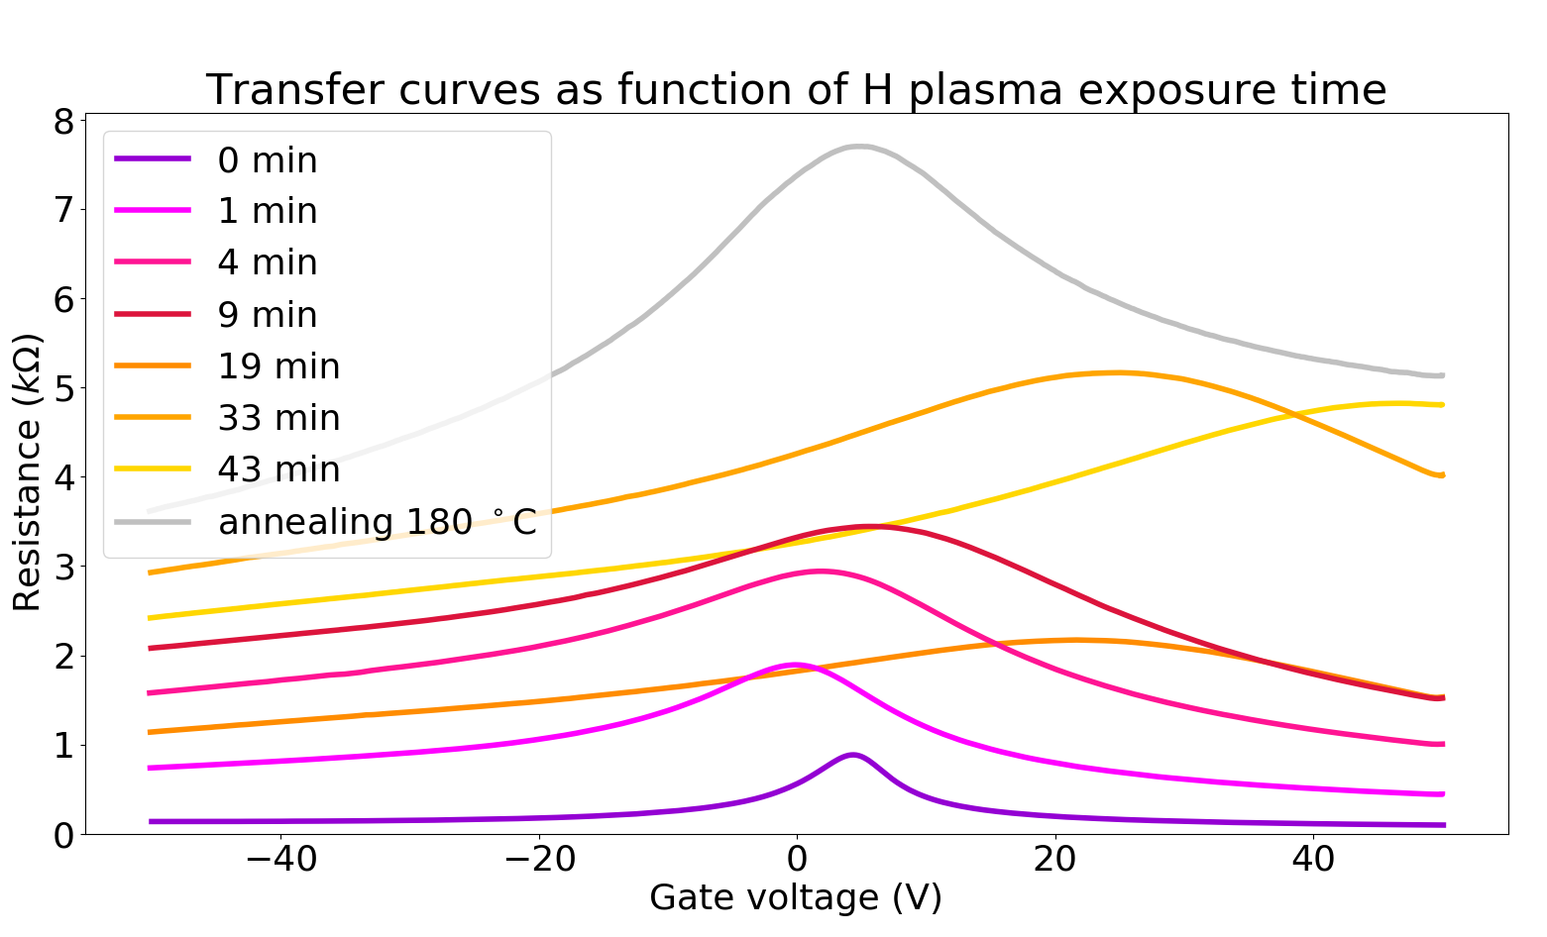
Compare simulations to hydrogenation results

Slide 26
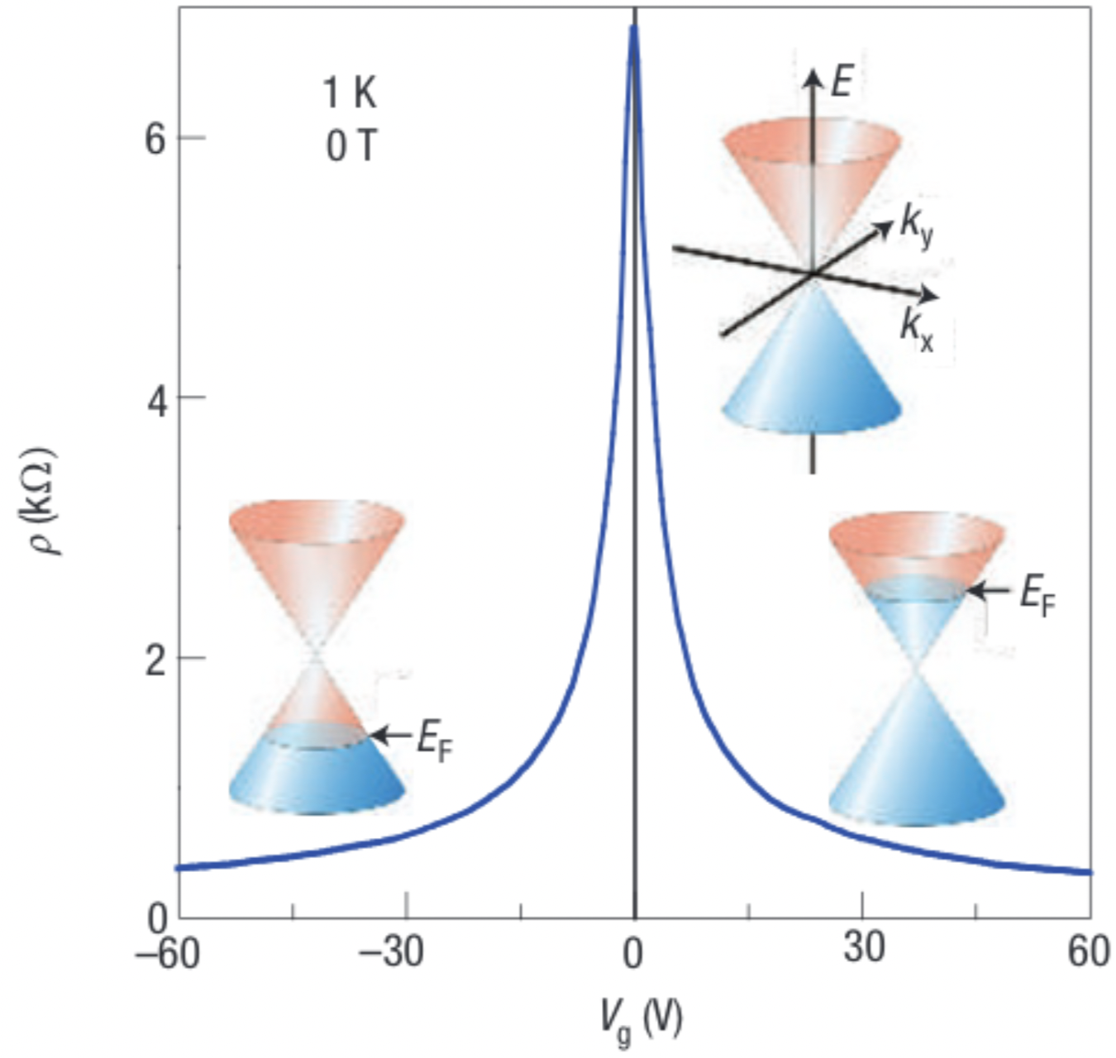
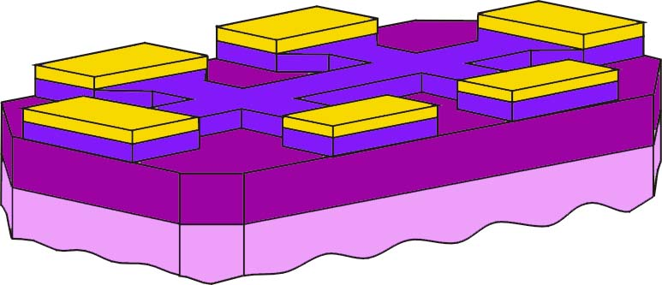

Graphene Field Effect Transistor
Au contacts
graphene
SiO₂
gate insulator
Si backgate
Graphenea, GFET-S10 data sheet
Geim, A. K. & Novoselov, K. S. The rise of graphene. In Nanoscience and technology: a collection of reviews from nature journals, 11–19 (World Scientific, 2010)

Slide 27
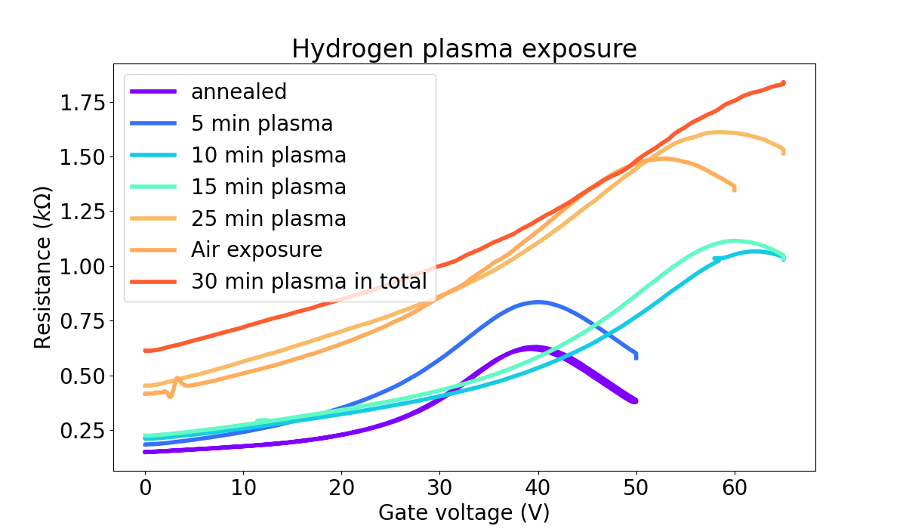
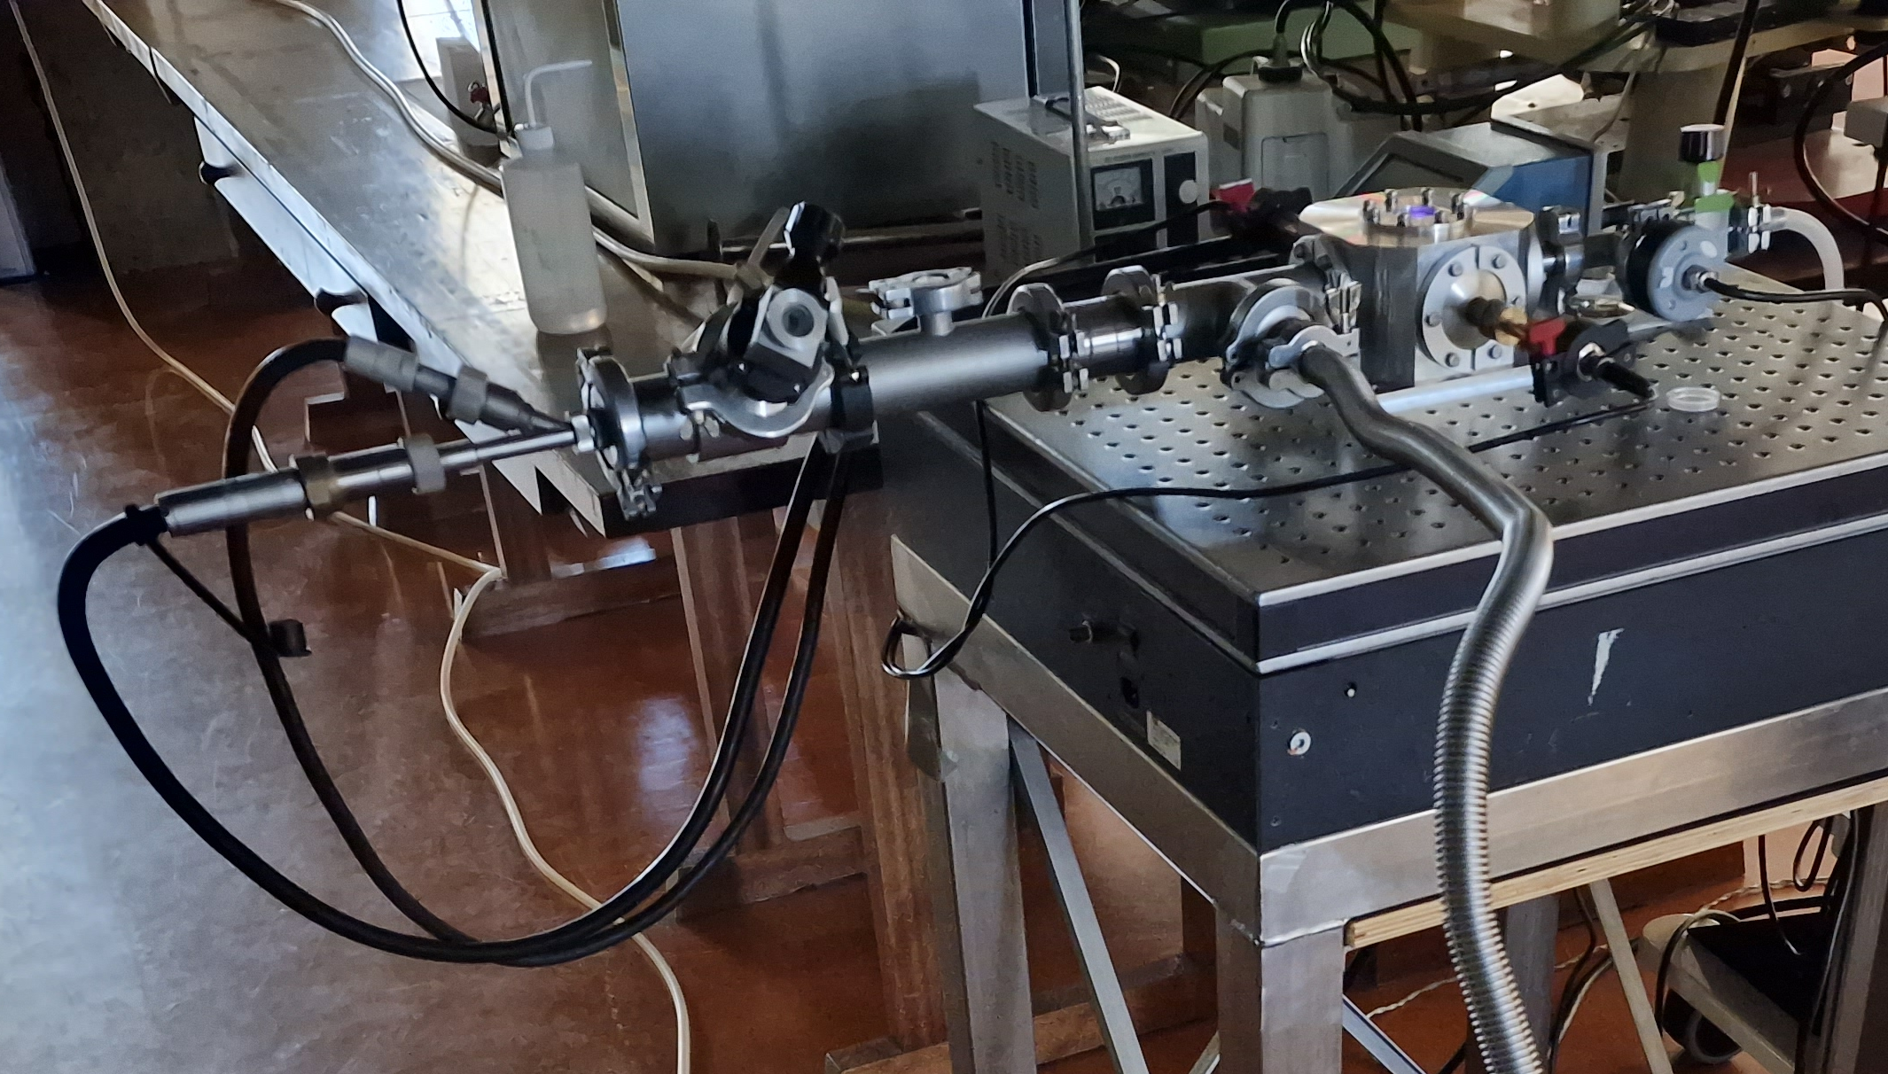
Hydrogenation process
Start with annealed sample
Exposed 1 mbar hydrogen plasma for 5 minutes
Exposed to air for 10 minutes
Repeat until we reach the wanted state
Notes:
Hydrogenated both samples, meanwhile cooling them with liquid nitrogen to check when the band gap starts to open -> 80s for first sample, 25 min for second

Slide 28
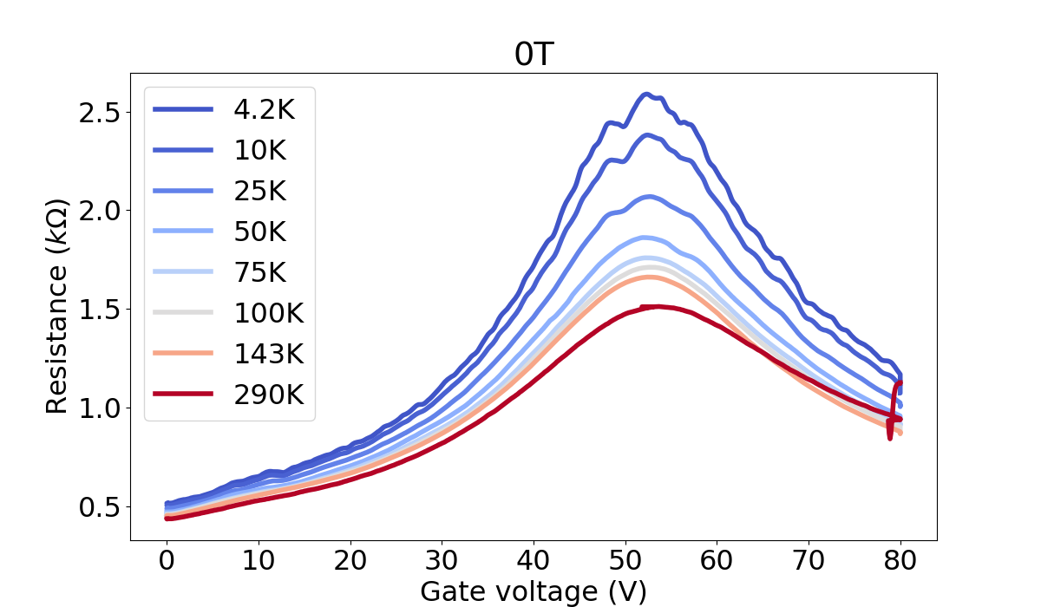
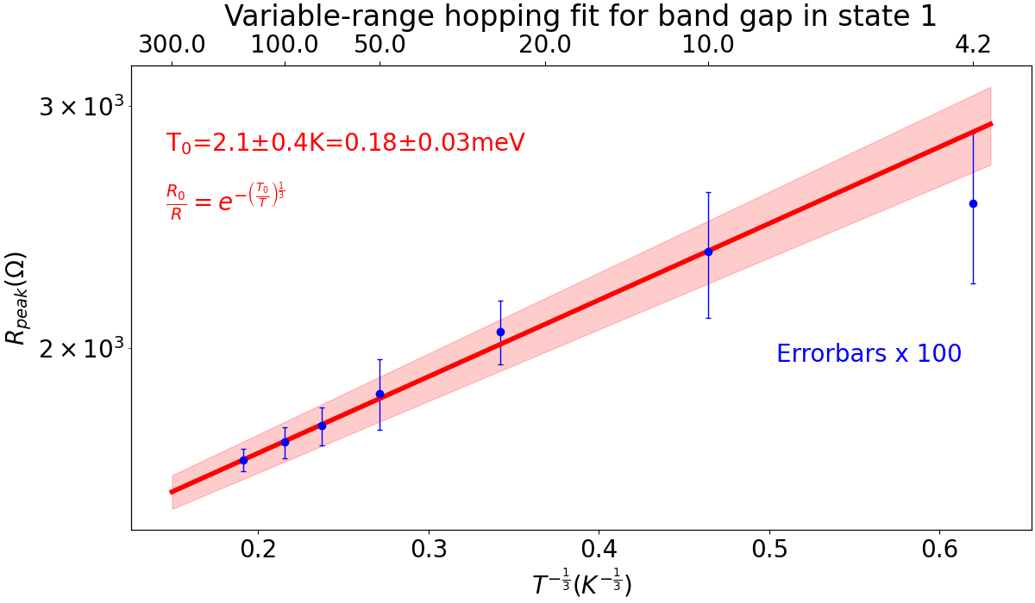
Temperature dependence
Peak resistance increased as temperature decreased
Pristine state: no temperature dependence
From vrh fit: band gap 2.1±0.4K

Slide 29
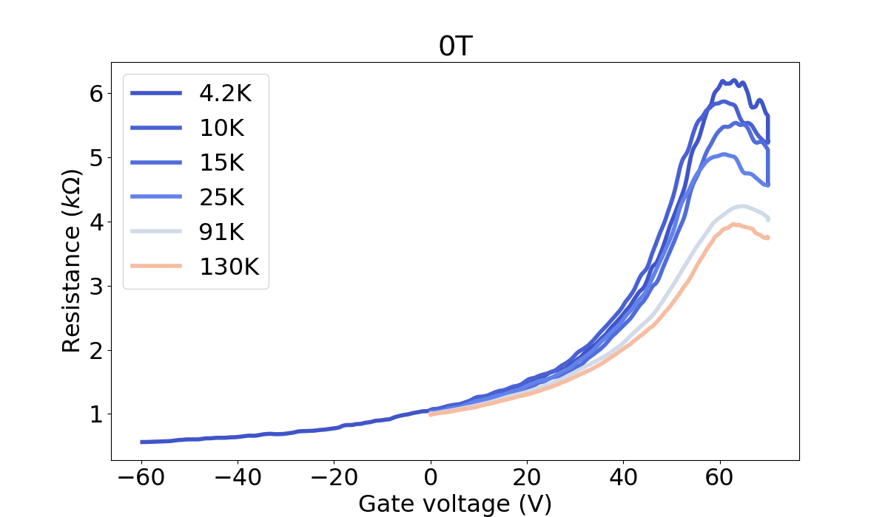
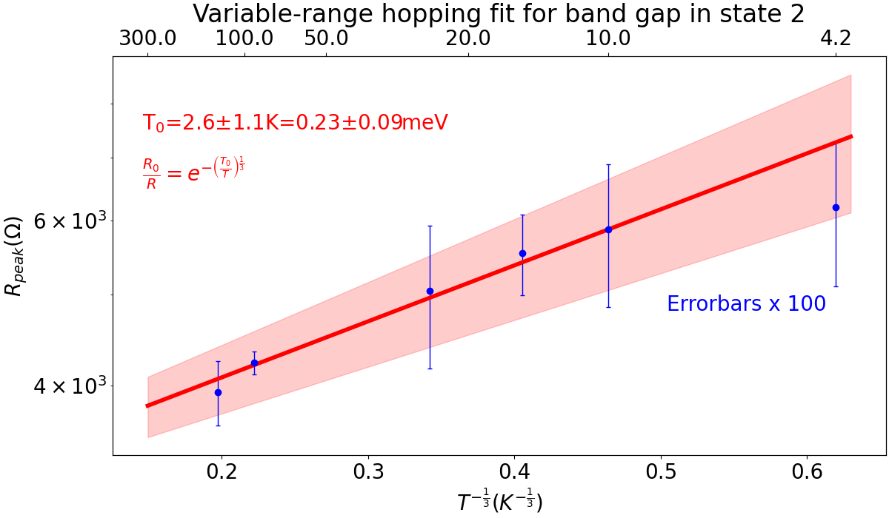
Temperature dependence
Neutrality point shifted
Temperature dependence similar
From vrh fit: band gap 2.6±1.1K

Slide 30
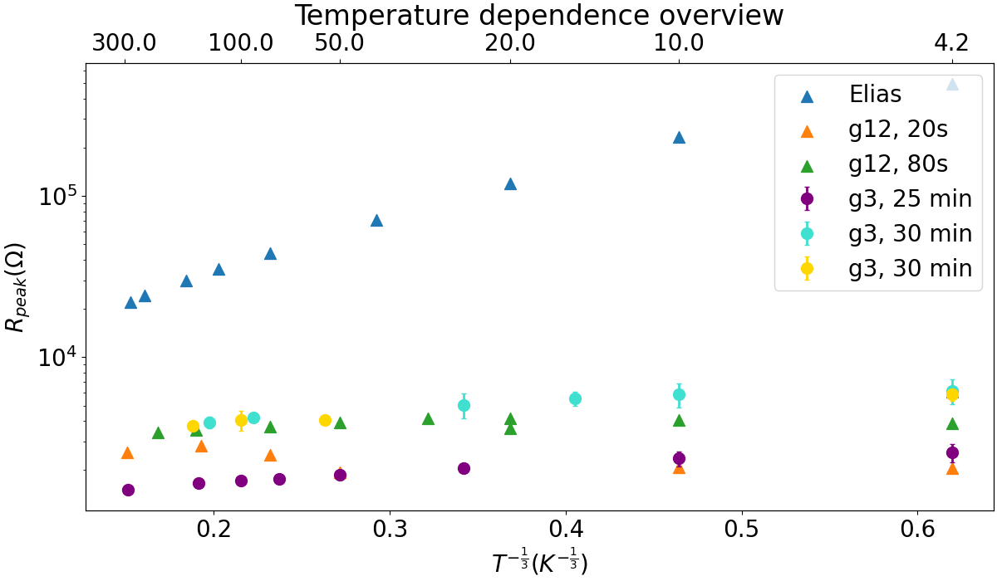
Temperature dependence
Compare samples g12 and g3
Similar band gap opening
Band gap is far smaller than for a fully hydrogenated graphene sample (Elias et al., Science 323, 610-613 (2009))

Slide 31
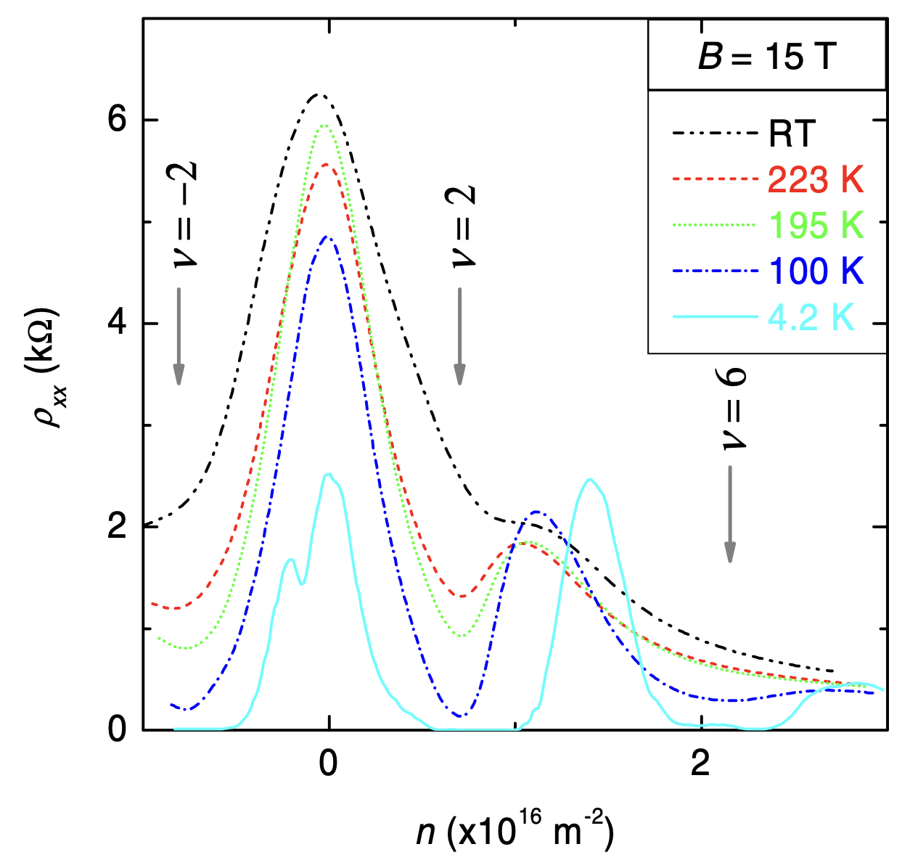
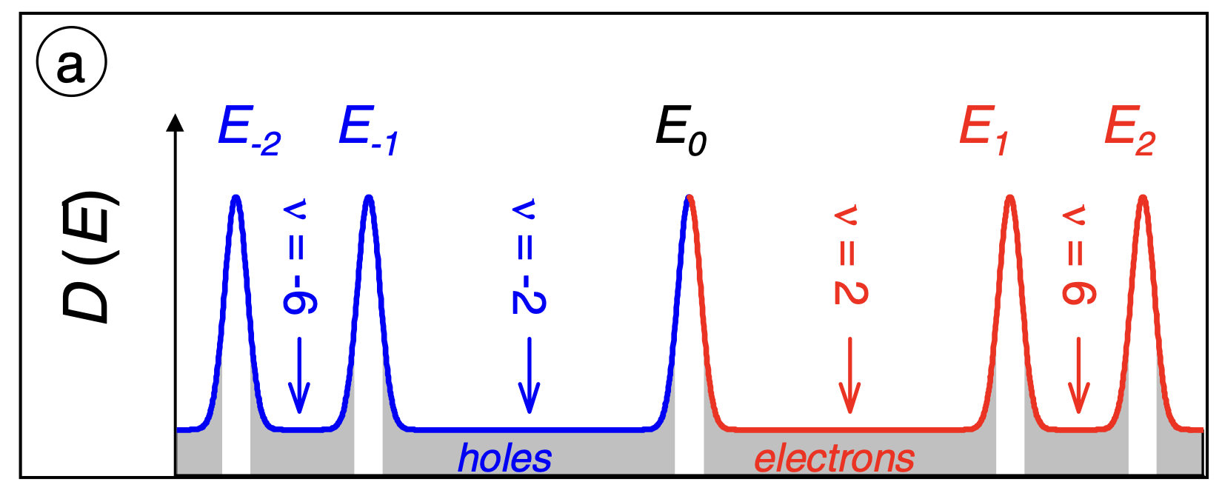
Magnetic field effects
A. J. M. Giesbers, U. Zeitler, M. I. Katsnelson, L. A. Ponomarenko, T. M. Mohiuddin, and J. C. Maan, Quantum-Hall Activation Gaps in Graphene. In PRL 99, 206803 (2007)
Notes:
At nu -2: only localised states -> no charge carriers -> no potential difference? Check with Uli

Slide 32
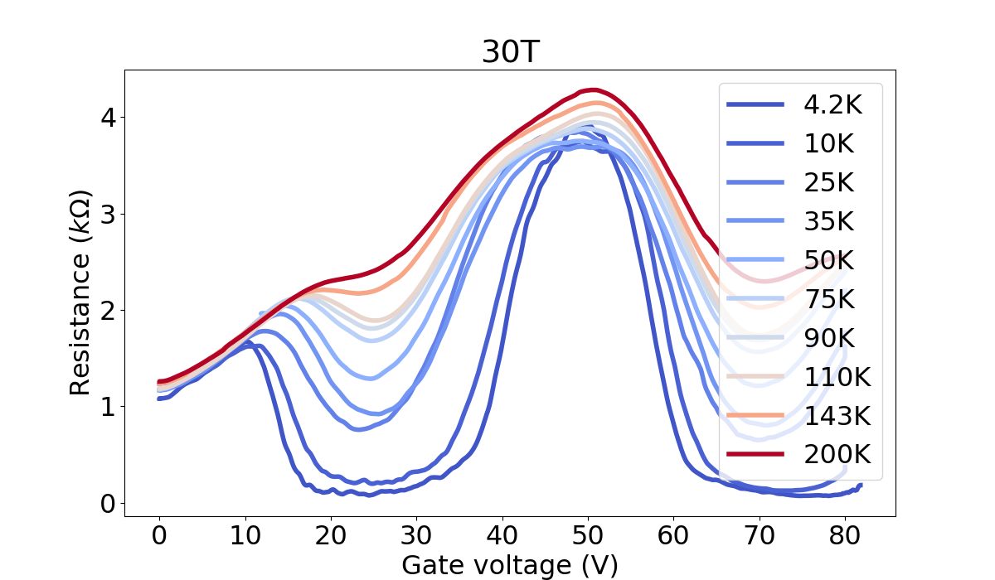
Quantum Hall Effect
𝜈=-2
𝜈=+2

Slide 33
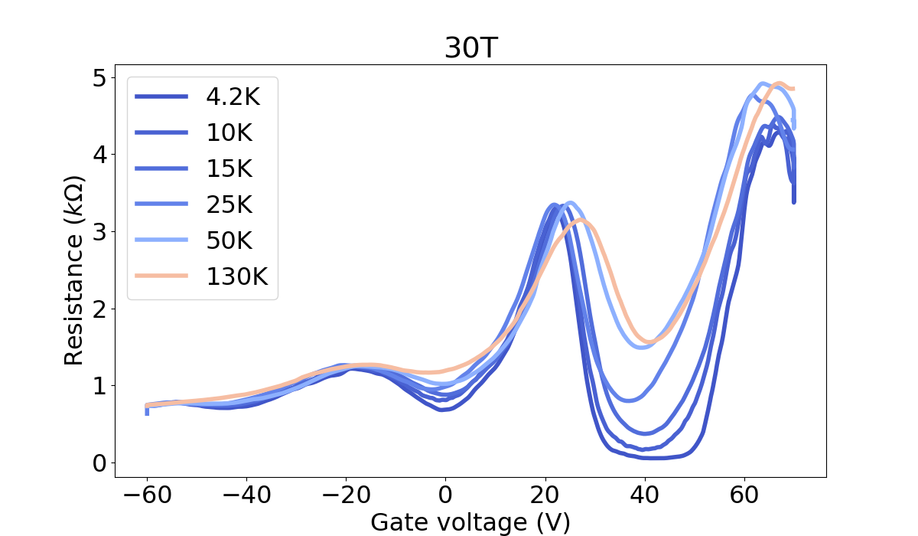
Quantum Hall Effect
𝜈=-6
𝜈=-2

Slide 34
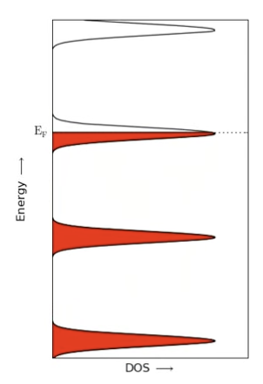
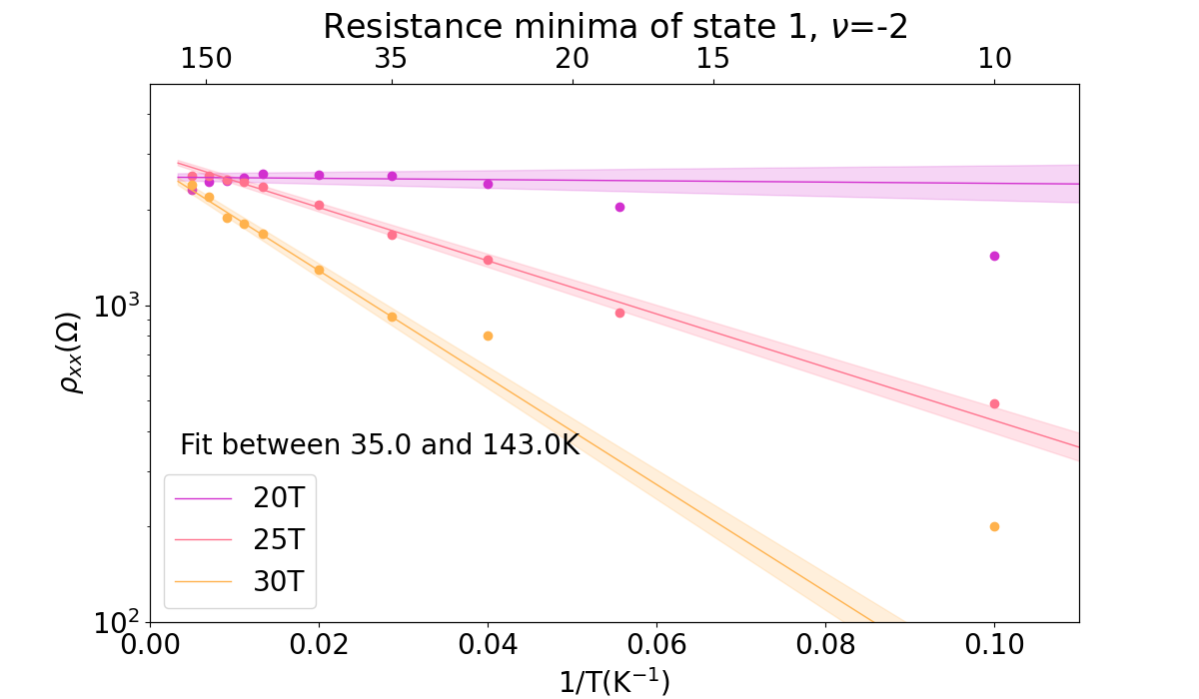
Activation energy
$$R∝exp\left(−Δ_{a}/k_{B}T\right)$$
Notes:
Pristine graphene: activation sqrt in B
Hydrogenated becomes linear due to curved band structure

Slide 35
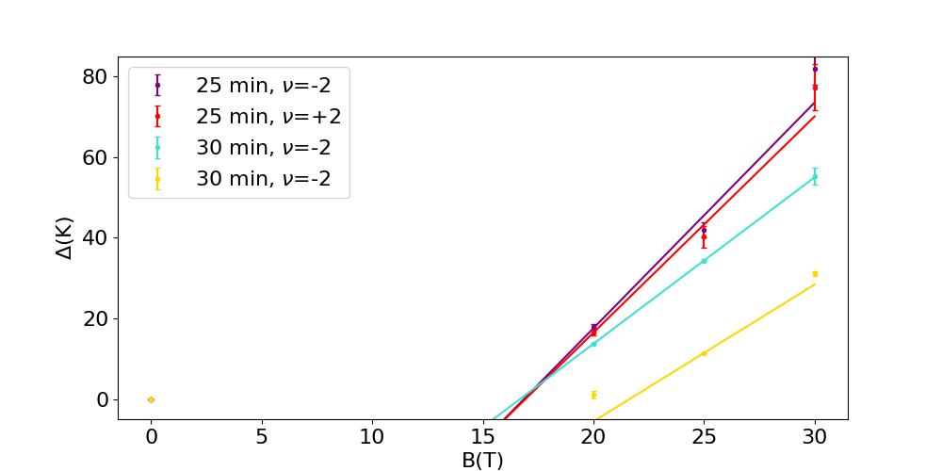
Activation energy
Activation gap depends on Landau level broadening and peak-to-peak distance
Effective electron mass can be extracted from the slope of the activation gap
25 minutes of plasma exposure, filling factor -2: $m_{}^{∗}=0,24±0.04 m_{e}$
30 minutes of plasma exposure, filling factor -2: $m_{}^{∗}=0,4±0.1 m_{e}$
For pristine graphene, Δ∝$\sqrt{B}$
$$Δ=\frac{ℏeB}{m^{∗}}−Γ$$

Slide 36
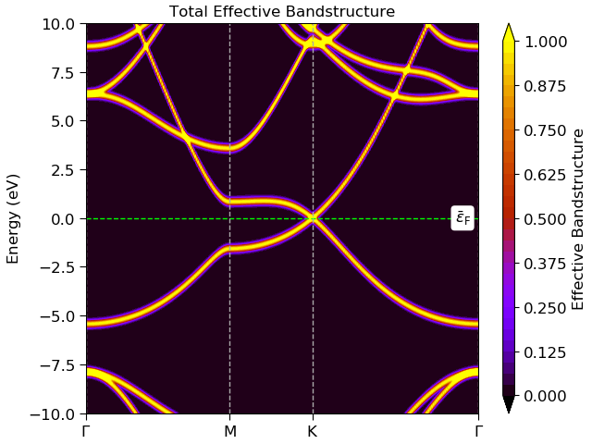
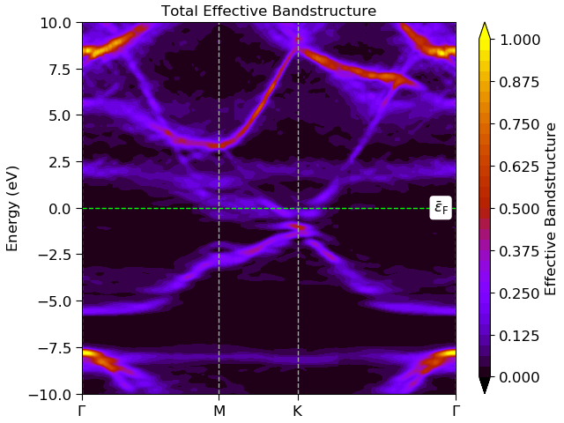
Simulations
Pristine graphene
12.5% H coverage

Slide 37
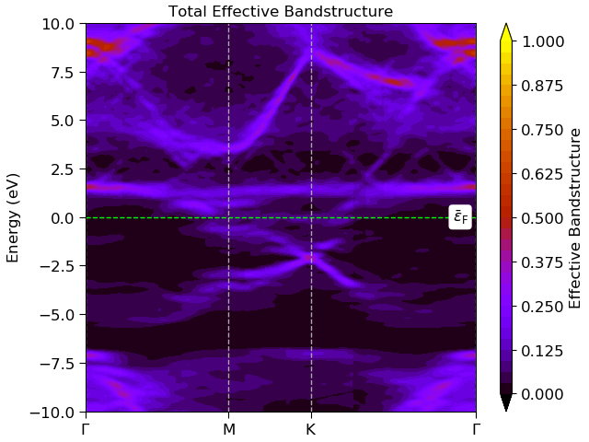
Simulations
Pristine graphene
25% H coverage

