Slide 1
Update on upconverter design, closed loop test & Firmware design (ALPACA)
M. Naafs, P. Bos
Nikhef contributors: M. Naafs (EE), P. Bos (EE), G. Visser (EE),
M. Adams (ME), V. van Beveren (SWE), T. Damen (SWE),
J. Mead (Phys), A.P. Colijn (Phys)
July 2nd 2025

Slide 2
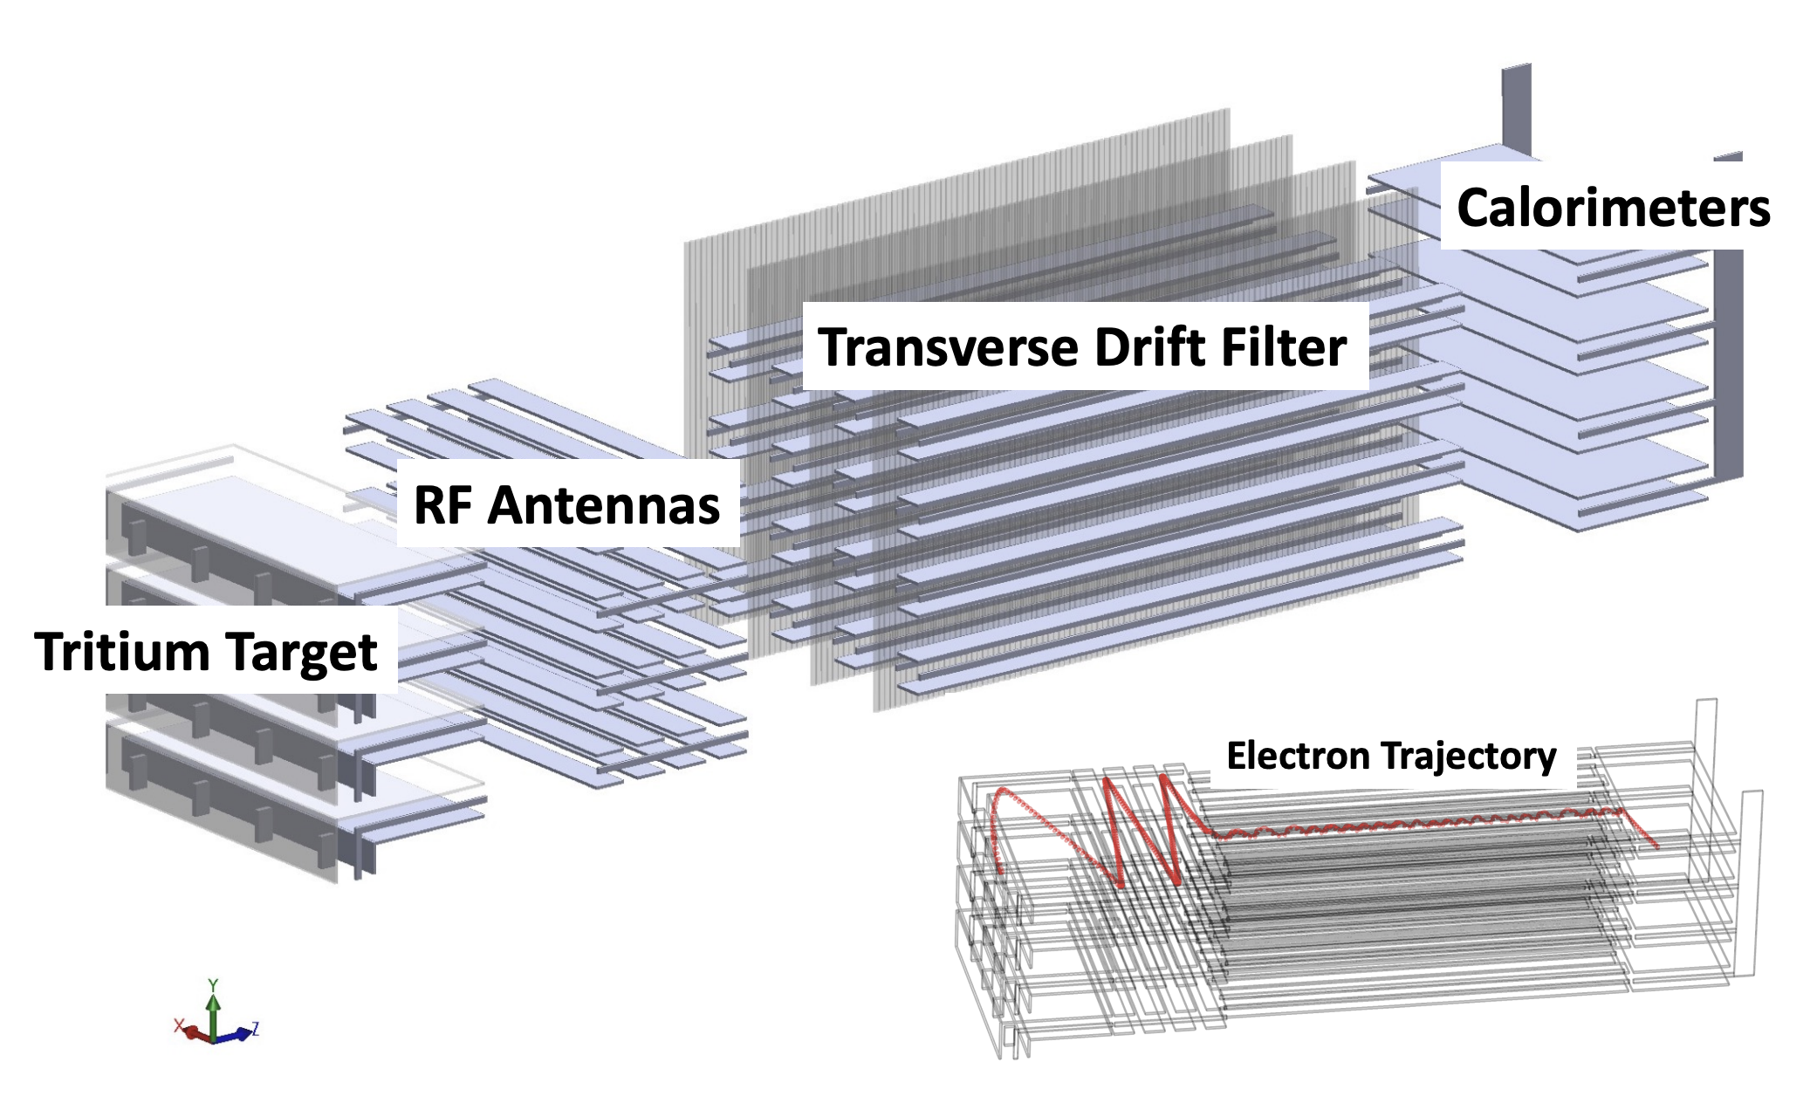
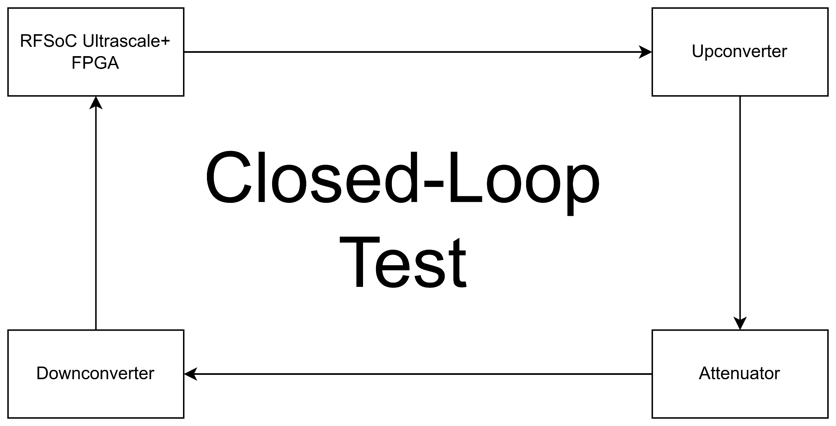
RF readout: cryogenic amplifier & downconverter
Low noise amplifier

Slide 3
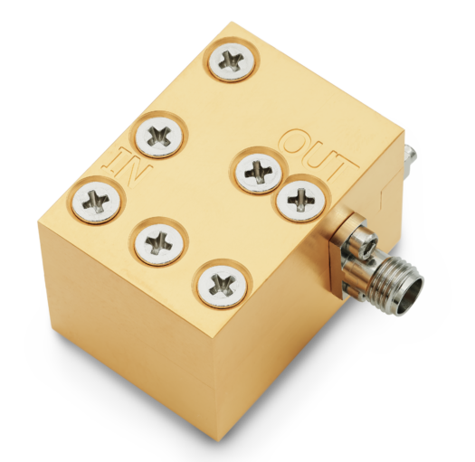
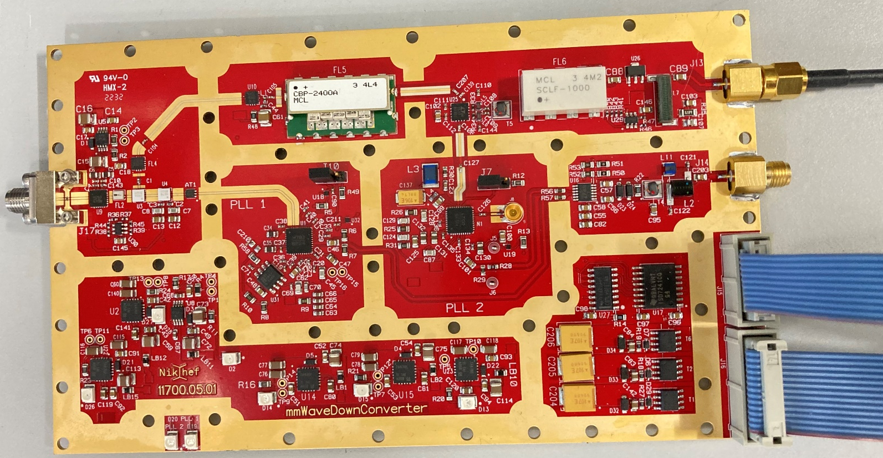
Previously: cryogenic amplifier & downconverter
Input range: ~ 25.5 to 27.5 GHz
Ouput centred at ~ 450 MHz
Expected signal power: -130 dBm to -120 dBm
(0.1 fW to 1 fW)
Cryogenic amplifier gain: 28 dB (~630x)
Downconverter input: -102 dBm to -92 dBm
(0.1 pW to 1 pW)
Downconverter is currently in use at LNGS
How weak of a signal is -120 dBm?
-Receiving at earth, the light from a 100 W light bulb on the moon
-Deep Space Network (DSN) uses 34 m dish antenna to receive -120 dBm
(S-band) from James Webb Space Telescope (1.74 Gm away)

Slide 4
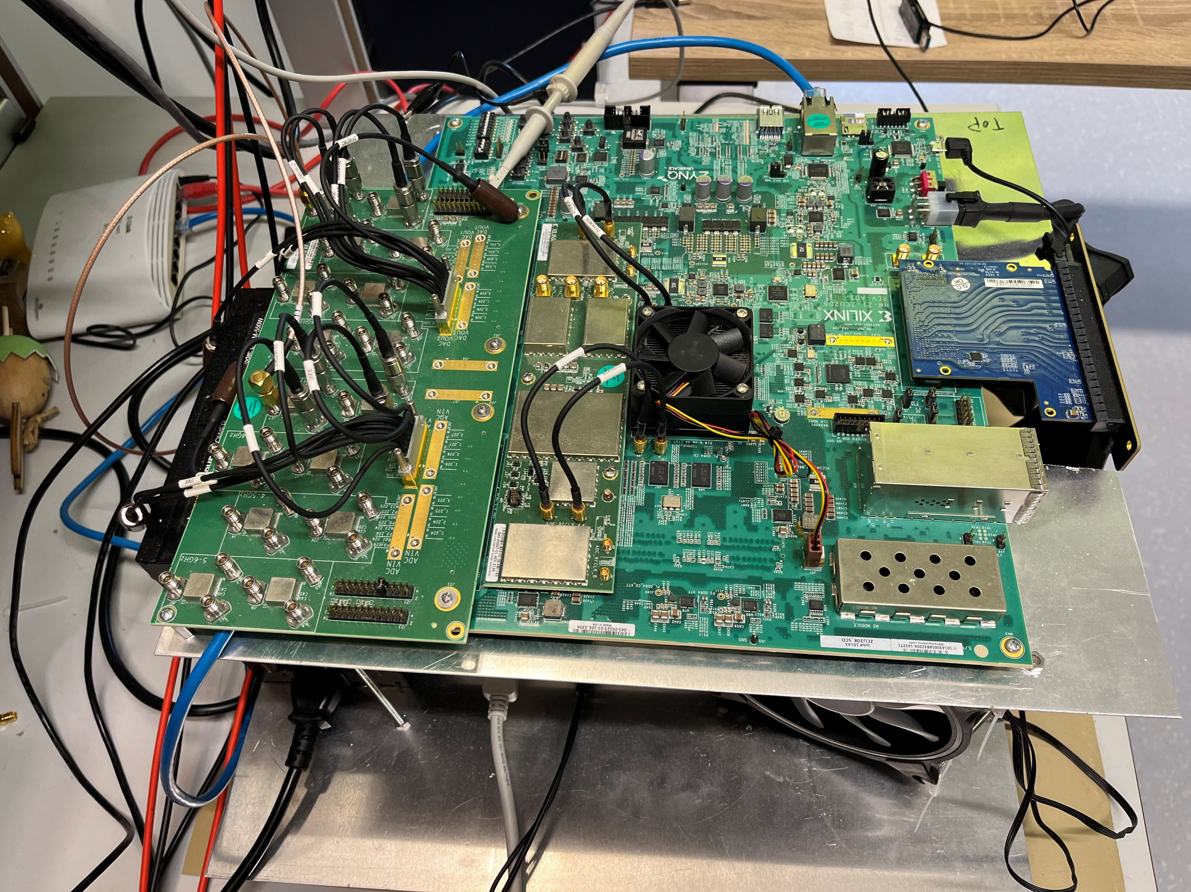
Data readout & A/D conversion
Analogue – digital conversion done by Xilinx RF-SoC Ultrascale+
8x 5 GSPs ADCs
8x 10 GSPs DAC
Used to make FFTs and stream data to disk
FW made by Pascal Bos

Slide 5
Why do we need an upconverter?
To make a “closed loop” test →
Inject a self-made test signal
Test detection algorithms
Why make one?
No really viable options are available for purchase on the market
FPGA Dev-board
+ gaming PC
Made at Nikhef
Commercial unit
Previously made at Nikhef, now in use in Italy

Slide 6
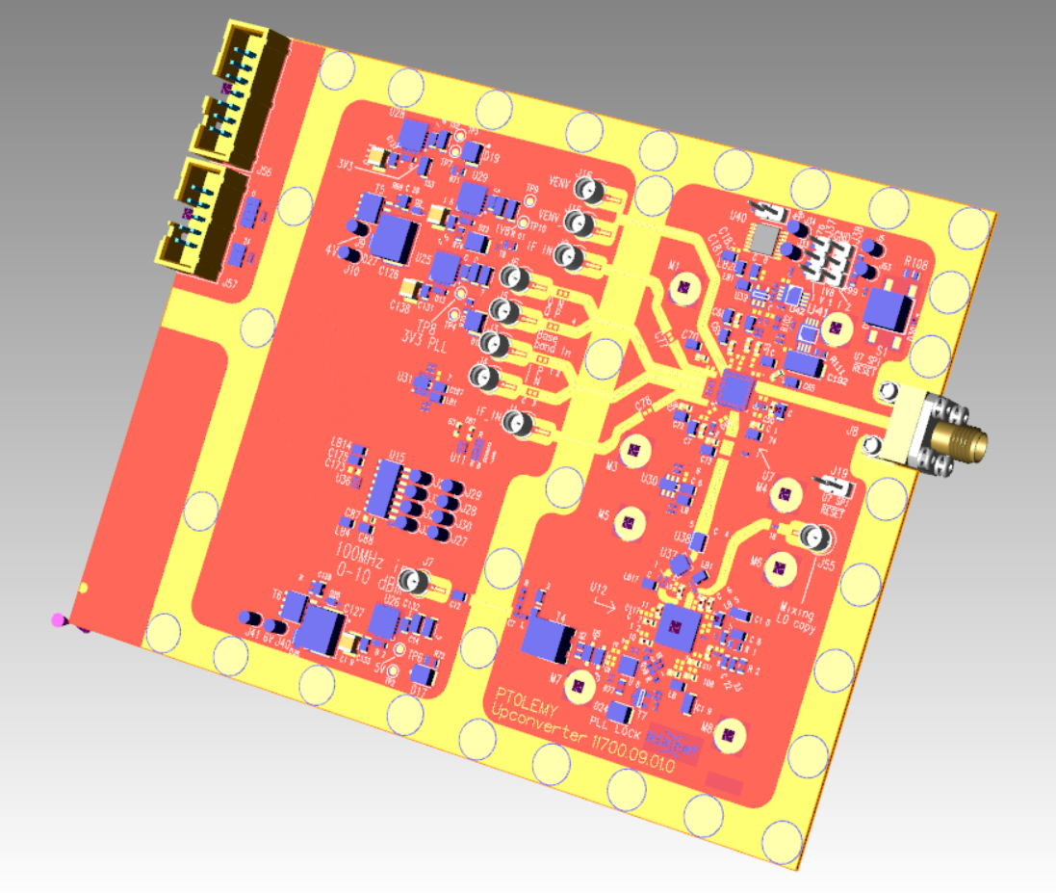
Currently: Upconverter PCB
Design is finished
Production quotes have been requested → will be ordered when quotes are in & chosen
Upconverter specs
Baseband input: DC – 6 GHz
IF Input: 800 MHz – 6 GHz
RF Output: 24 – 44 GHz
RF output power: ~3 dBm

Slide 7
Block schematic of the upconverter
I (0)
26.5 GHz
mm wave out
RF SOC
DAC
Mixer
Q (90)
Internal
4 x lo
→ To attenuator
0
180 Deg
Low noise
Power supply
SPI
control
Controller
board
Balun
LO aprox. 5 GHz.
Controller
board
100 MHz in
LO
(PLL)
Ref shaper
upconverter
7

Slide 8
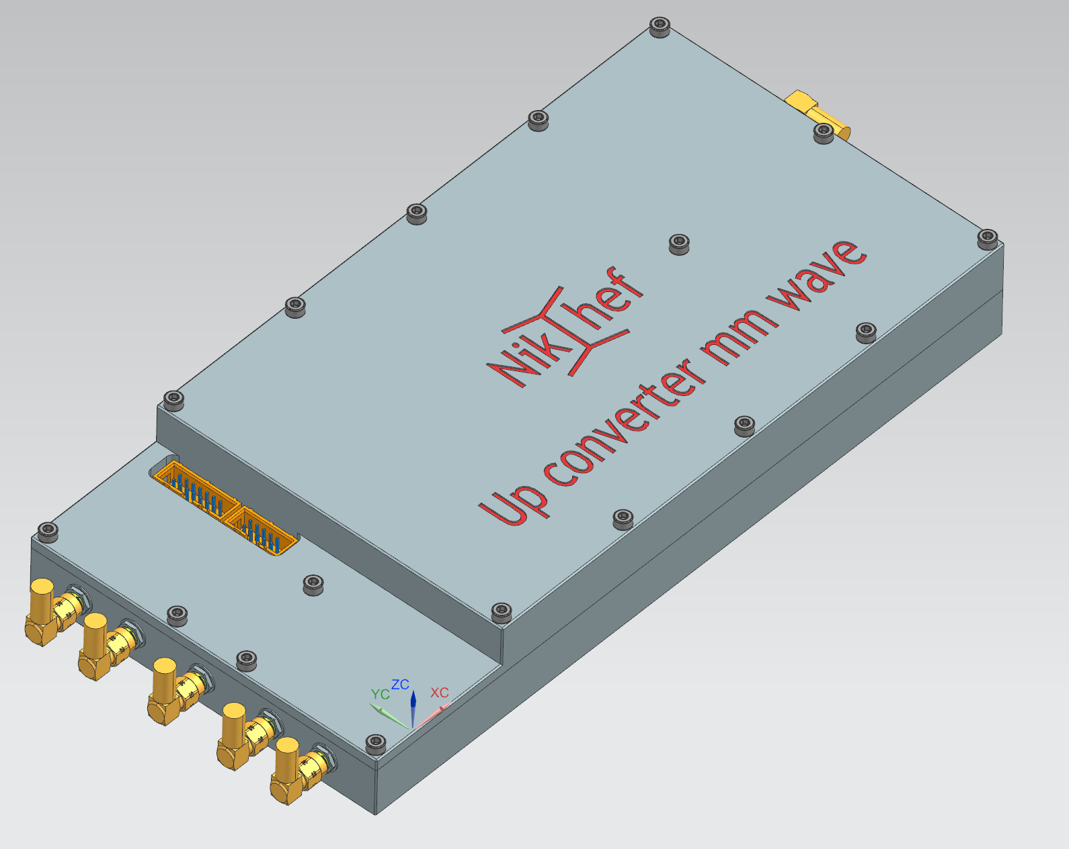
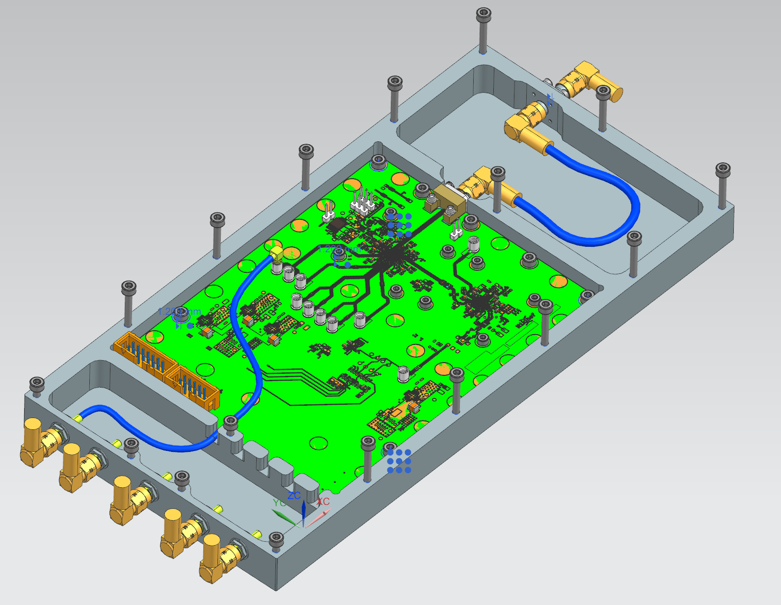
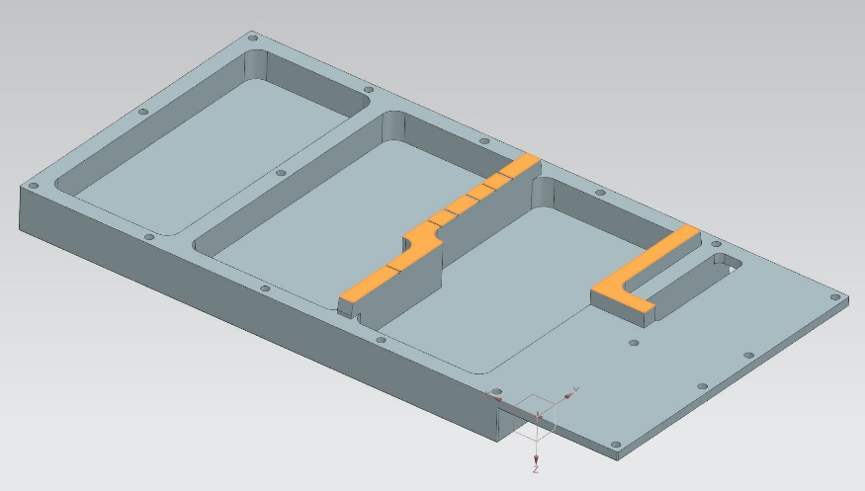
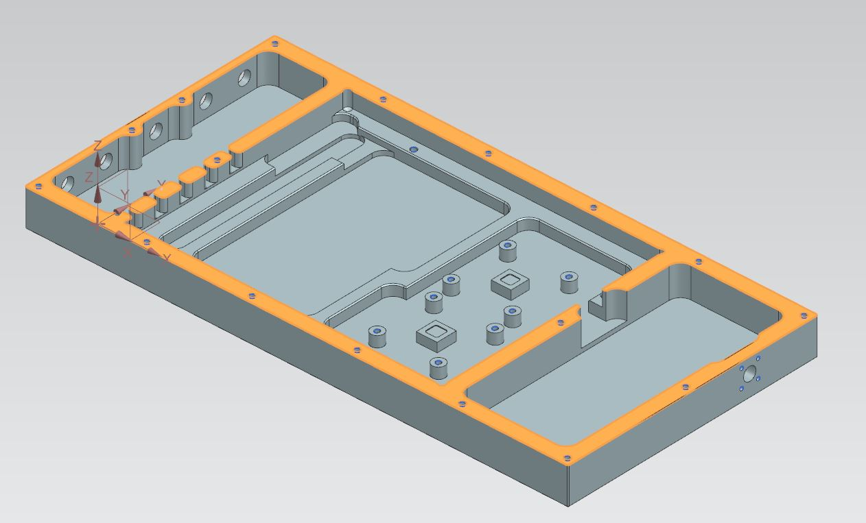
Upconverter housing
Upconverter housing has been made
Next steps:
-Send to company for coating
-Order RF seals
Why put upconverter in a shielded box?
Radiated signal through air might swamp received signal on downconverter
Leaked signals might be O(20-60 dB) (~ 100x – 1E6x) stronger than att. signal

Slide 9
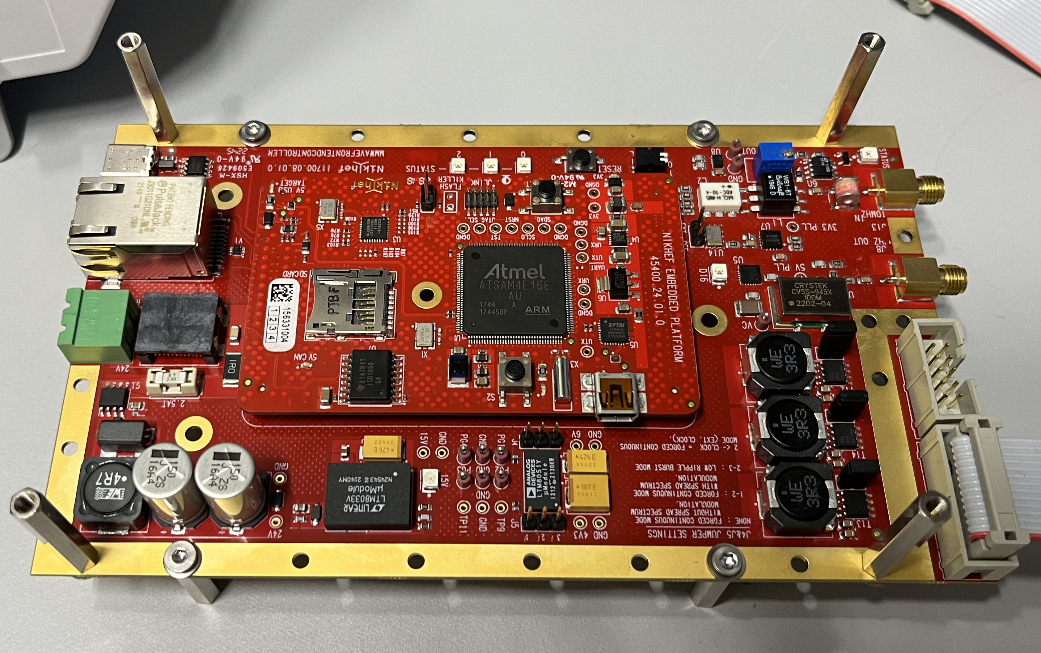
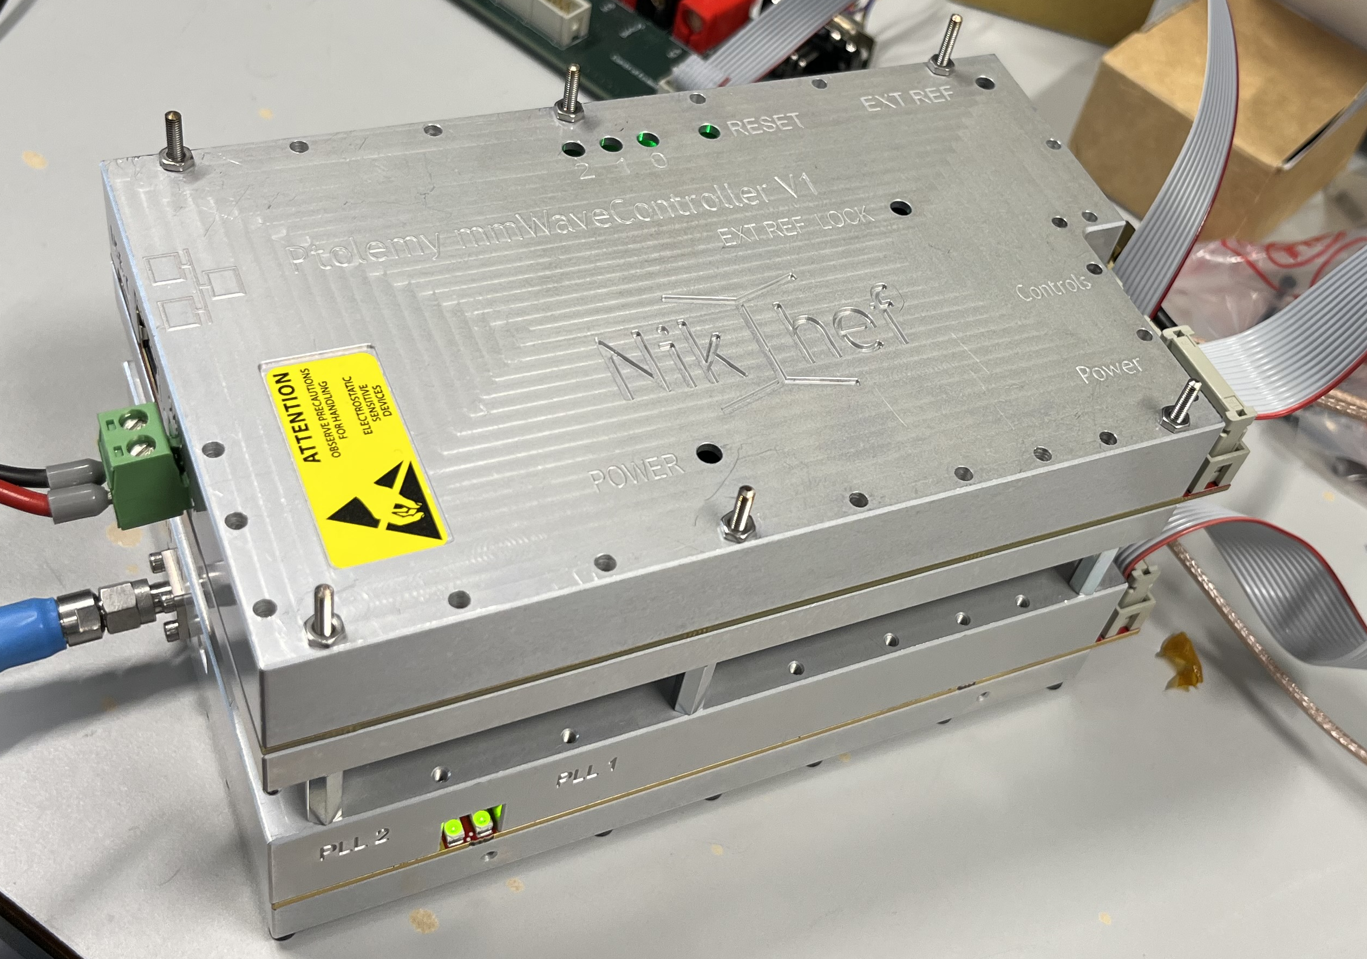
Controller PCB
For the downconverter a controller was made based on the Nikhef Embedded Platform (NEP), running Zephyr OS.
This will be reused for the upconverter

Slide 10
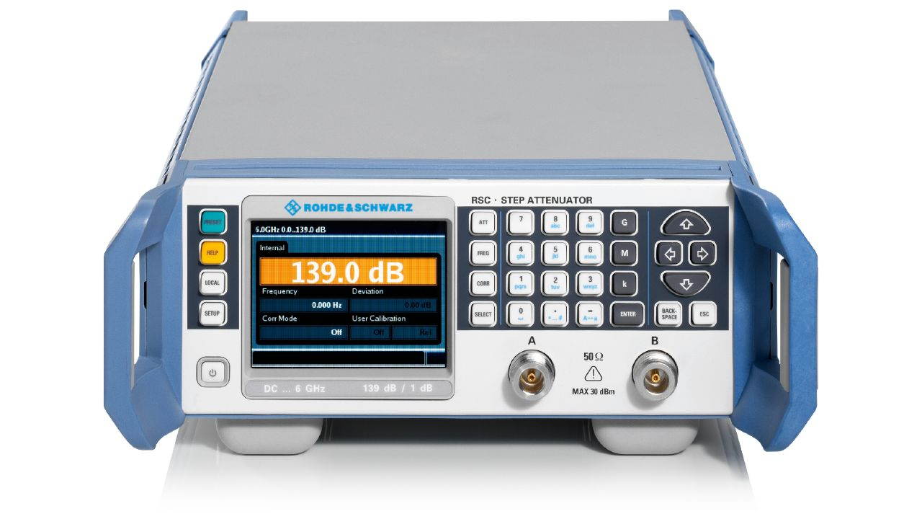
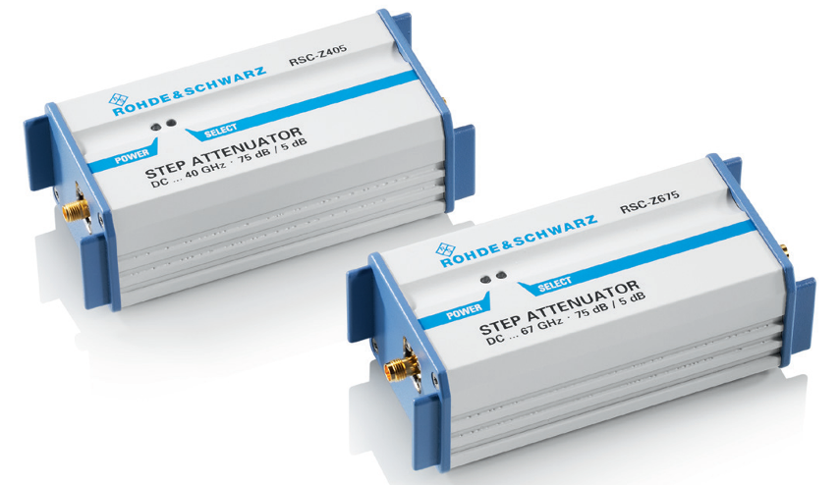
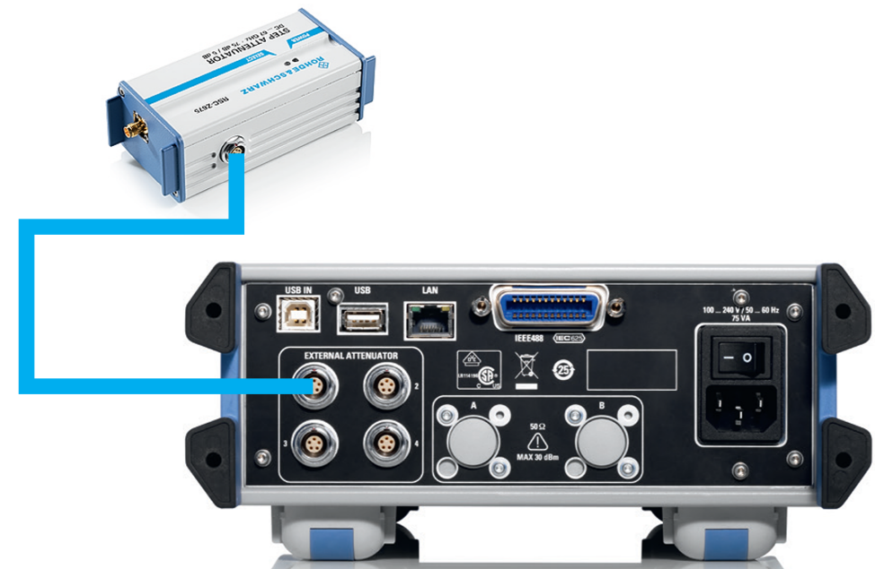
Controllable attenuator
Upconverter produces ~ 3 dBm output power → we need -120 dBm
Making controlled attenuation is hard. It is cheaper to buy than to make yourself
We chose R&S RSC controllable step attenuator
The remainder of attenuation is done with up to 60 dB of inline coaxial 2.92 mm attenuators
External attenuator (RSC-Z405):
DC to 40 GHz, 5 dB steps, 0 – 75 dB

Slide 11
On to part II, Digital design & FW
Please switch from thinking analogue to digital now ☺

Slide 12
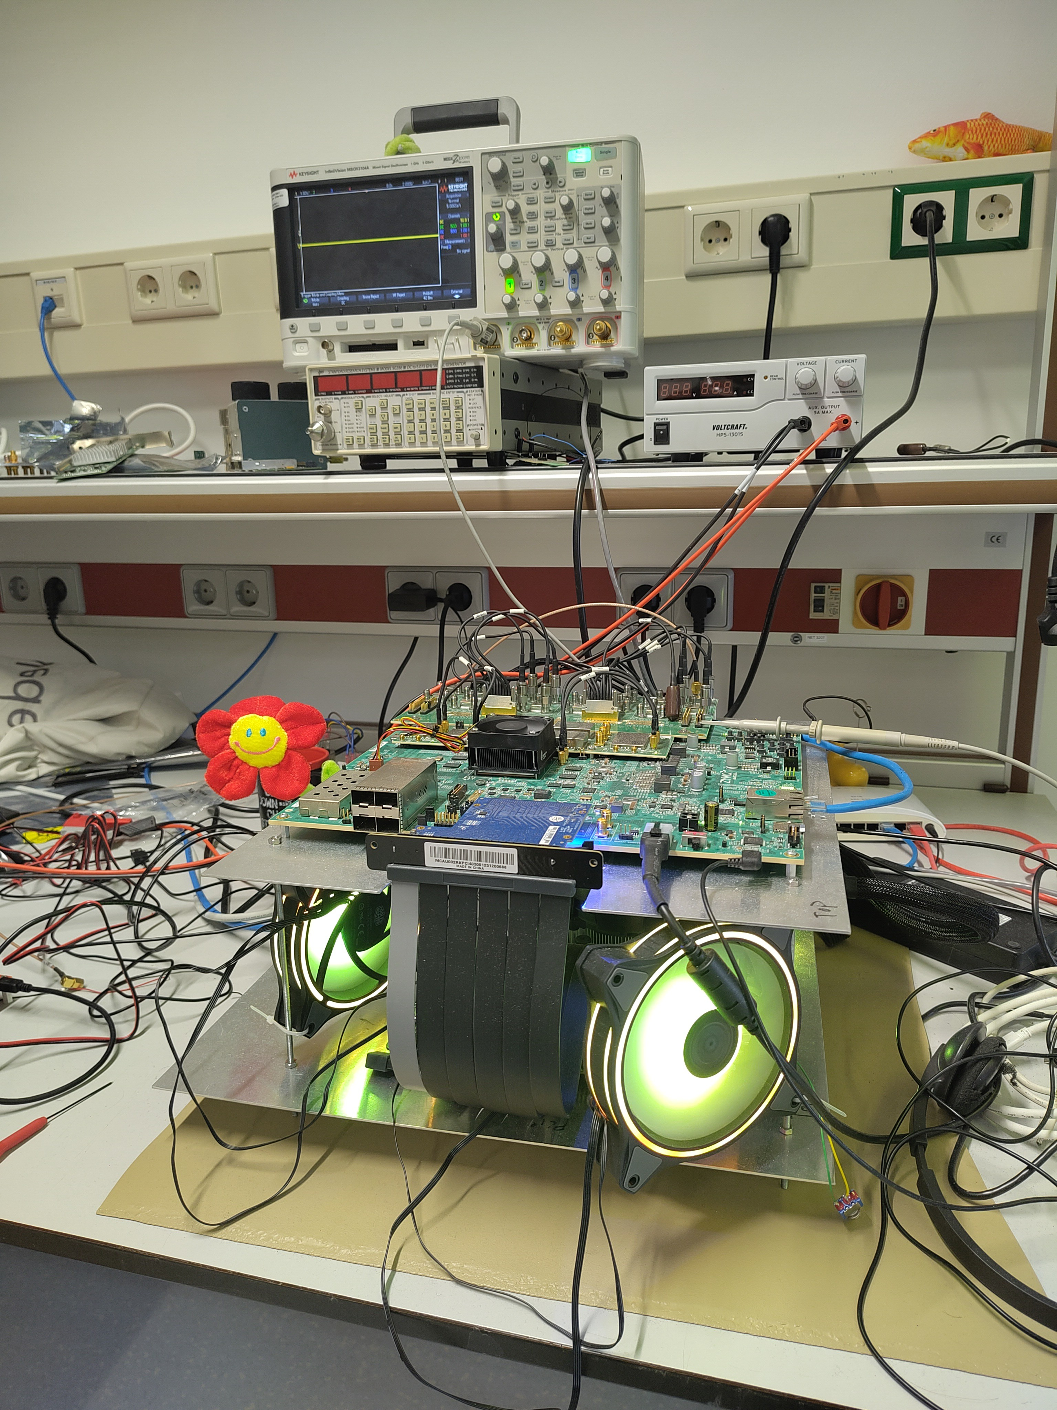
Digital design, status
What we are doing
Where we are now
Where we are going

Slide 13
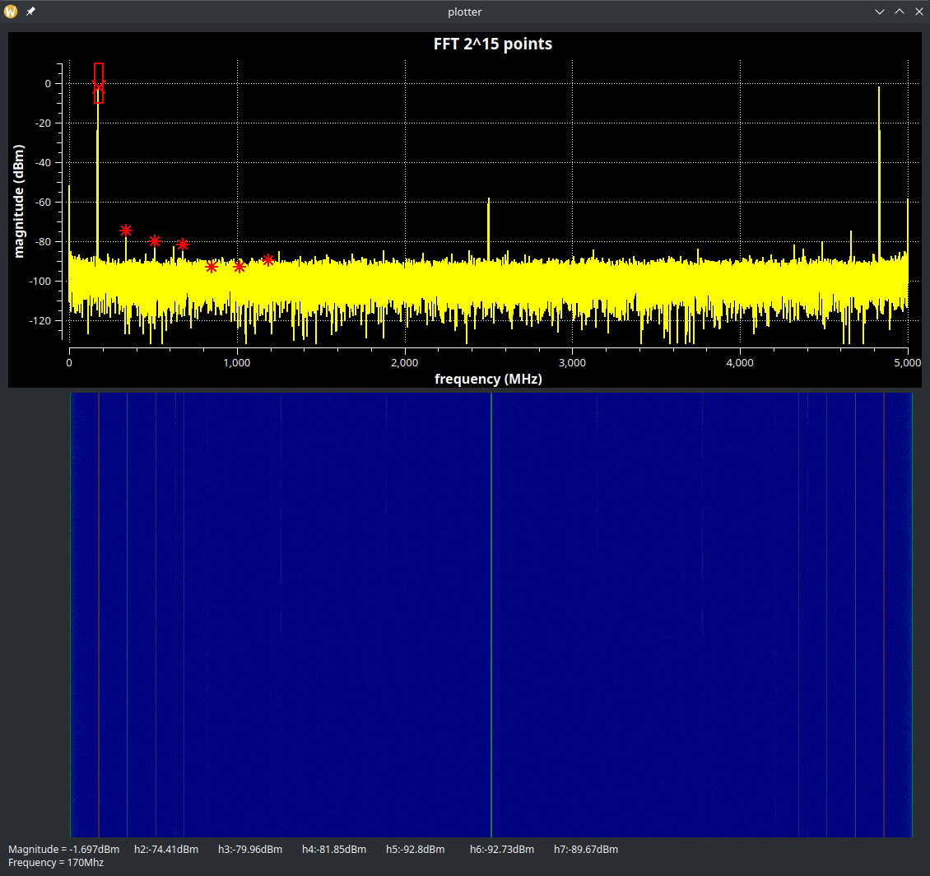
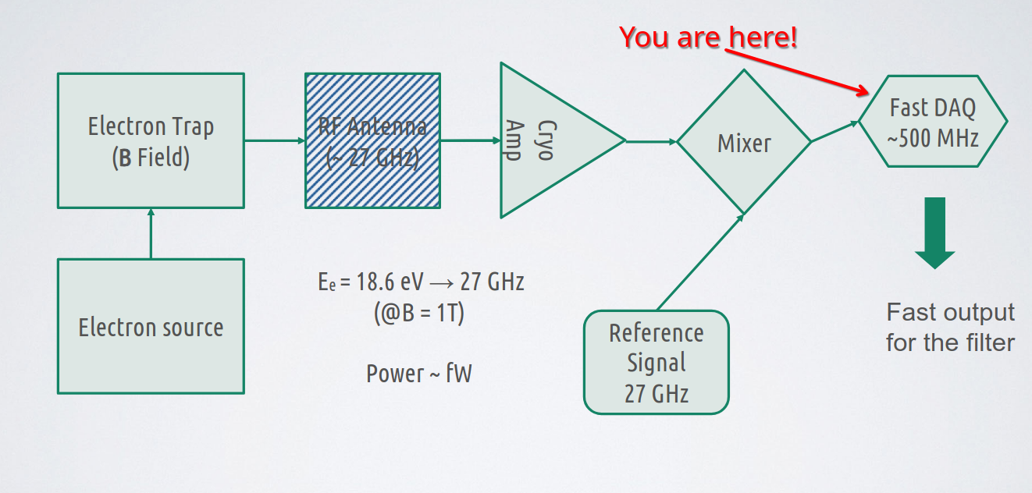
Digital design, status,
What is happening?
We are using a FPGA with integrated ADC’s to process the first signals originating from the electrons.
This is achieved by a using a 2D FFT engine, that allows lossless frequency domain transformations.
It’s called: “Advanced Lossless Processor for Analogue” Conversions and Analysis.
Or ALPACA for short. (thx chatgpt)

Slide 14
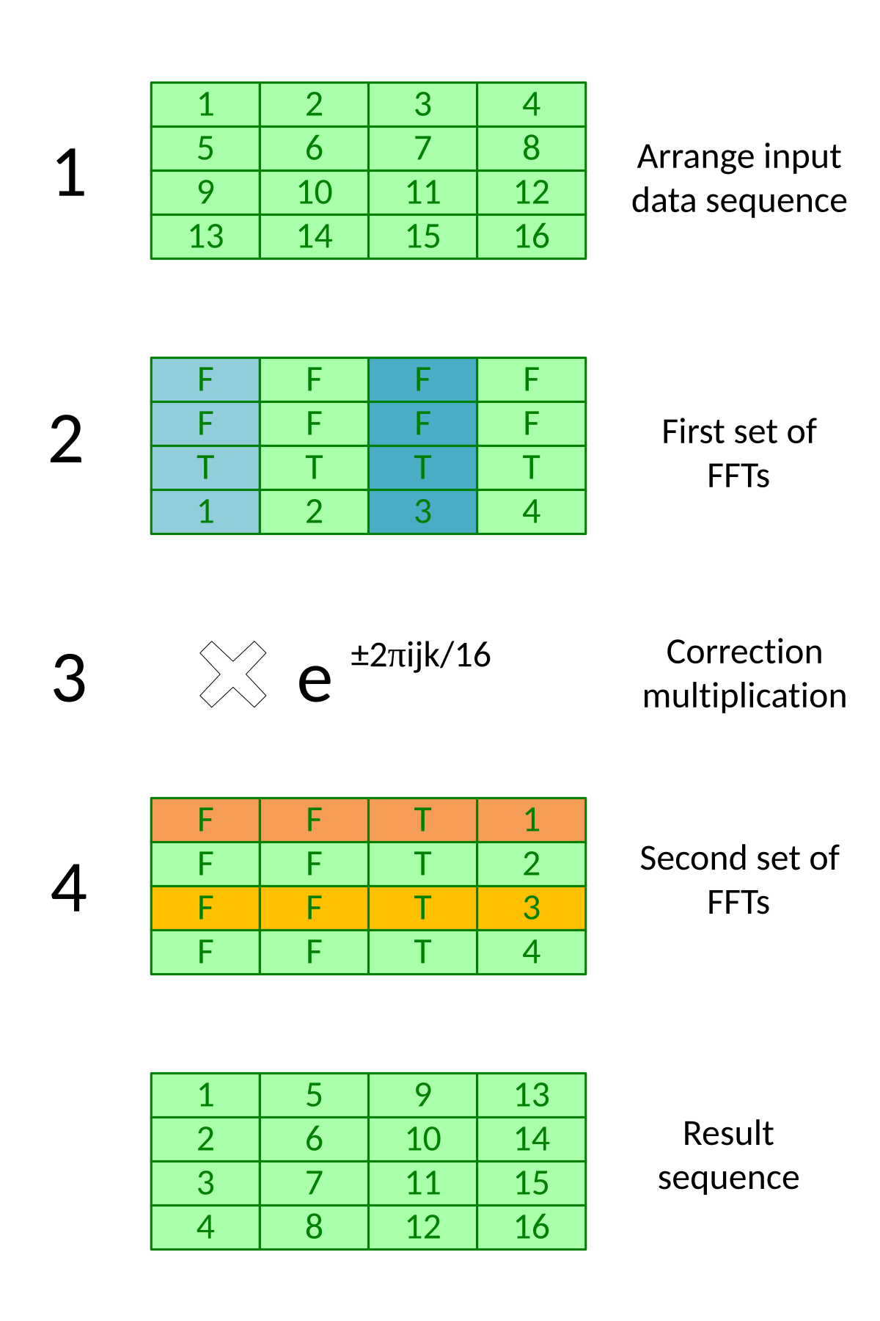
Digital design, status,
Inside Alpaca
ALPACA uses a 2D Fast Fourier Transform called “Bailey’s Algorithm”. Ideal for parallel processors and perfect for FPGA’s.
Currently we can perform 2^16 points FFT’s 13μs. Resulting in 76kHz of frequency resolution. Without throwing away a literal bit of information. (But we are Hann windowing, so some suppression is being done)
Better resolutions can be achieved by:
  Lowering sample rate (at the cost of bandwidth)
  Increase fft size (at the cost of refresh rate.)
Currently a basic trigger function is ready. By “box triggering”, this can be adjusted at run time and can be adjusted/expanded to our needs.

Slide 15
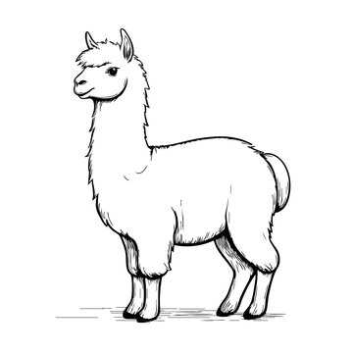
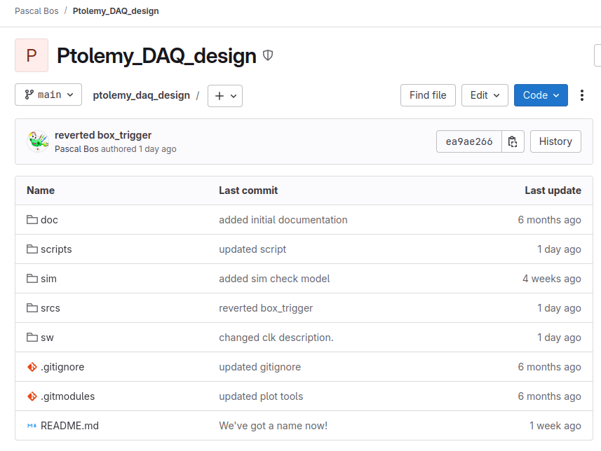
Digital design, status,
Where is alpaca going?
Future development could focus on:
  Suppressing the weighting effect. Caused by windowing (high cost because of double implementation).
  Increasing frequency resolution.
  Integrating the RFSoC into test setup at LNGS (current priority).
Sources :https://gitlab.nikhef.nl/bosp/ptolemy_daq_design
Email: pascal.bos@nikhef.nl

Slide 16
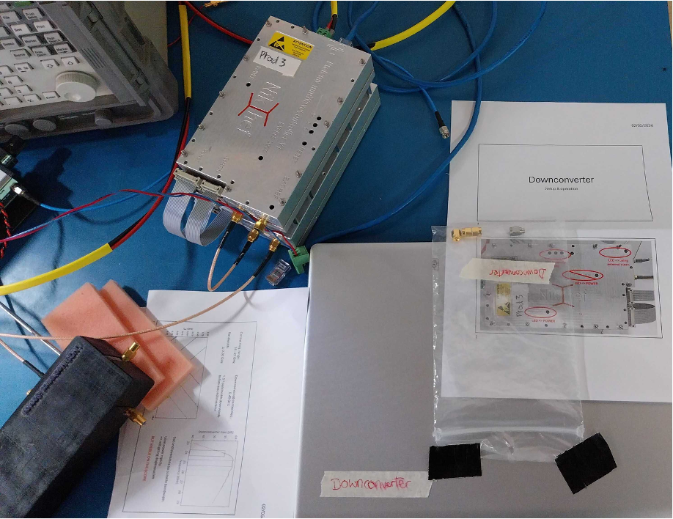
Thank you for your attention
Downconverter in use @LNGS
RFSoC for FW developemtent @Nikhef

Slide 17
Backupslides

Slide 18
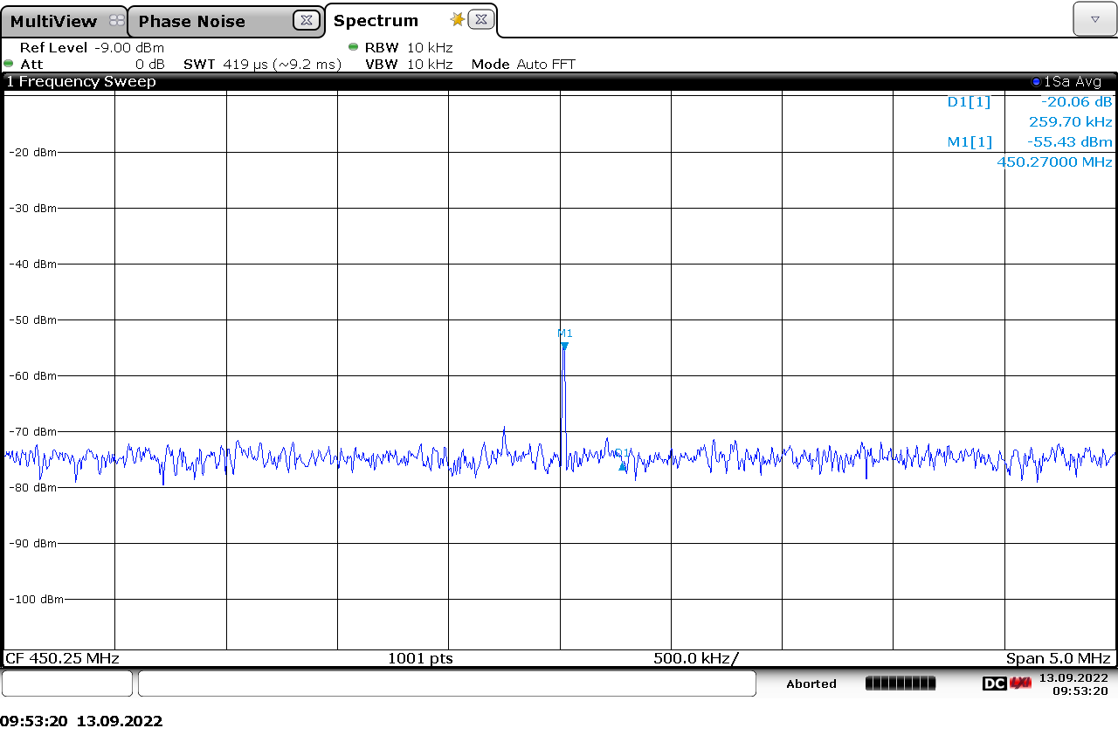
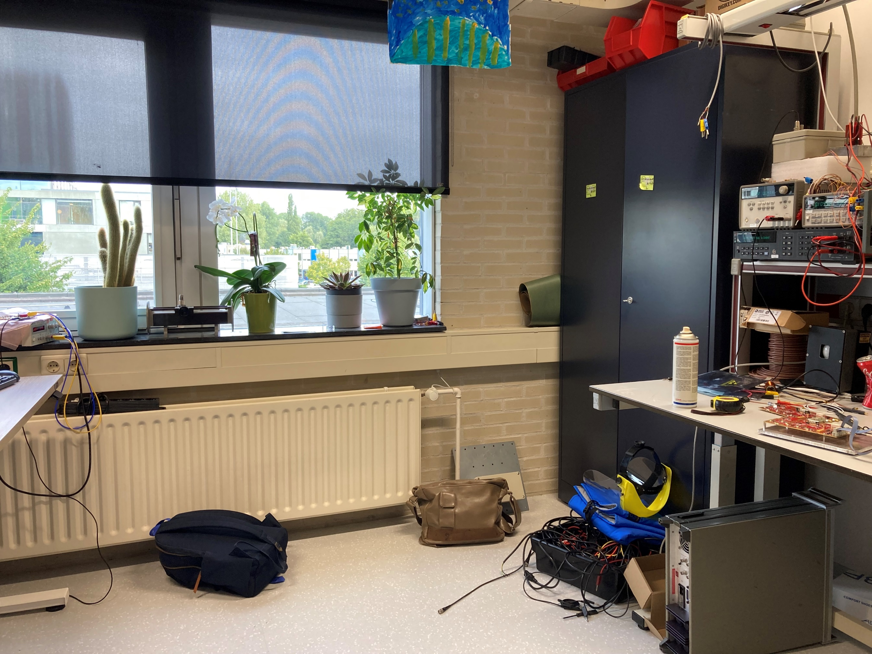
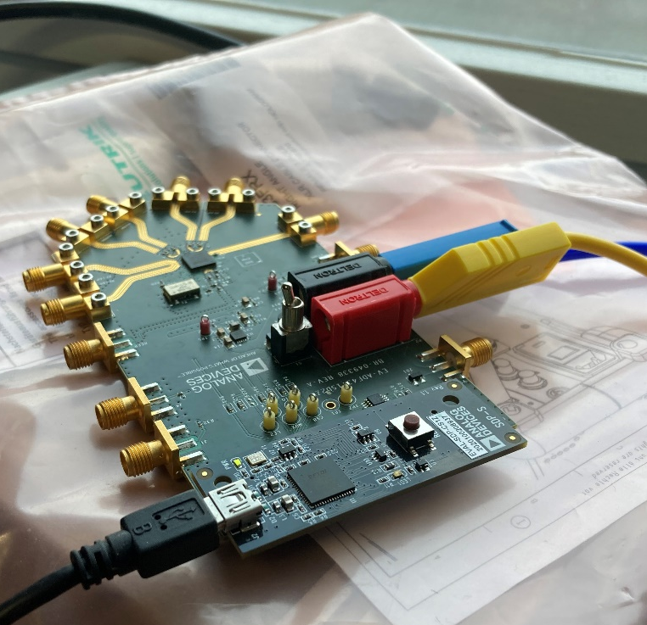
“First Light”
Source
This not a proper measurement
Next Slide is proper
Downconverter
Source (26.5GHz)

Slide 19
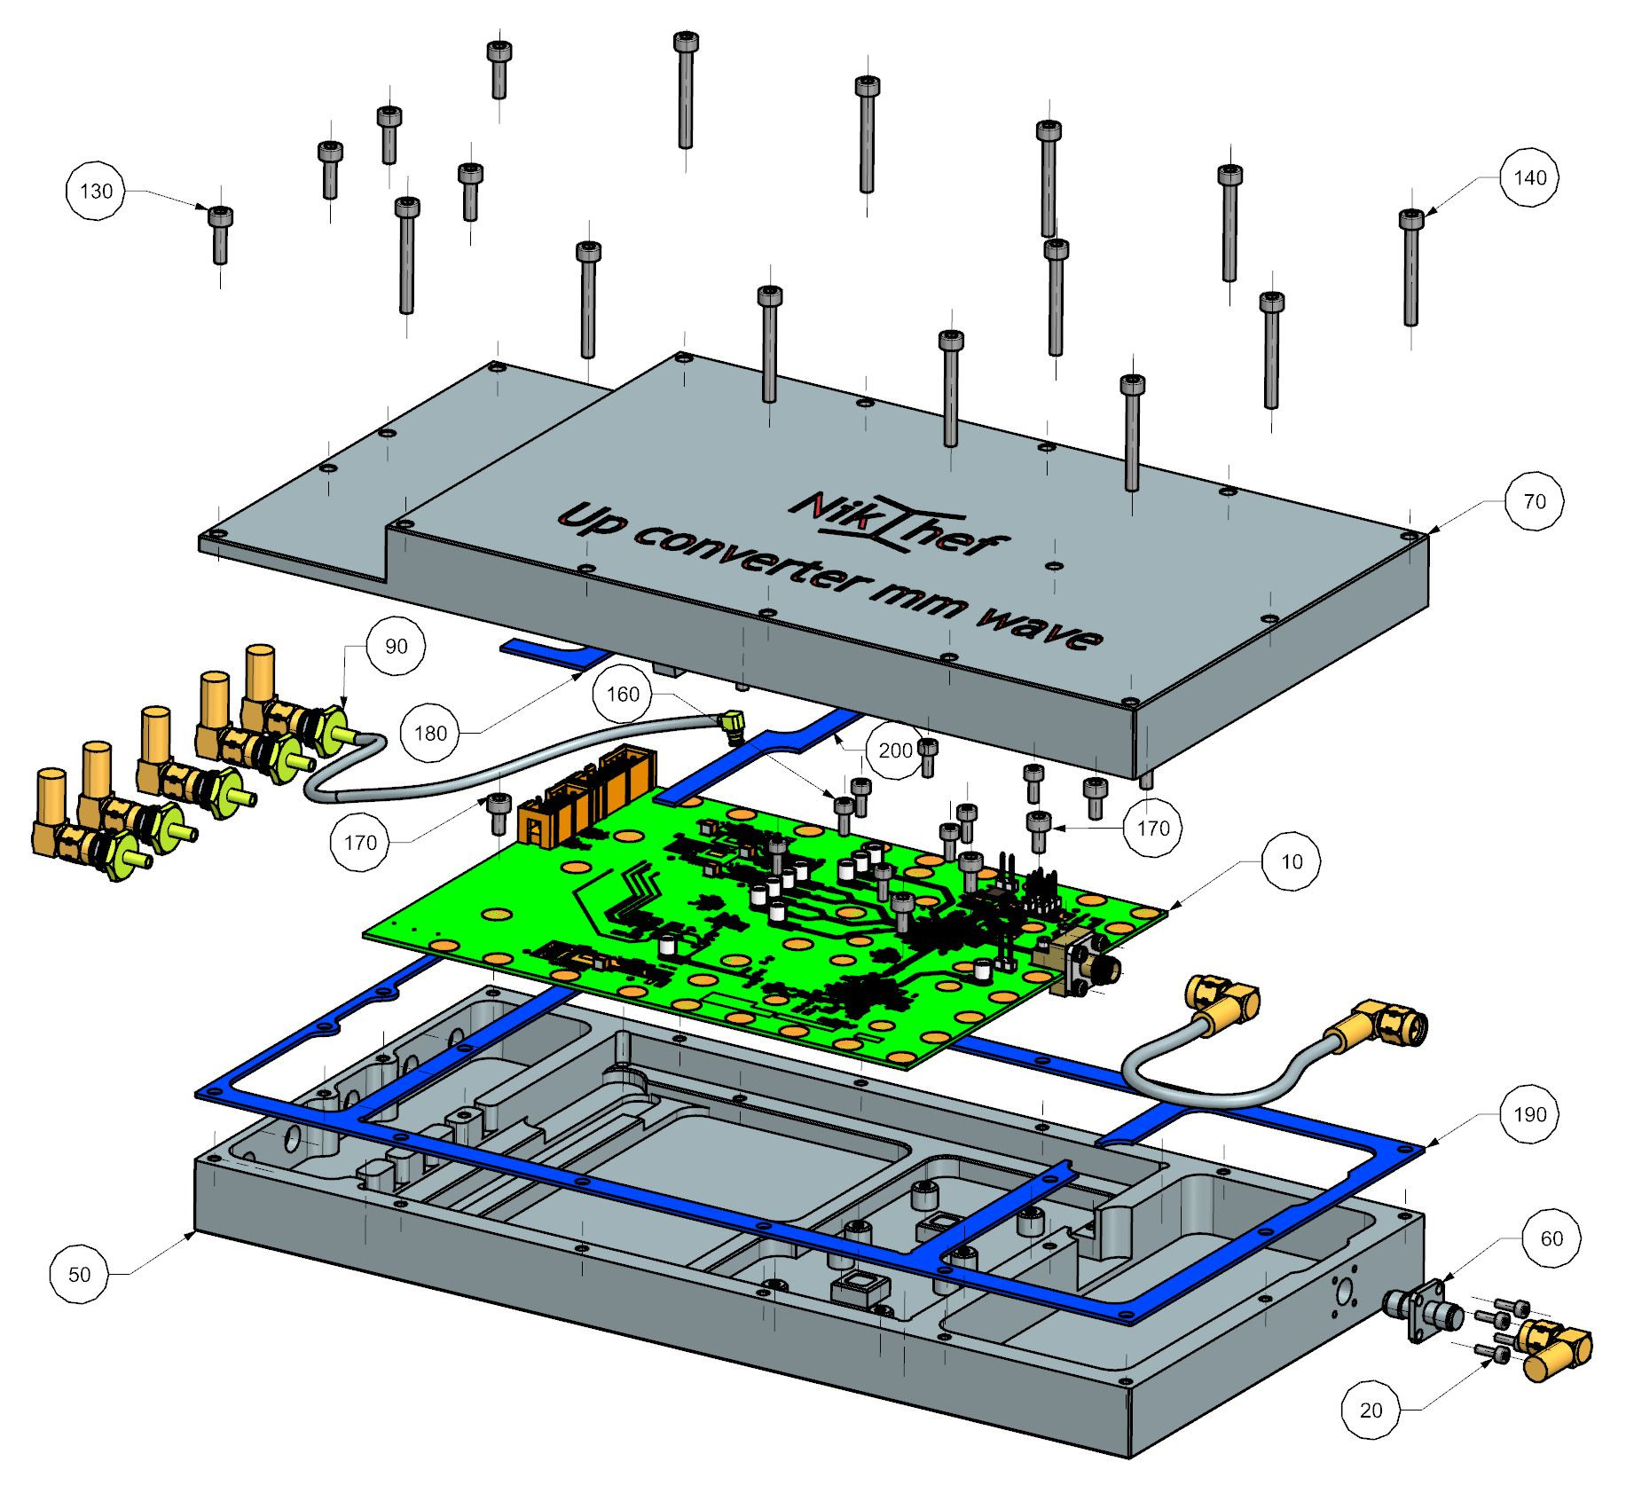
Upconverter housing – exploded view

Slide 20
ALPACA backupslides

Slide 21
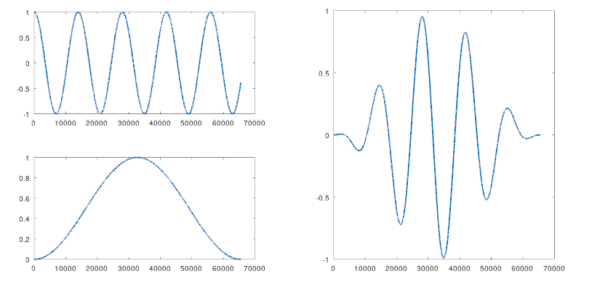
Backup
Most of the signals don’t start at zero.
So the sinusoid here has a “step”.
This messes you up.
Windowing suppresses this step by multiplying it with near-zero.

Slide 22
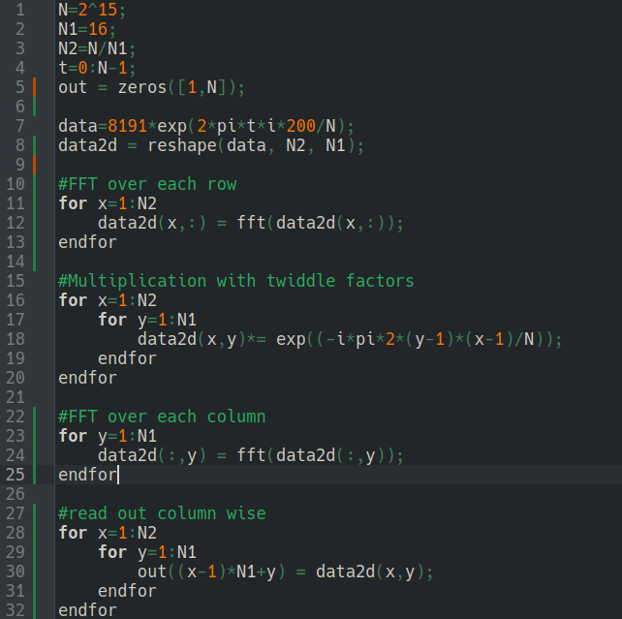
Backup,
Octave script to “proof” Baileys algorithm.
implementing this in a hdl, A LOT HARDER.

Slide 23
Backup
Things made so far (by Pascal):
  HDL design
    Managing ADC’s & DAC’s data streams
    Ported ‘Wupper’ to RFSoC to use PCIe
    Wrote a lossless FFT implementation.
  Ported Linux on the CPU of the RFSoC
  Made a linux kernel driver to connect CPU<->FPGA
  Made userspace apps to manage RfSoC.
  Wrote C++ to visualize information, including data protocols.
Things to make:
  Document things more.
  Implement Bailey’s algorithm done
  Implement it twice to counter window suppression effects.

