Slide 1
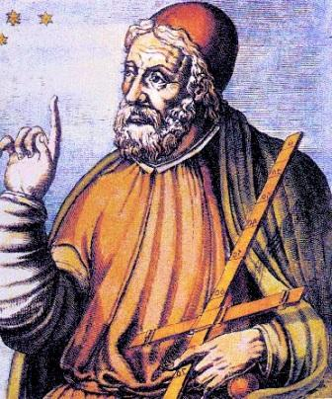
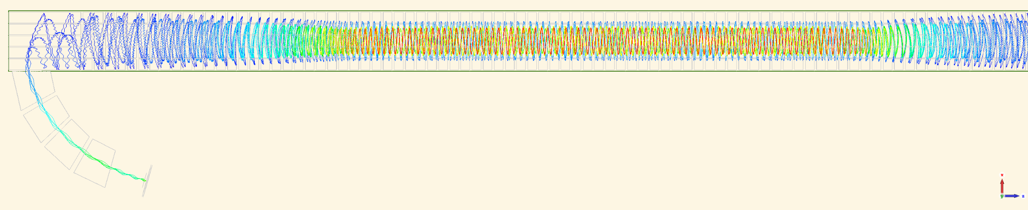
1ug Tritium Configuration and Transmission for LNGS Demonstrator
Wonyong Chung
Princeton University
July 2025
Nijmegen

Slide 2
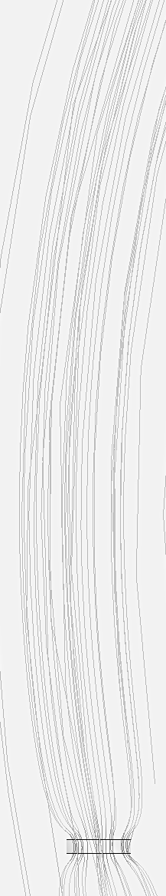
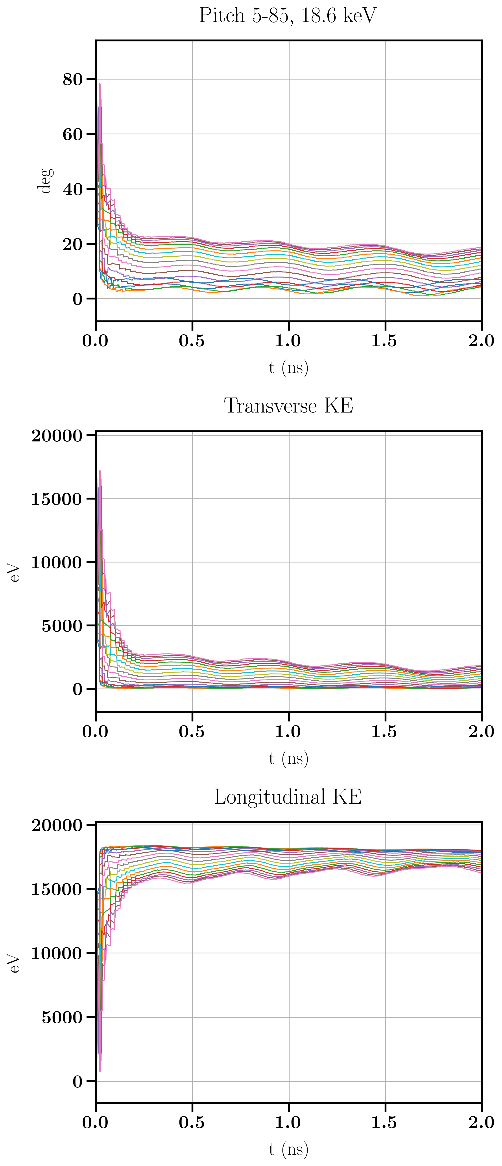
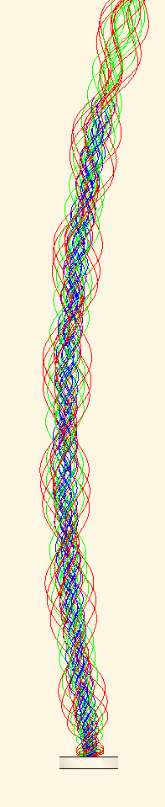
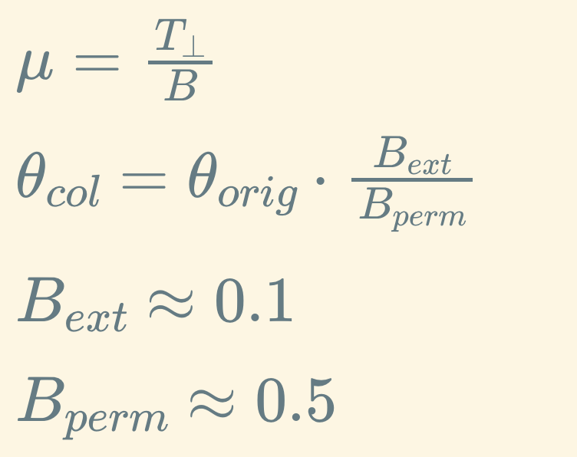
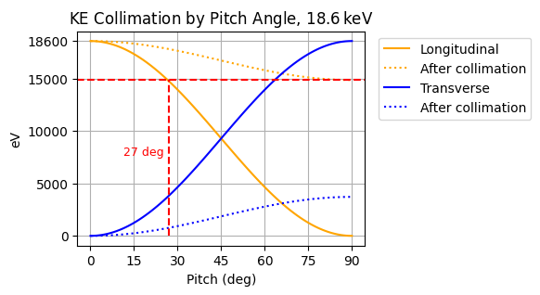
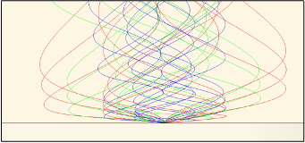
Permanent Magnet Target
Unconstrained trajectories follow field lines
Transverse momentum collimated into longitudinal
  Linear “collimation factor” in B via adiabatic invariant
Effectively a pitch range compression (90 → 27)

Slide 3
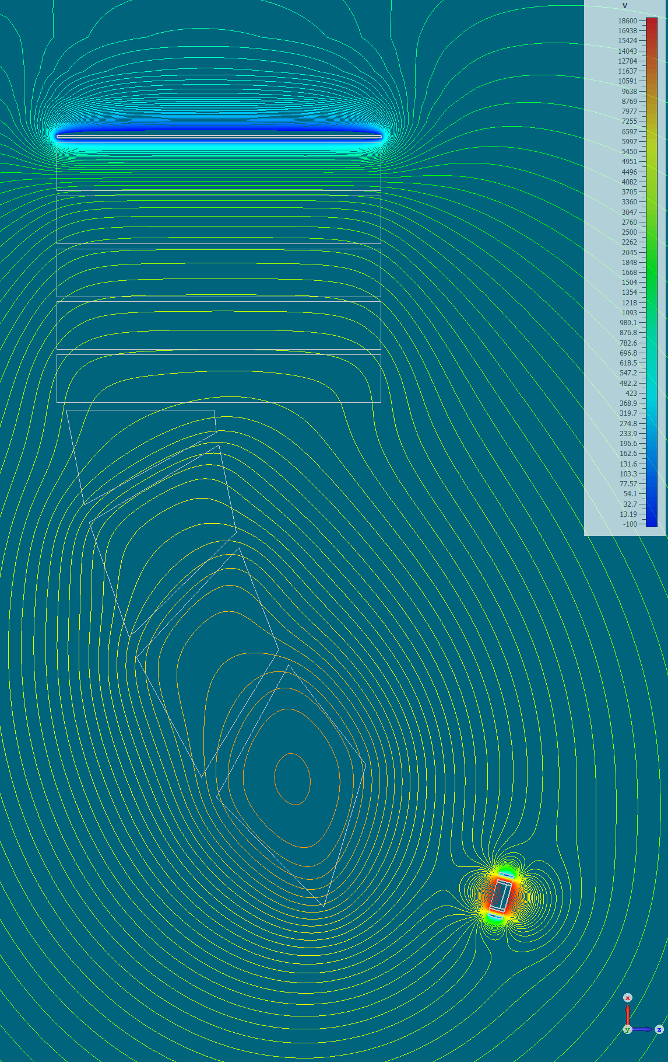
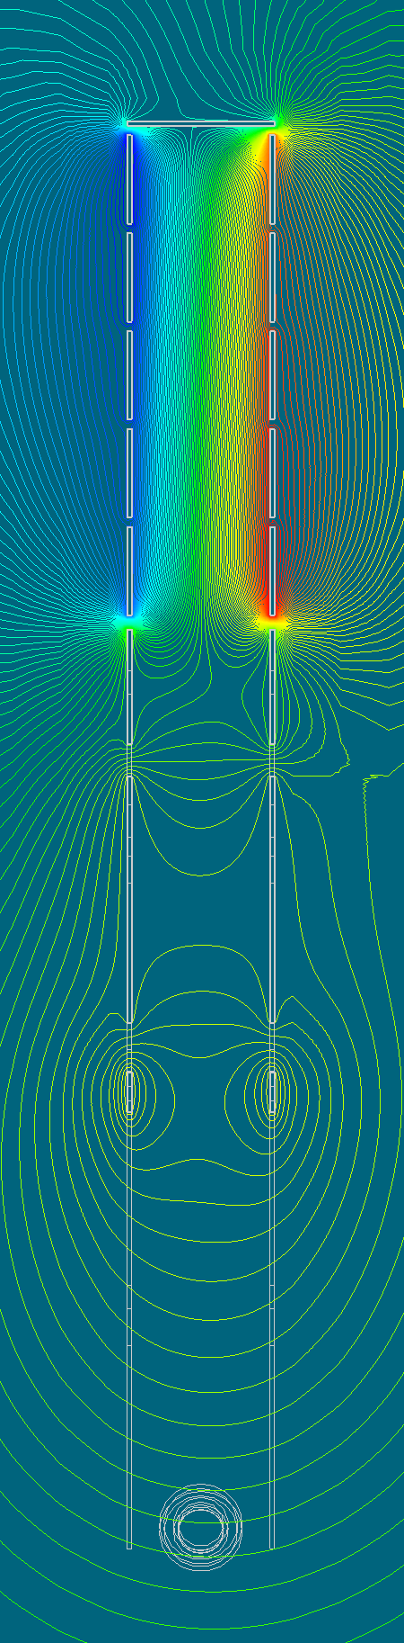
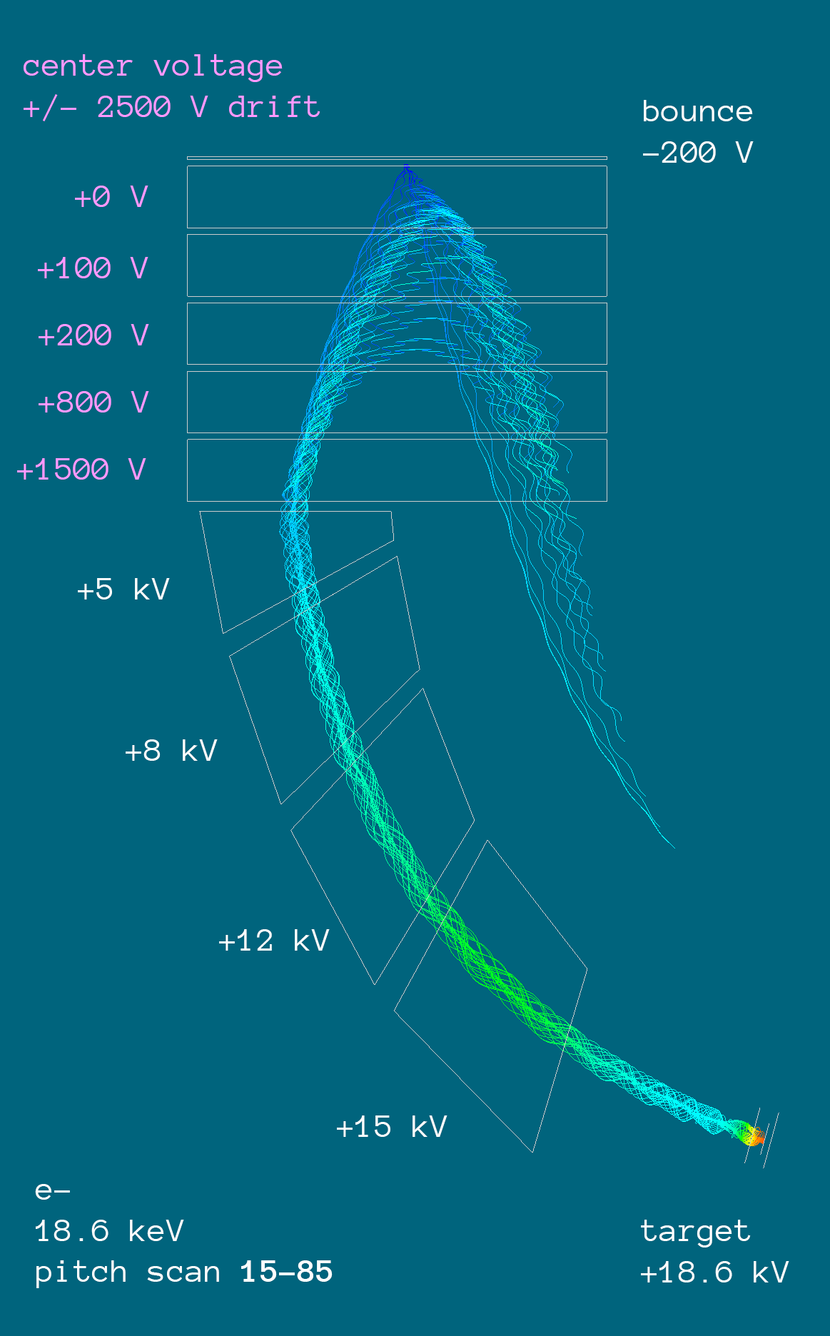
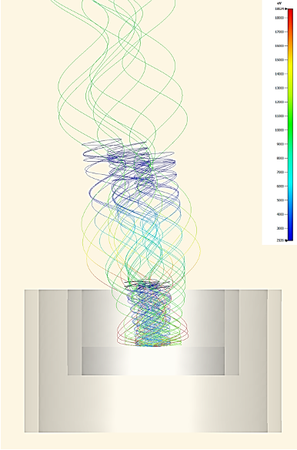
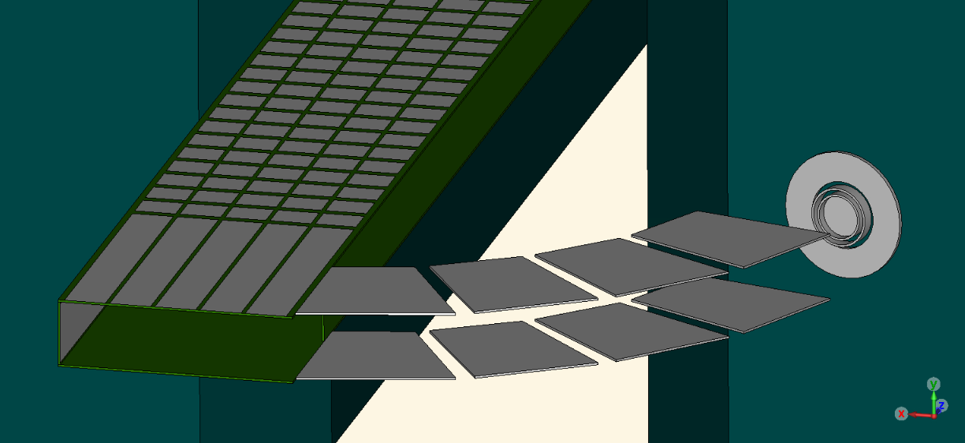
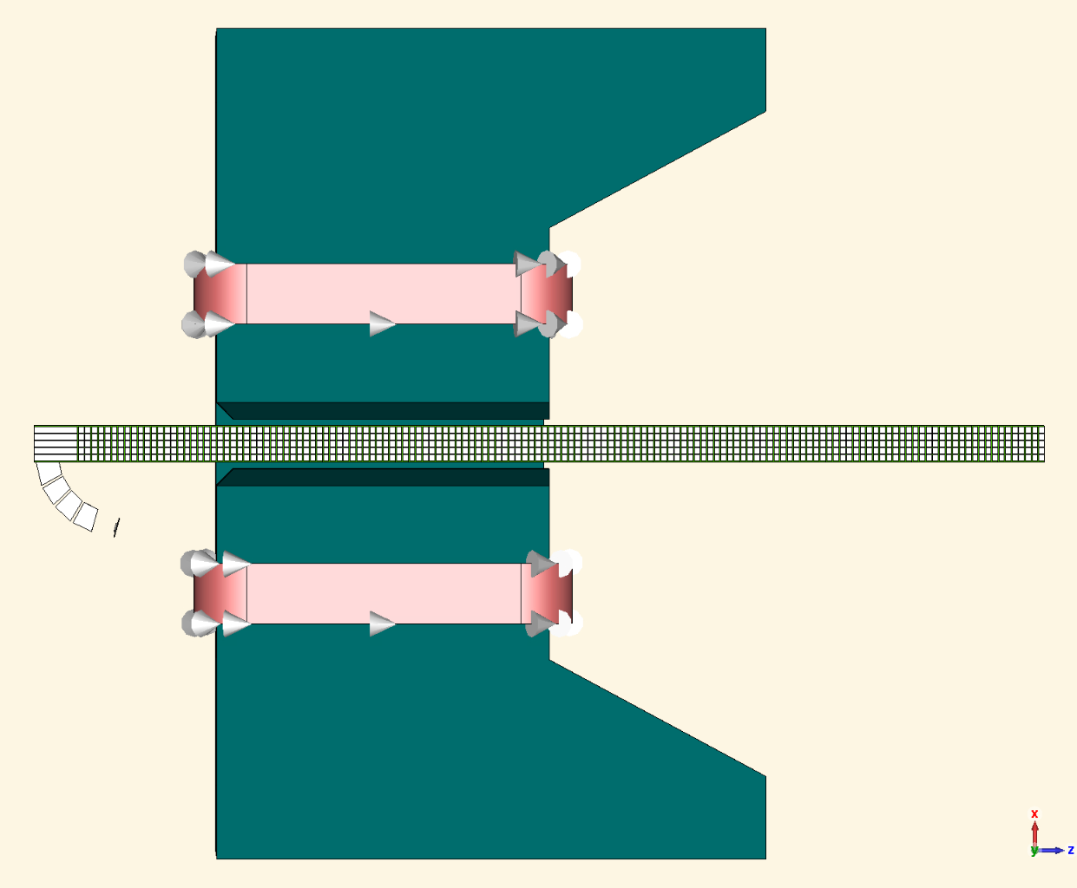
Collimated Injection
Shape electrodes to follow the magnetic field lines
  Well-parameterized by ellipse equation
  Aligns potential gradient against path of electron
  Drains parallel momentum
Once electrons enter central channel
  Apply fast drift in z
  Contain bounce motion
  Accelerate to uniform region
Tranmission studies
  1mm radius (0.0314 cm²)
18.6 keV electrons
pitch 5, 25, 45, 65, 85

Slide 4
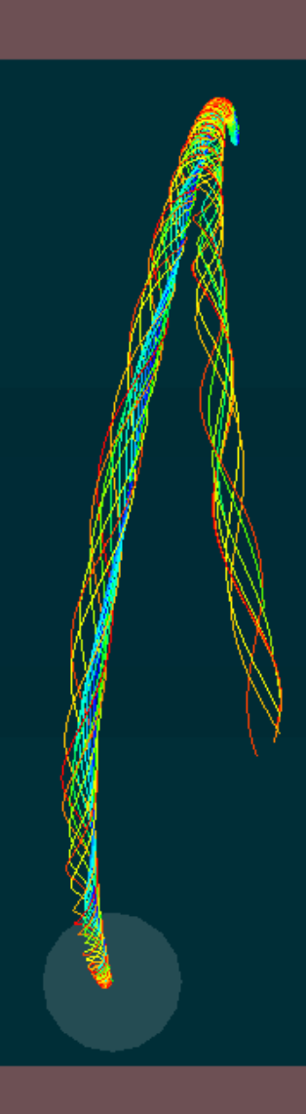
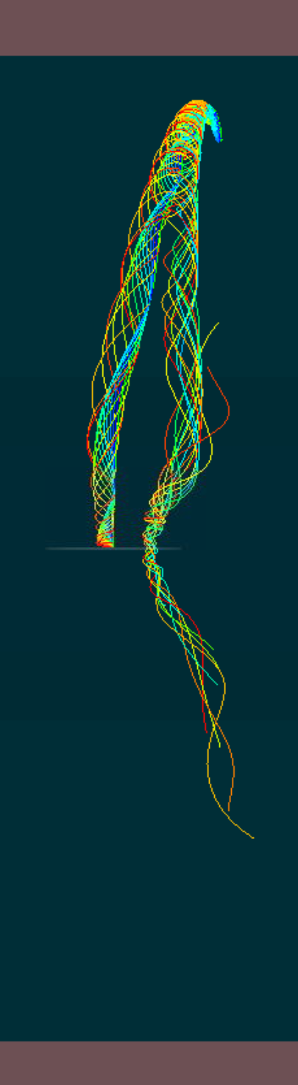
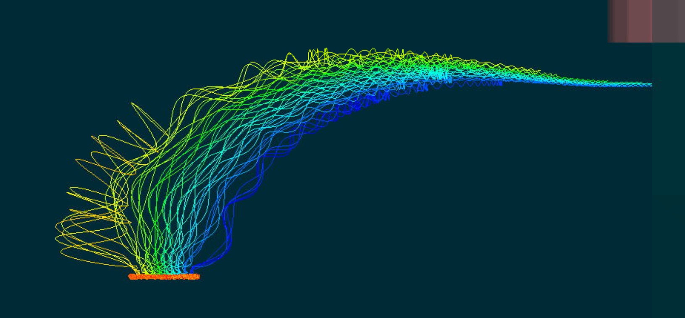
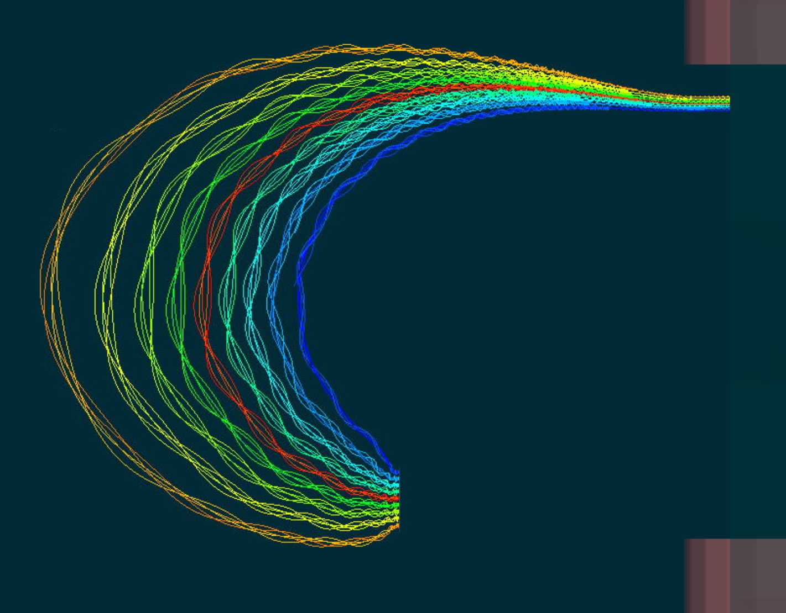
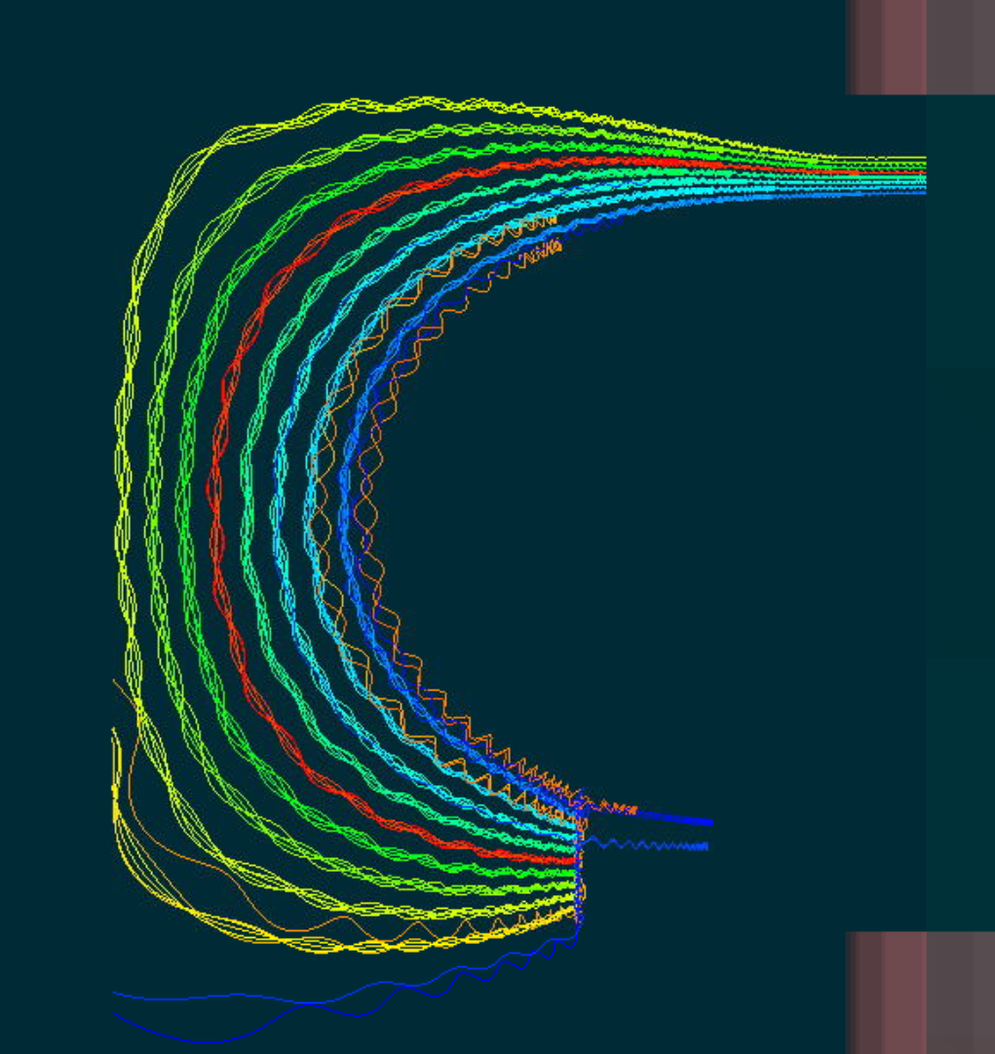
1ug Tritium Target Size
Magnetic field only
1.5 T permanent magnet
1ug ~ 50 cm² (at 50% loading)
5 cm radius -> 78.5 cm²
  Usable area: 3cm radius -> 28.25 cm²
  Double sided: 56.5 cm²
Single- or double-sided?
  2x single-sided: start at fringes
  1x double-sided: start at center
Depends on:
  z-spread of trajectory envelope
  y-drift target clearance
Which is more advantageous for transport?
  Pick a drift direction (x or y)
Choose center (for this study)
x
z
z = -1.75m
R = 5cm
x
y
R = 5cm
R = 5cm
z = -1.50m
z = -1.30m

Slide 5
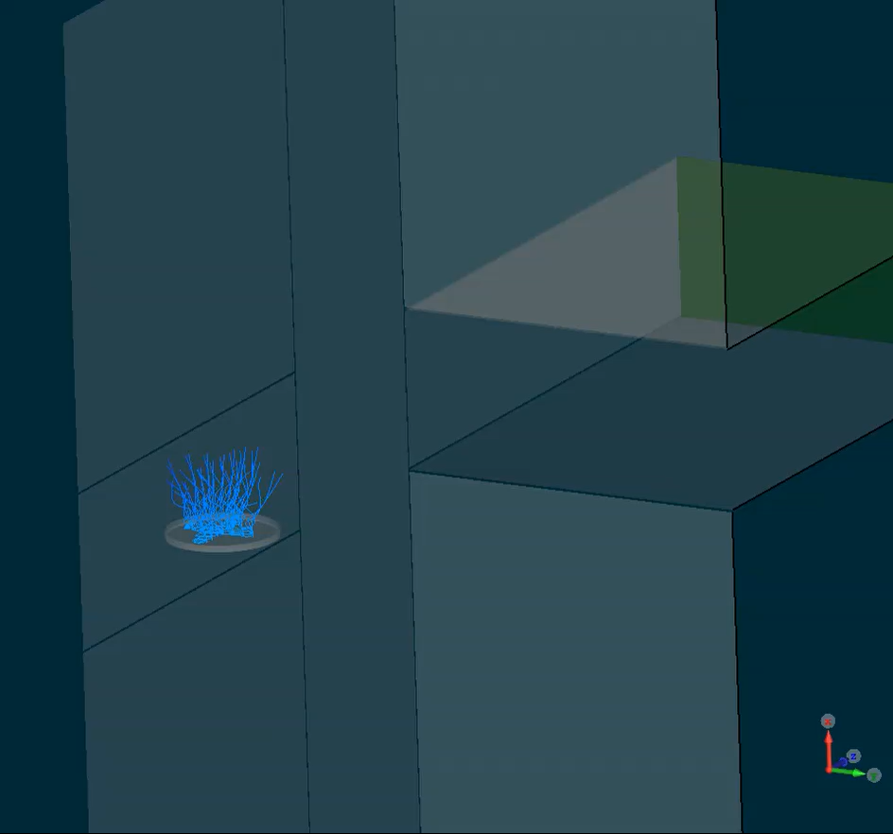
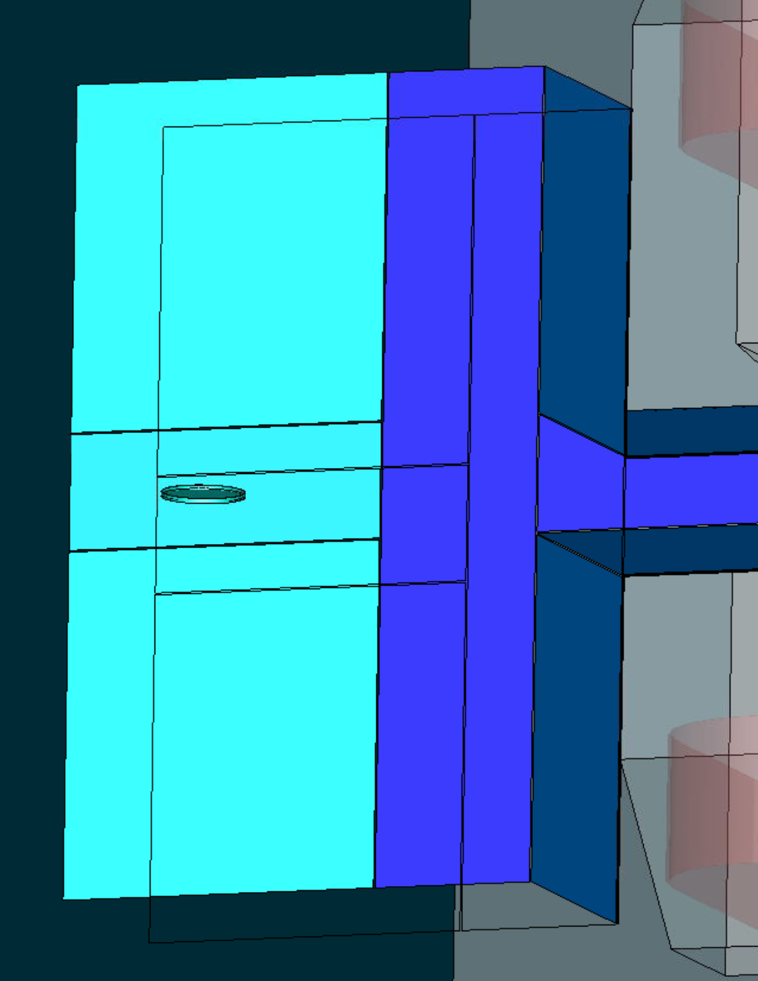
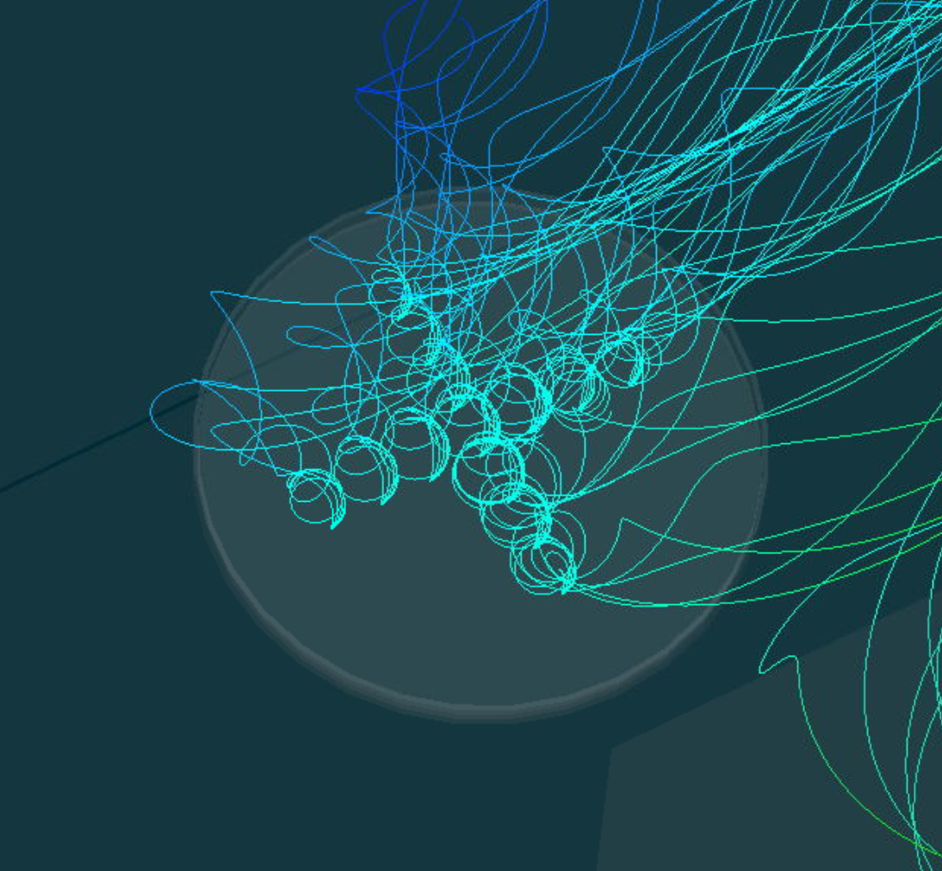
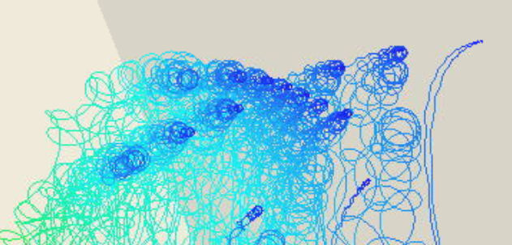
High Drift at Pinch Points
Apply high-drift (+bounce) near magnetic bottle points
Constant drift term, no field matching (to see isolated effect)
Uniform potential wells around target (parallel draining)
12.5kV
-20kV
-1kV
10kV
18.6kV
First bounce
+120kV
-1kV
12.5kV

Slide 6
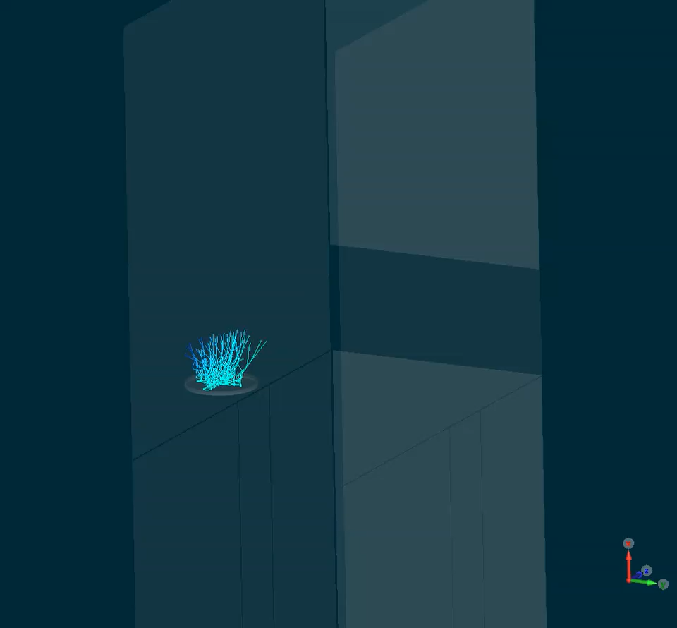
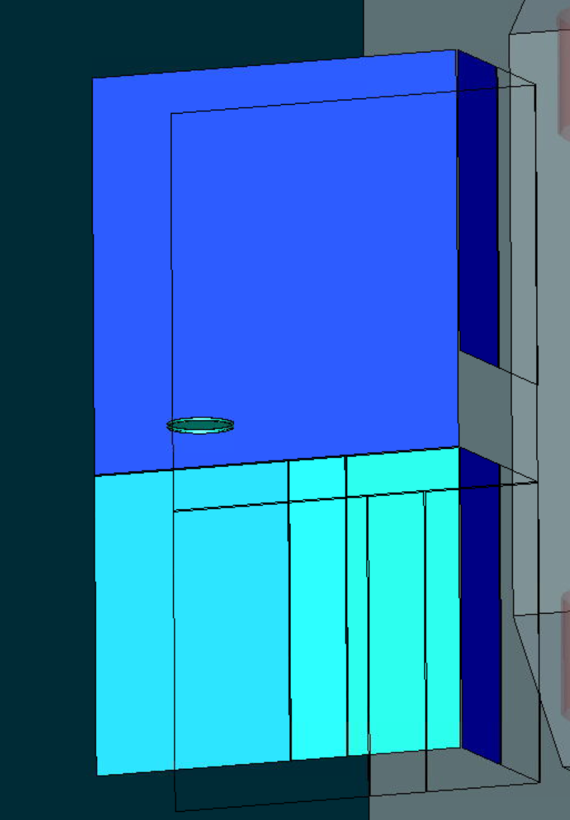
Sequential Potential Wells
Lower half: Increase longitudinal potential wells along z
Upper half: Constant drift term, no field matching
+2.5kV
-1kV
+62.5kV
18.6kV
First bounce
17.5kV
15kV
-1kV
12.5kV

Slide 7
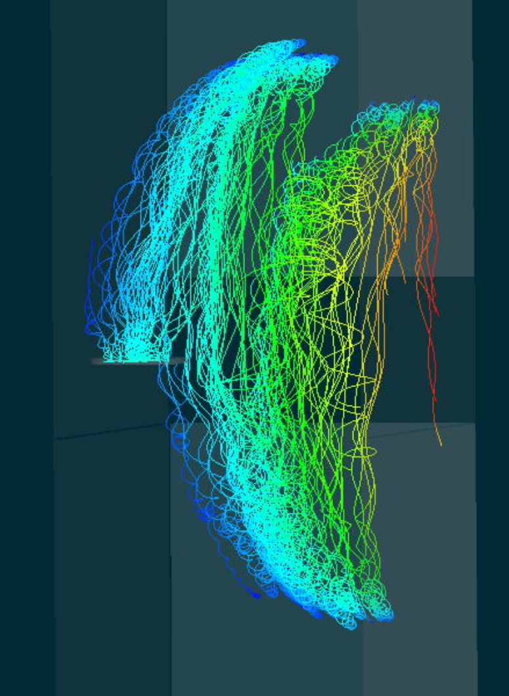
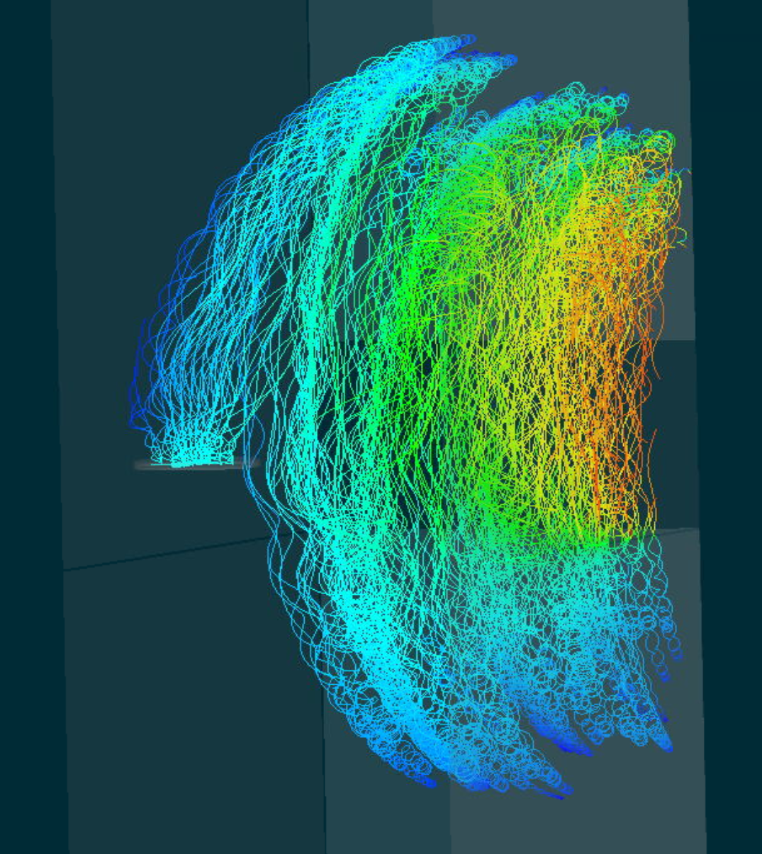
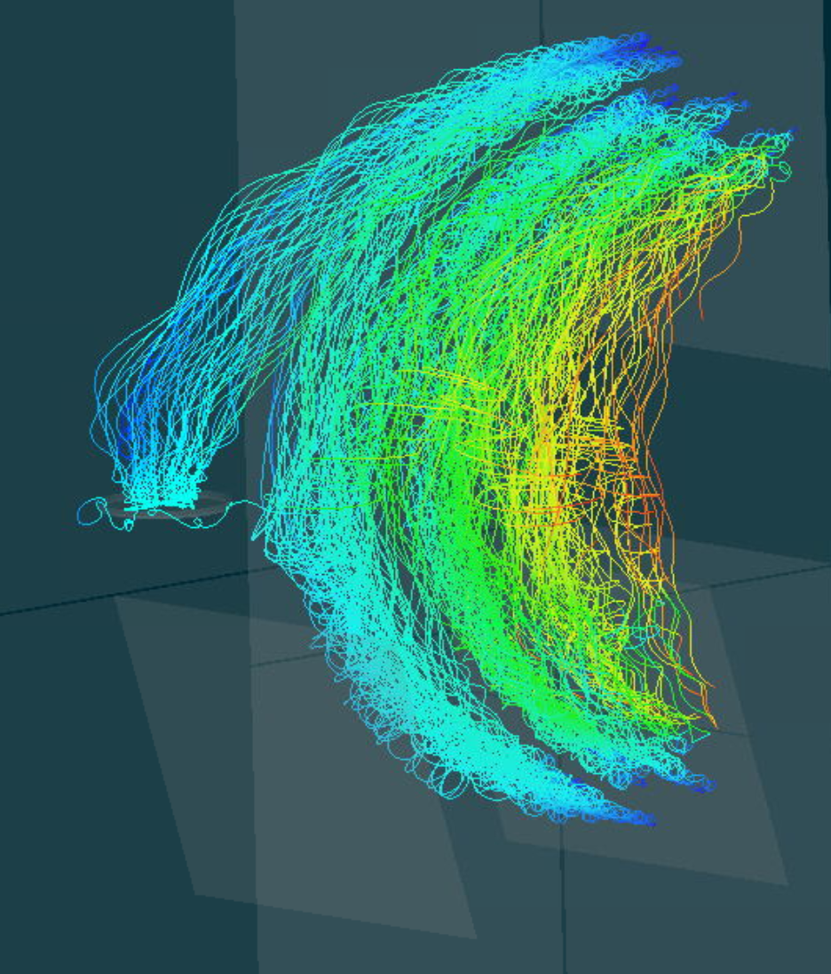
More Attempts
Established that it is possible to move 1ug of phase space volume in a systematic way
To do: Fine tune acceptance and voltages

