Slide 1


Evaluation of PTOLEMY sensitivity to neutrino mass
Leonardo Perna – GSSI (leonardo.perna@gssi.it)
Source code available here

Slide 2
Overview
Implementation of the theoretical β spectrum
Gaussian smearing to simulate finite energy resolution
Evaluation of exclusion and discovery sensitivity to the neutrino mass
Extension of the analysis to improved theoretical models accounting for ³He⁺ - graphene interactions and bound final states
Model discrimination using a Likelihood Ratio Hypothesis Test to assess the distinguishability
2

Slide 3
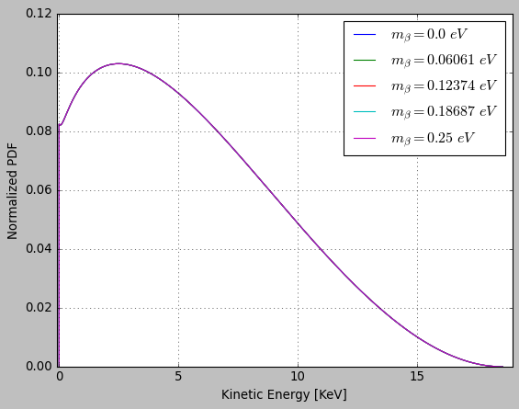
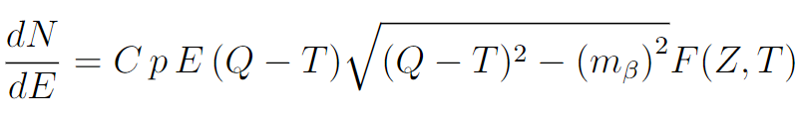
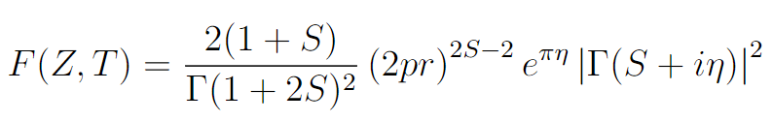
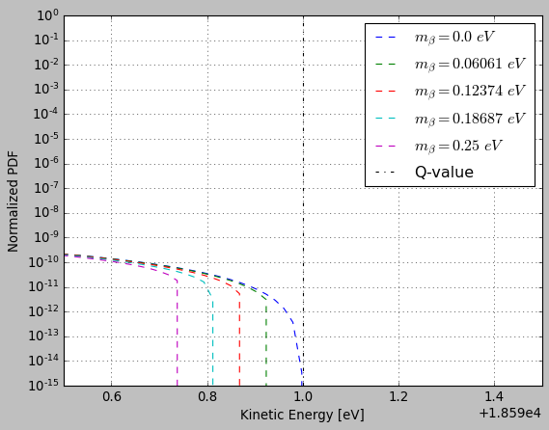
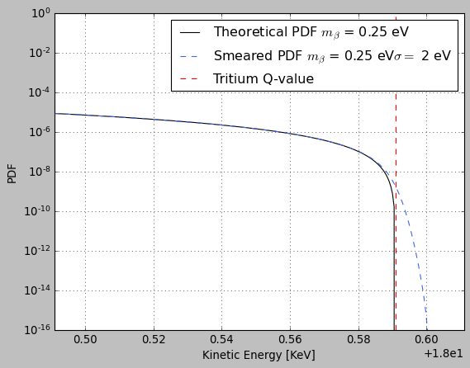
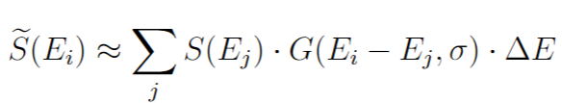
β-Spectrum
& gaussian smearing
β spectrum for different m_{β} values
The β-spectrum is computed as
where is the Fermi Function
The Gaussian smearing has been applied to the spectrum using an analytical convolution with a Gaussian kernel in the range σ ∈ [0, 2] eV (m_{β} ∈ [0, 0.25] eV)
An example of Gaussian smearing
β spectrum for different m_{β} values:
End-point region

Slide 4
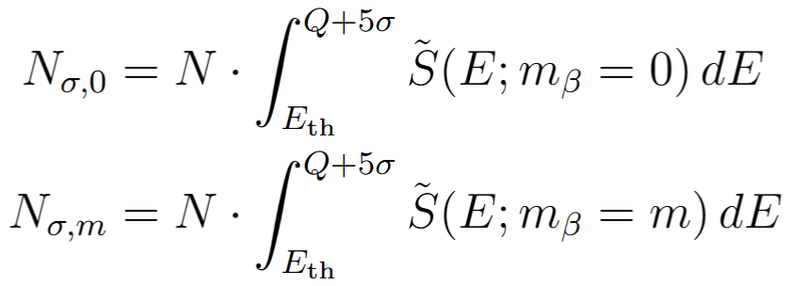
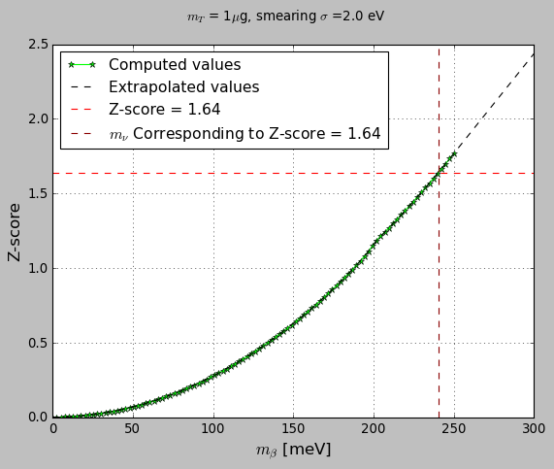

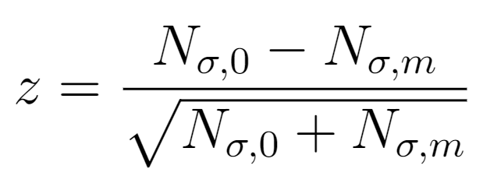
Exclusion sensitivity to neutrino mass:
Counting method
The considered quantities are the number of counts of events exceeding the energy threshold:
The considered test statistic (Gaussian distributed)
Interpolating the m_{β} value corresponding to z = 1.64 allows to
extract the 90% CL exclusion sensitivity to neutrino mass m_{β}
1-10-100 μg
0.5
3 years

Slide 5
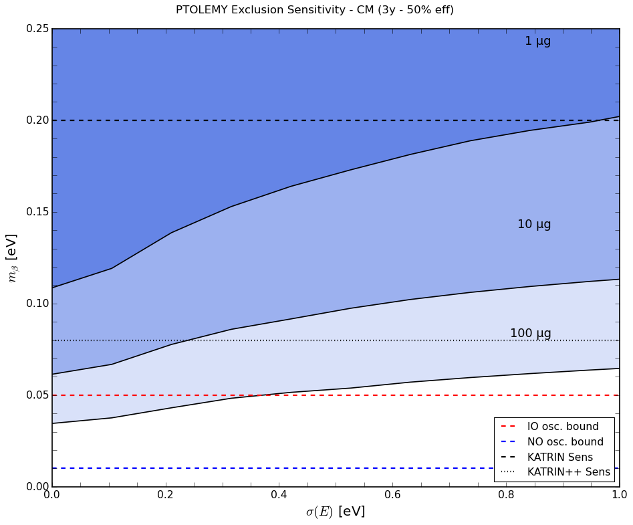
PTOLEMY collaboration results
Credits: Nicola Rossi (2024) – Review on sensitivity to neutrino mass
This work

Slide 6
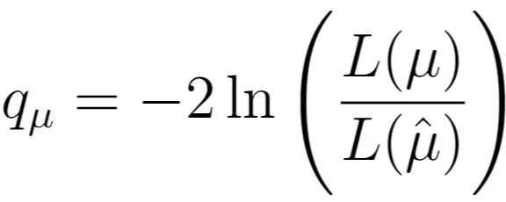
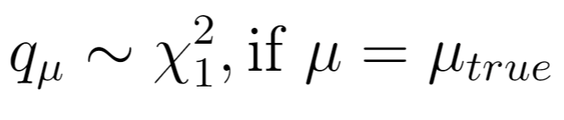
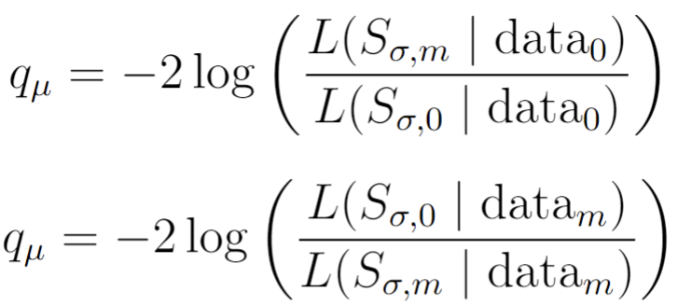
Exclusion & Discovery sensitivity to neutrino mass:
Profile likelihood method
The considered test statistic is the profile likelihood
Exclusion sensitivity
[Cowan-2011]
Discovery sensitivity

Slide 7
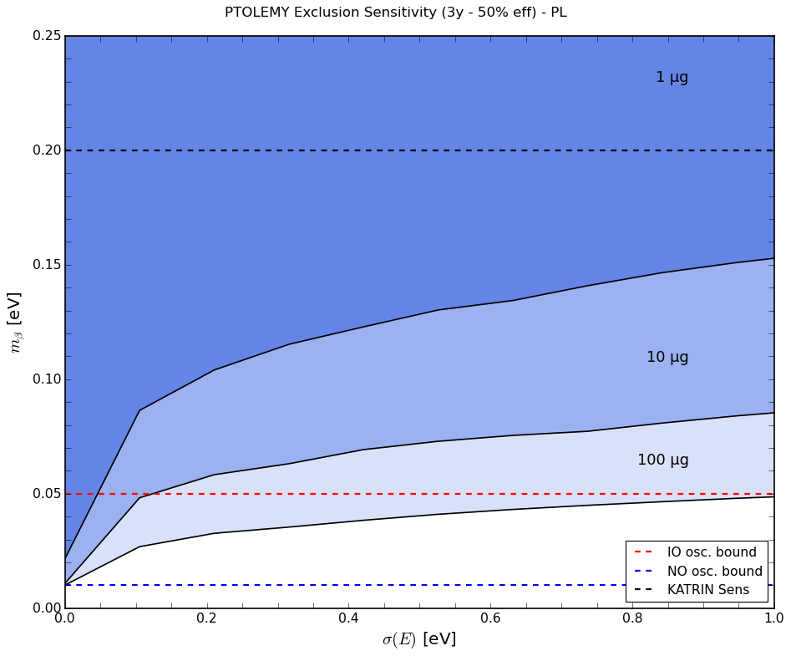

PL method:
90% CL exclusion sensitivity
PL method:
3σ CL discovery sensitivity

Slide 8
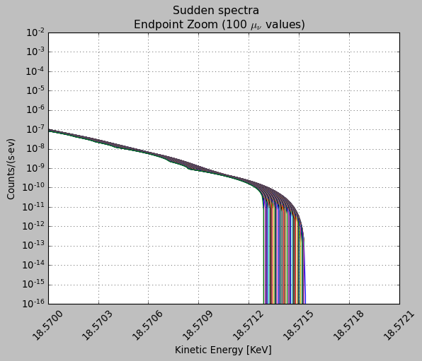
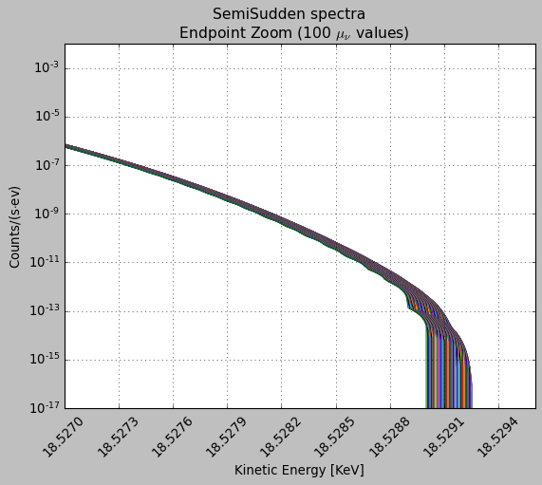
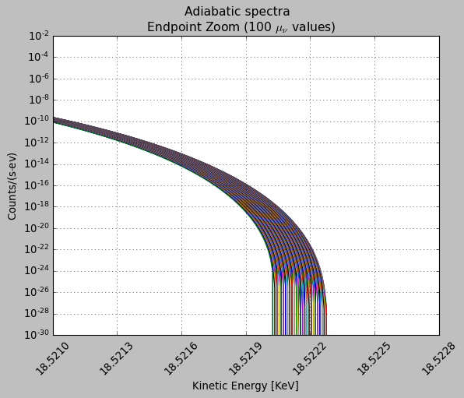



Graphene-induced spectral deformations
Discrete spectrum: bound final state - ³He⁺ remains bound to the graphene
Continuous spectrum: ionized final state – ³He⁺ is ejected from the graphene
Three recipes used to compute numerically the modified spectra [Angelo Esposito]:
  Sudden : for each position of the helium, electron density fixed as it was when the tritium was sitting at its equilibrium position (discrete + continuous)
  Semi-sudden : for each position of the helium, electron density fixed as it was when the tritium was at the same position as the helium (discrete + continuous)
  Adiabatic: allow the whole system to relax to the new configuration (only continuous)

Slide 9
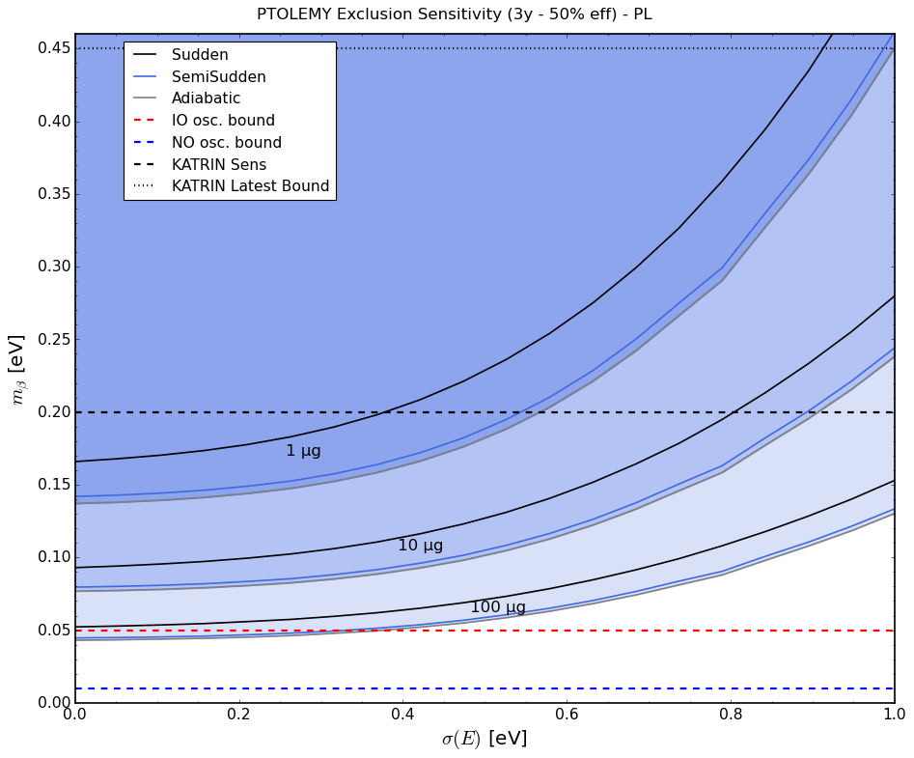
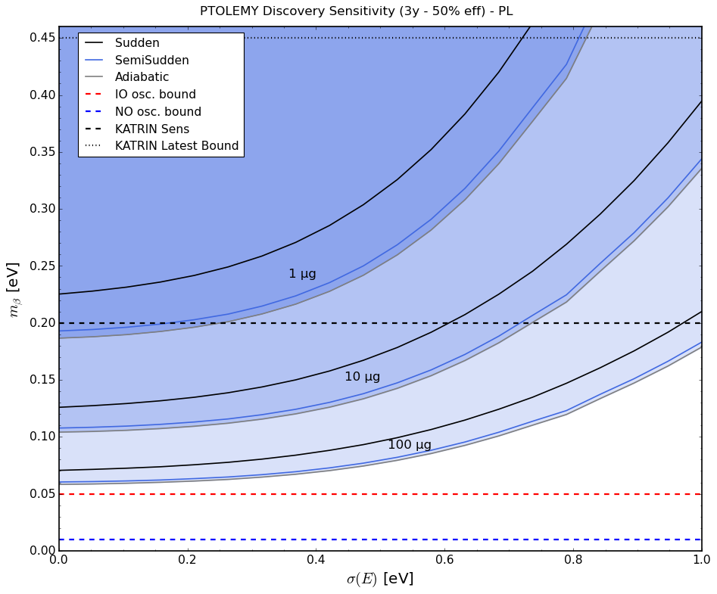
PL method: Exclusion
σ ∈ [0,1] eV, m_{β} ∈ [0, 0.46] eV
PL method: Discovery
σ ∈ [0,1] eV, m_{β} ∈ [0, 0.46] eV

Slide 10
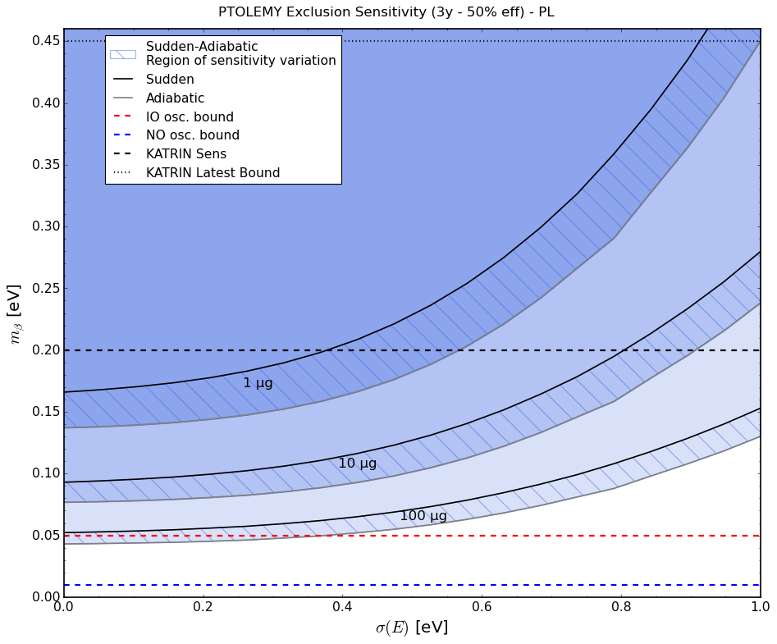
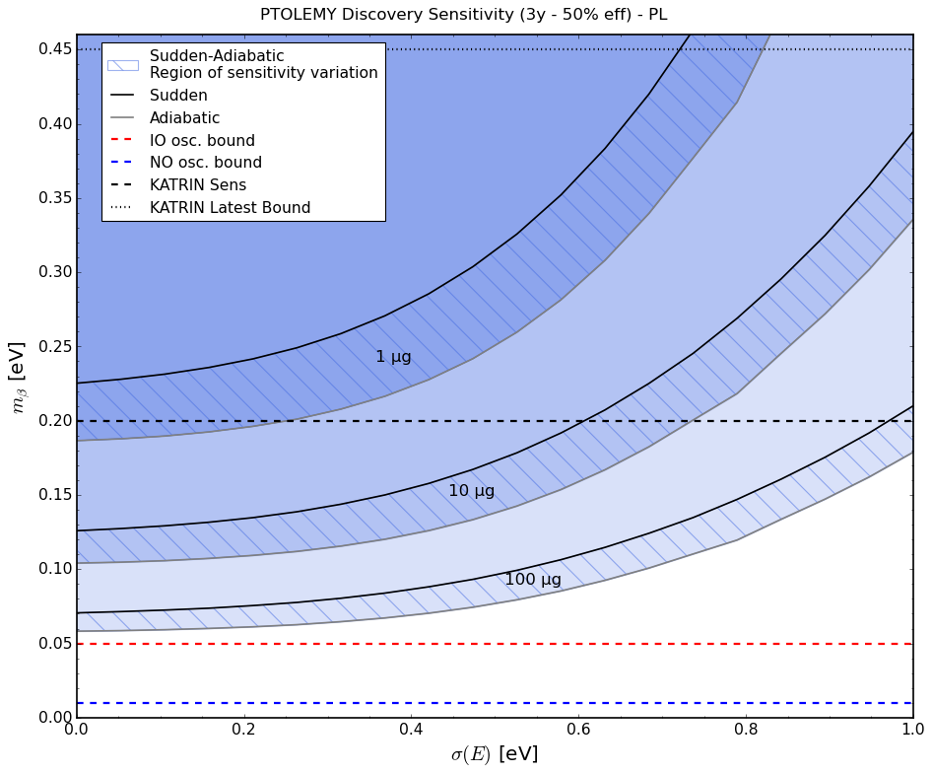
TOP-BOTTOM CURVES

Slide 11
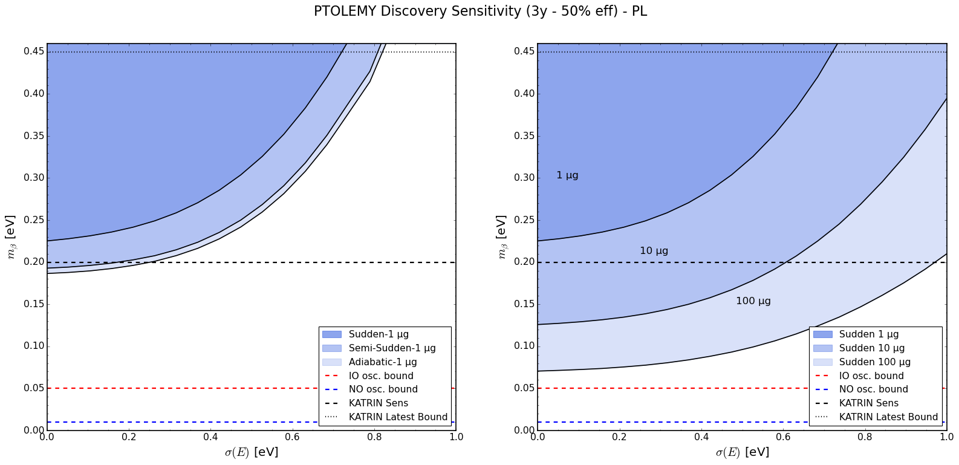
Discovery:
Fixed tritium mass (1μg), different models
Discovery:
Fixed model (Sudden), different tritium masses

Slide 12
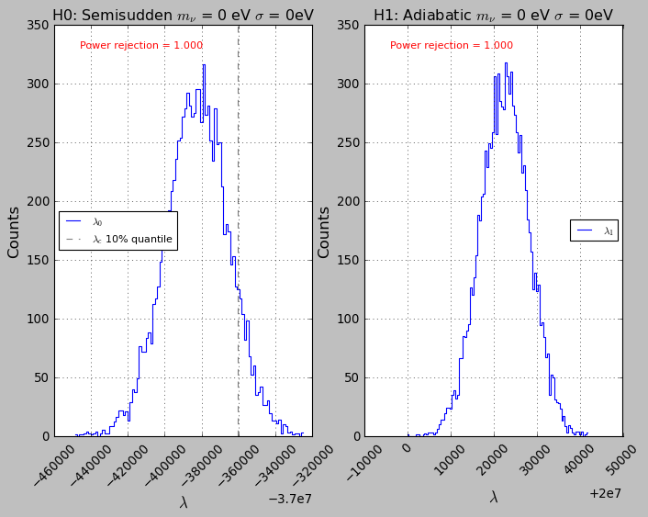
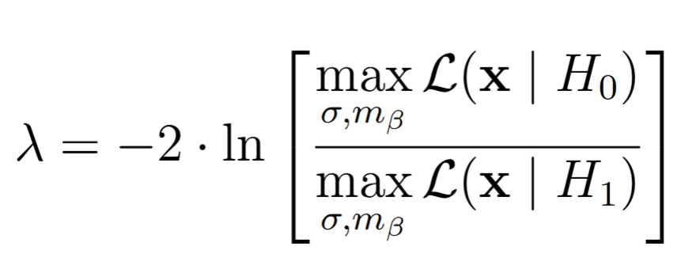
Likelihood Ratio Hypothesis test
Goal: assess the possibility of misidentification between
Sudden, Semi-sudden, adiabatic spectra
Considered test statistic:
→ H₀ and H₁ two alternative models (e.g. Semi-sudden and Adiabatic)
Procedure:
  Generate toy data under H₀(σ₁, m_{β1}) and compute the λ distribution
  Fixing the p-value, compute λ_{c} (p-value = 0.1)
  Generate toy data under H₁(σ₂, m_{β2}) and compute the toy fraction that exhibits λ>λ_{c};
  This is the rejection power between two models (H₀ and H₁).
  Formally: Power = P(reject H₀|H₁ is true)
  Results: Power = 1 for each combination of parameters (σ and m_{β}) and models (H₀ and H₁)

Slide 13
Thank you for your attention
13

Slide 14
Backup slides
14

Slide 15
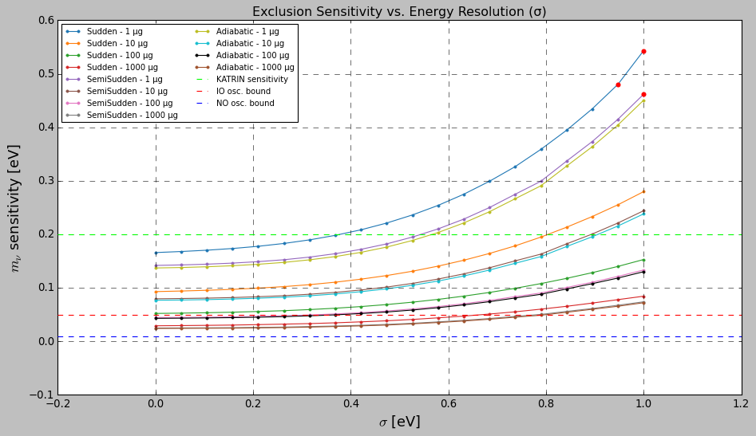
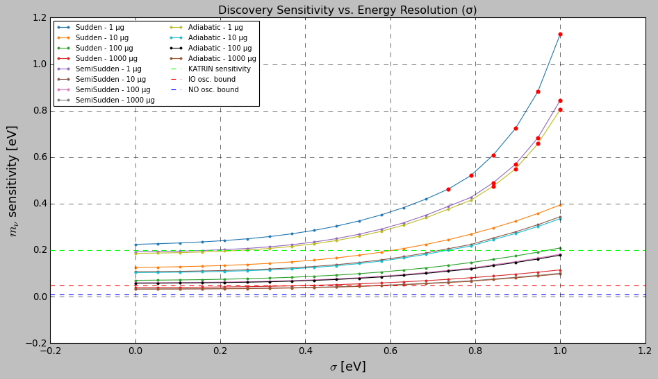
PL method:
90% CL exclusion sensitivity
PL method:
3σ CL discovery sensitivity

Slide 16
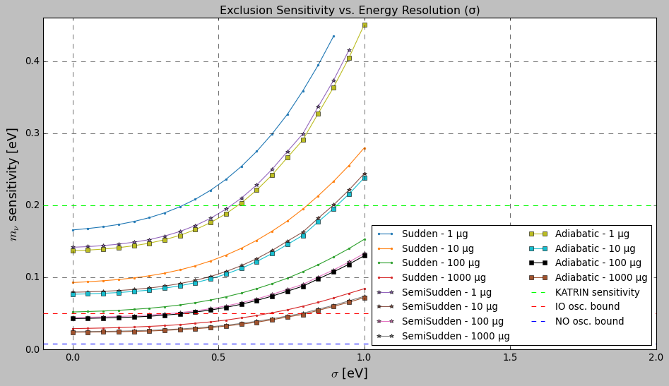
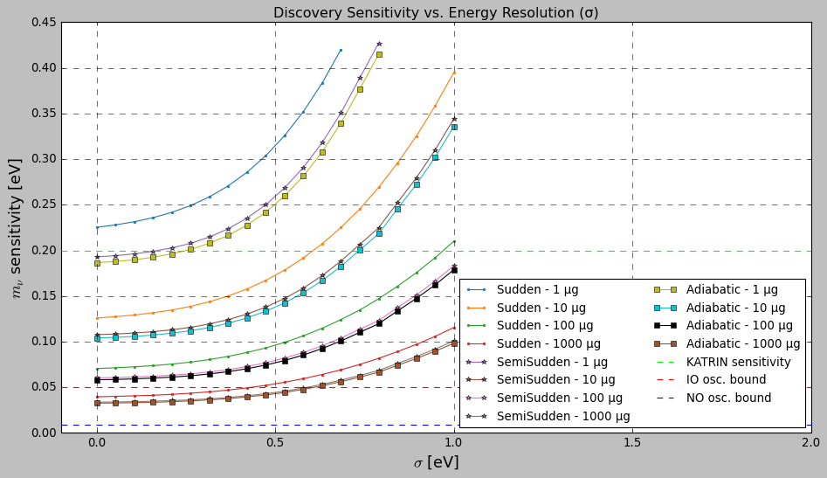
PL method:
90% CL exclusion sensitivity
PL method:
3σ CL discovery sensitivity

Slide 17
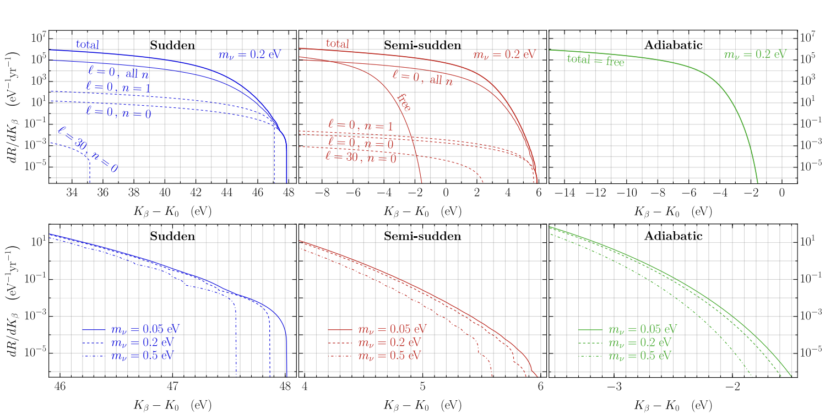
[Andrea Casale et al.]

Slide 18
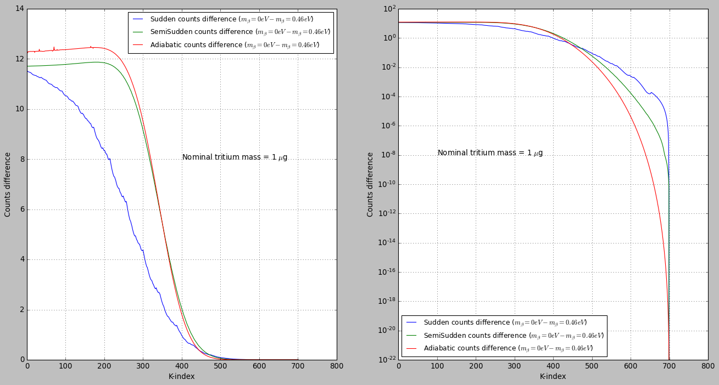
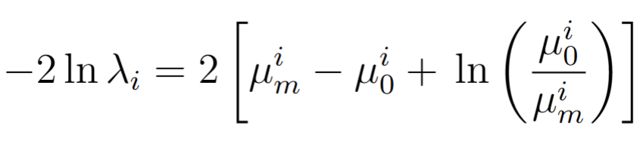
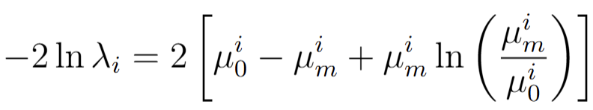
Exclusion
Discovery

