Slide 1
GRAND in Nijmegen
21/3/2022
Charles Timmermans

Slide 2
Introduction to GRAND
UHECR or ɣ
Radio signal
Interaction
Radio signal
Particle shower
Interaction
Tau Decay
𝝉
Cosmic Neutrino
Particle shower
Antennas
Giant Radio Array Neutrino Detector
GRAND
A Multi-Messenger Observatory

Slide 3
Introduction to GRAND
GRAND collaboration:
Sci. China Phys.Mech.Astron. 63 (2020) 1, 219501
GRAND will almost certainly measure neutrinos and detect their sources

Slide 4
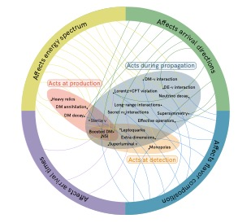
Introduction to GRAND
Effects of new physics

Slide 5
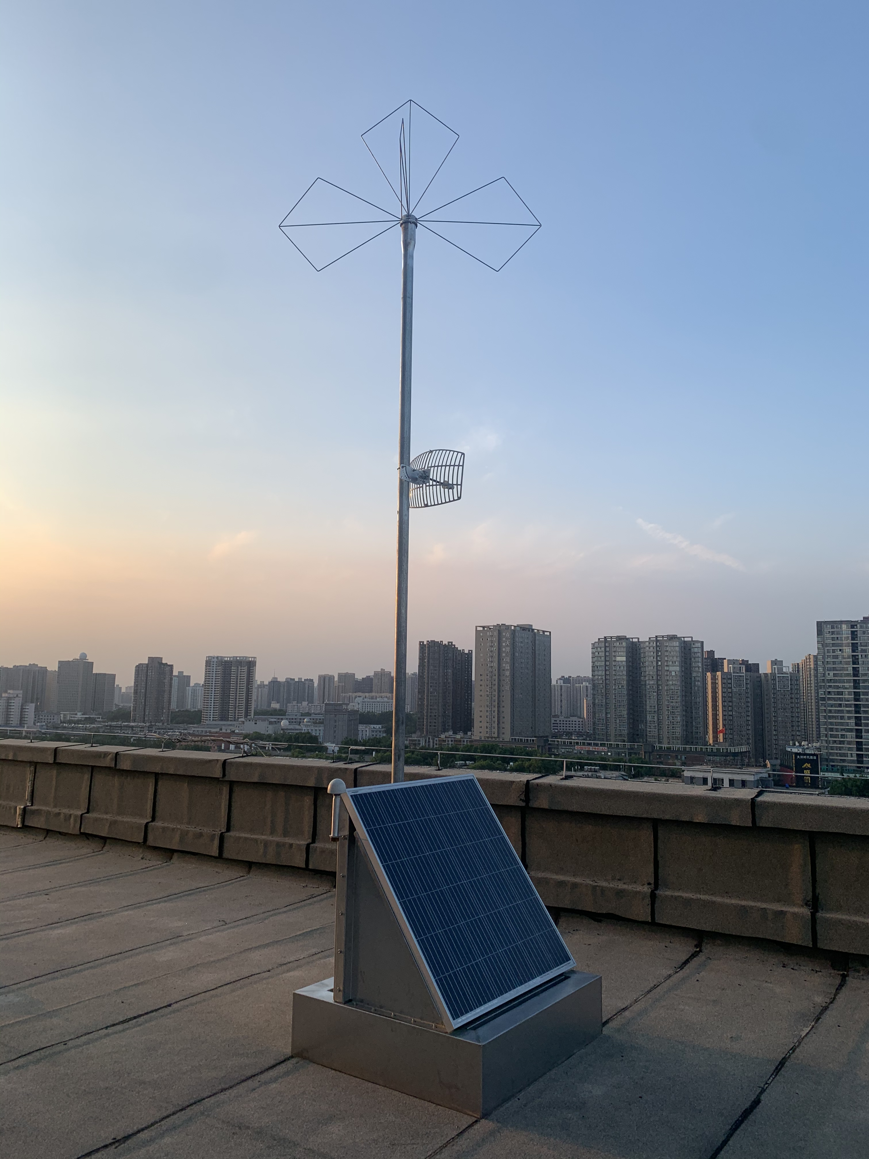
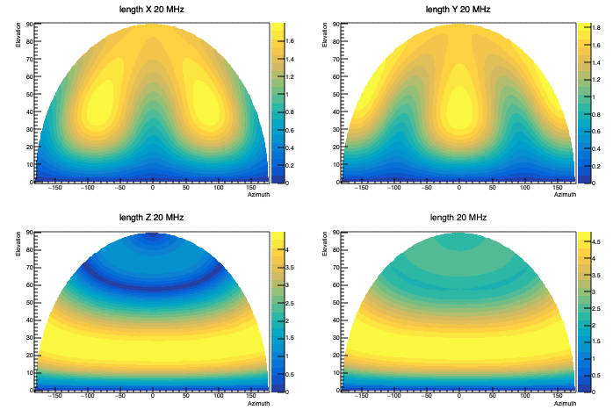
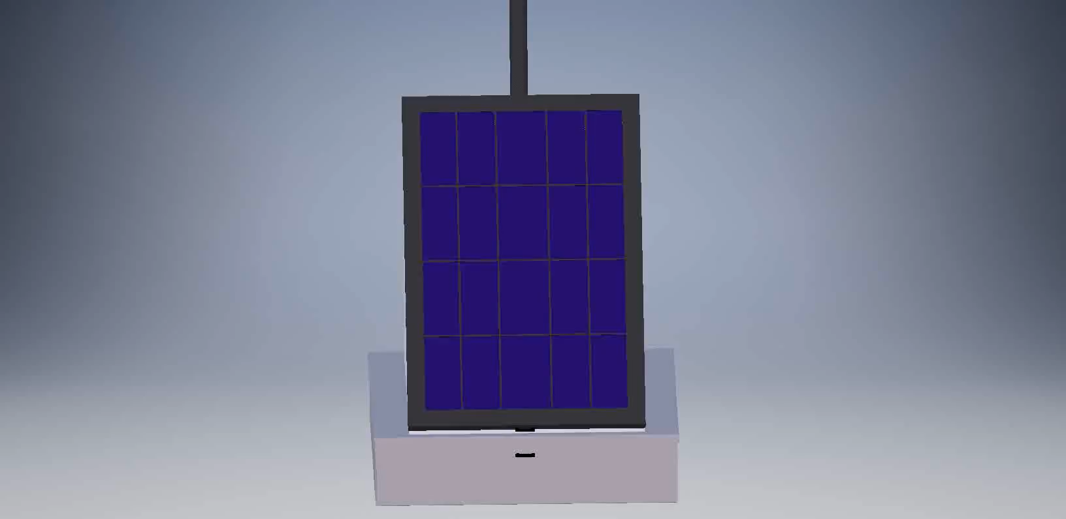
The Antenna Design

Slide 6
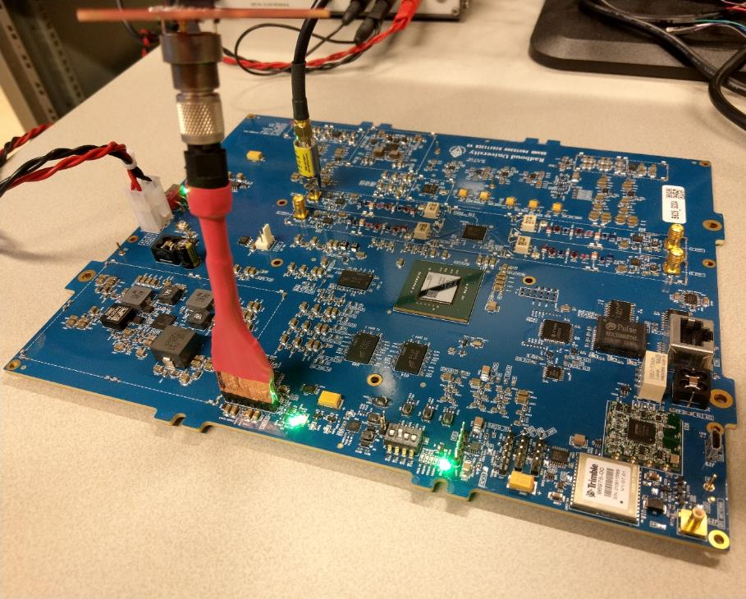
Analog front end
Radio
GRAND Digitizer Unit
2-level amplification
LNA
Variable gain amplifier/attenuator
Filtering 50-200MHz
ADC (14-bit 500 million samples per second)
Sensors
GPS
ADC
Receiver & ADC
ADC
Radio
Radio
Sensors
ADC
GPS chip
GPS

Slide 7
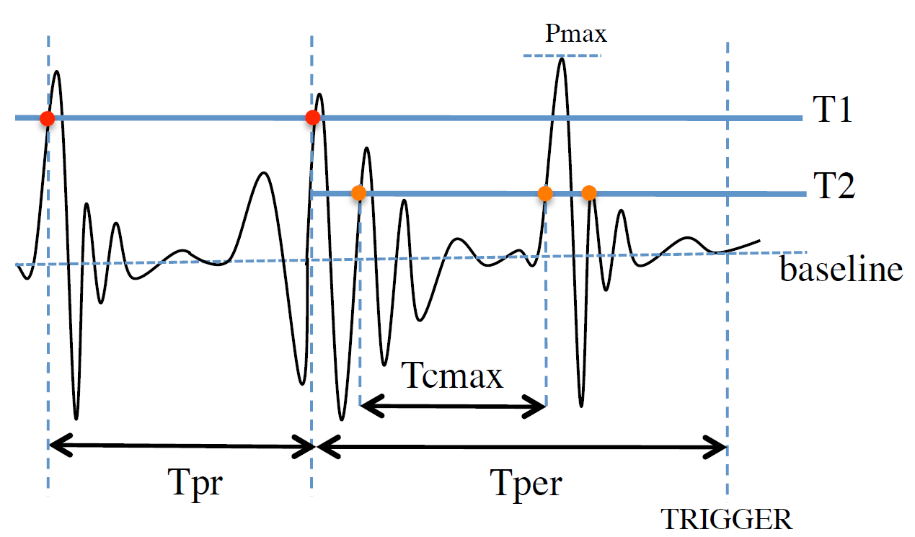
Analog front end
Radio
GRAND Digitizer Unit
2-level amplification
LNA
Variable gain amplifier/attenuator
Filtering 50-200MHz
ADC (14-bit 500 million samples per second)
500 mill. samples per s
Control
GPS 1PPS; RX
Sensors data
Sensors
GPS
ADC
Receiver & ADC
Digital electronics - FPGA
Notch filters – reduce noise levels and narrow band interfering signals
FPGA
L1 Triggering
Time-over-Threshold
No preceding pulse
No succeeding pulse train
Buffers 2 events (2 $μ$s event window)

Slide 8
Analog front end
Radio
GRAND Digitizer Unit
2-level amplification
LNA
Variable gain amplifier/attenuator
Filtering 50-200MHz
ADC (14-bit 500 million samples per second)
500 mill. samples per s
Control
GPS 1PPS; RX
Sensors data
Sensors
GPS
ADC
Receiver & ADC
Digital electronics - FPGA
Notch filters – reduce noise levels and narrow band interfering signals
ARM CPU
L1 Triggering
Control
Triggered event & metadata
Time-over-Threshold
No preceding pulse
No succeeding pulse train
Buffers 2 events (2 $μ$s event window)
ARM CPU
L2 Triggering (optional)
Buffers 400 events

Slide 9
Analog front end
Radio
GRAND Digitizer Unit
2-level amplification
LNA
Variable gain amplifier/attenuator
Filtering 50-200MHz
ADC (14-bit 500 million samples per second)
500 mill. samples per s
Control
GPS 1PPS; RX
Sensors data
Sensors
GPS
ADC
Receiver & ADC
Digital electronics - FPGA
Notch filters – reduce noise levels and narrow band interfering signals
ARM CPU
WiMAX Bullet
to central DAQ
L1 Triggering
Control
Triggered event & metadata
Time-over-Threshold
No preceding pulse
No succeeding pulse train
Buffers 2 events (2 $μ$s event window)
ARM CPU
L2 Triggering (optional)
Buffers 400 events
Triggered event timestamps
Control
Set of buffered triggered events
& metadata
Central DAQ
L3 Triggering
Compares triggered events timestamps from individual detection units

Slide 10
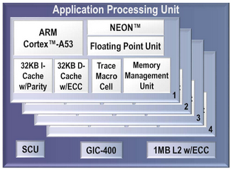
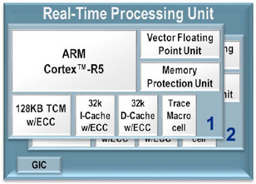
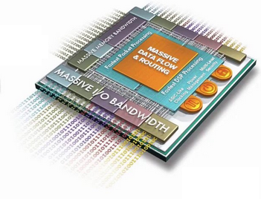
Power Management
SW avenue
PM Masters:
Based upon the battery voltage, we are now able to reduce the board power by 5W and the system power by 10 W automatically
Control
Control
Control
Power state
PM Controller:
SOFTWARE
Power Management Stack
Power
state
Power state
Power
state
PM Slaves:
Power state
ADC
Ethernet
Memory
GPS

Slide 11
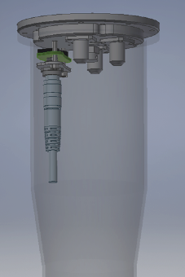
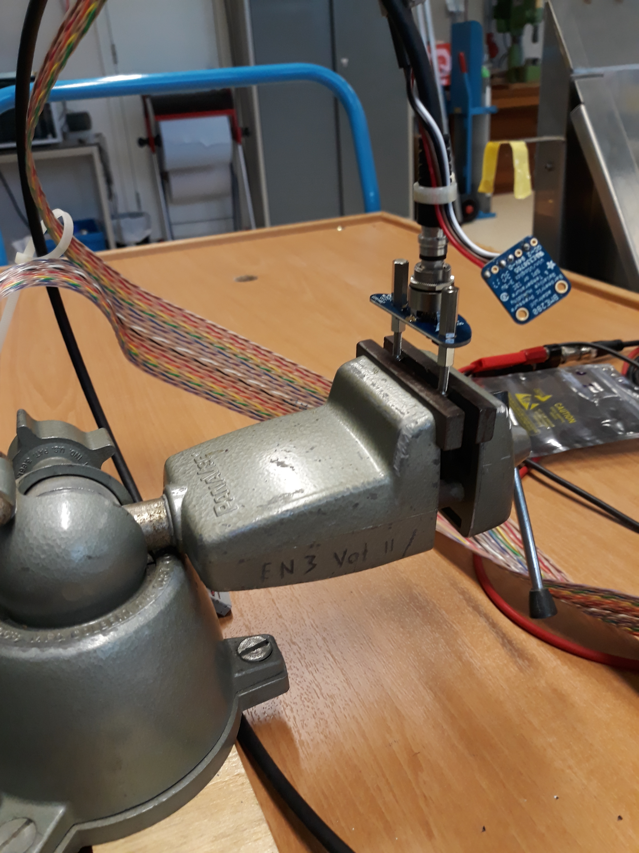
Additional Hardware Design
100 sensor boards have been produced
Designed, built and tested in Nijmegen
All analog readout

Slide 12
Reconstructing the event from the radio signal
Leading mechanisms: Geomagnetic and Charge excess
Picture from Fabrizia Canfora, PhD thesis Nijmegen (2021)
In addition: the Cherenkov effect!

Slide 13
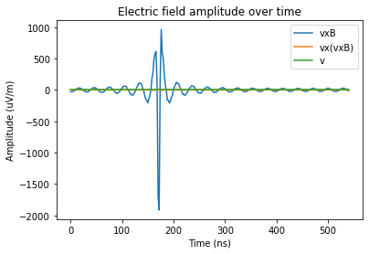
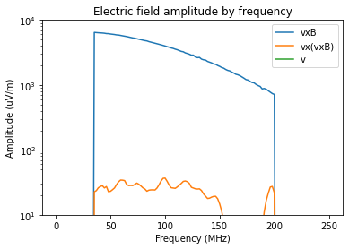
Reconstruction: Spectral Slope
Picture: Stefan Janssen
The idea: When the emission region is closer to the detector, the signal is more spread in time
This effect is seen for vertical showers in Auger
Question: Does this also work for horizontal showers

Slide 14
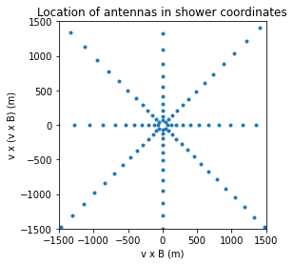
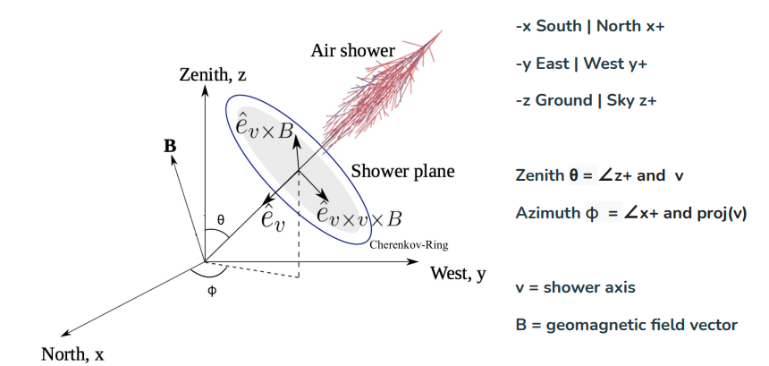
Reconstruction: Spectral Slope
Master’s thesis Inge van Rens
Picture by Henk Brans

Slide 15
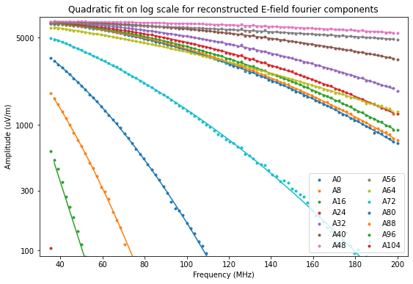
Reconstruction: Spectral Slope
Master’s thesis Inge van Rens
Zenith: 79.5°
Azimuth: 0°
Distance to Xmax: 66450 m
Distance to shower core increases with increasing antenna number
For each antenna, the derivative of the fit at 100 MHz is used as a measure for pulse shape.

Slide 16
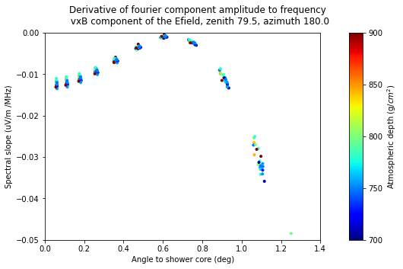
Reconstruction: Spectral Slope
Master’s thesis Inge van Rens
Average Xmax
Shower axis
θ
Antenna
Conclusion from Inge’s work: For horizontal showers there is no clear effect visible

Slide 17
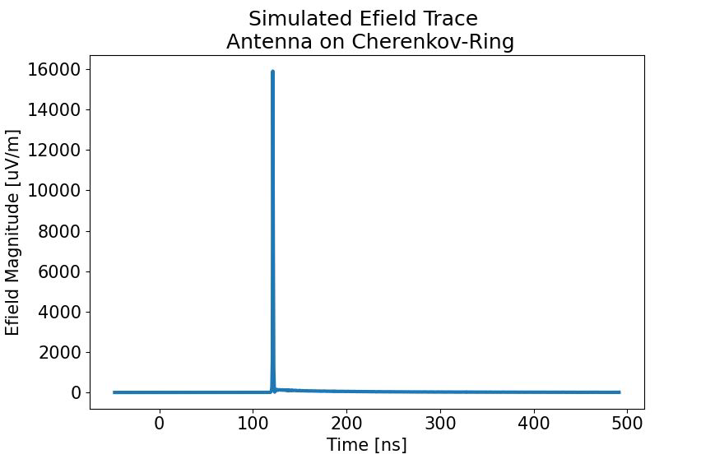
Reconstruction: Shower EM Energy
Master’s thesis Henk Brans
Idea:
On the Cherenkov cone you measure an integral of the radio emission in a very short amount of time
Thus: A composition independent measurement of the ELECTROMAGNETIC ENERGY in the air shower
Conversion to shower energy needs to take muons/neutrinos into account → model dependence

Slide 18
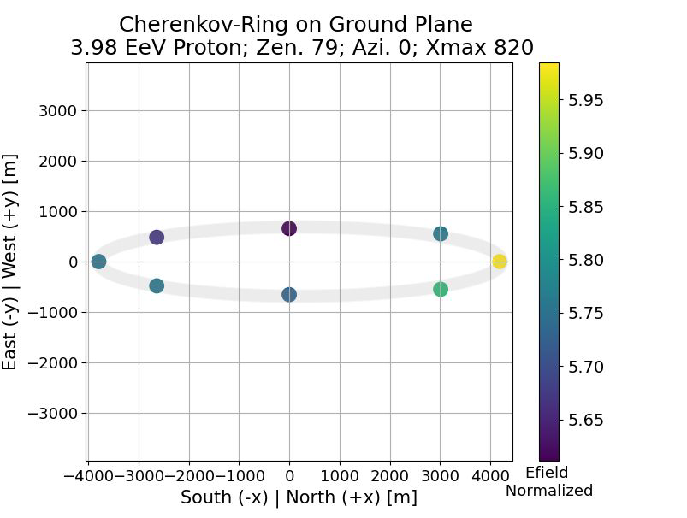
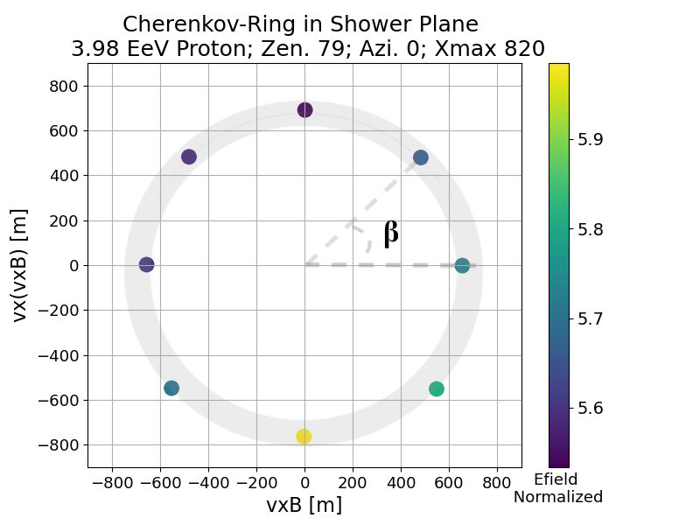
Reconstruction: Shower EM Energy
Master’s thesis Henk Brans

Slide 19
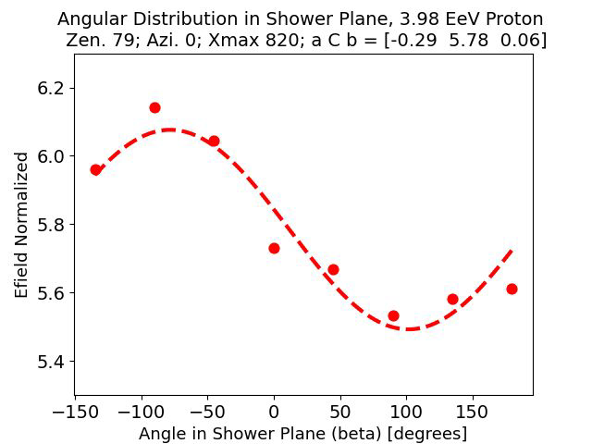

Reconstruction: Shower EM Energy
Master’s thesis Henk Brans
C Energy Estimate Parameter

Slide 20
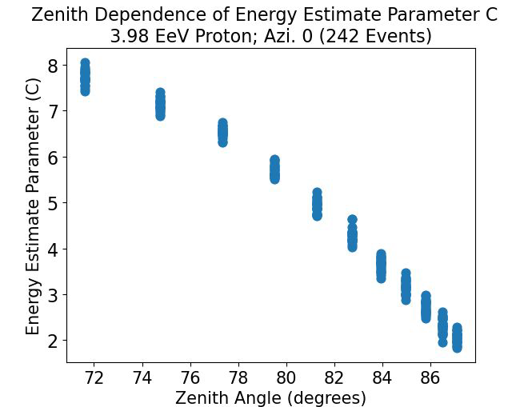
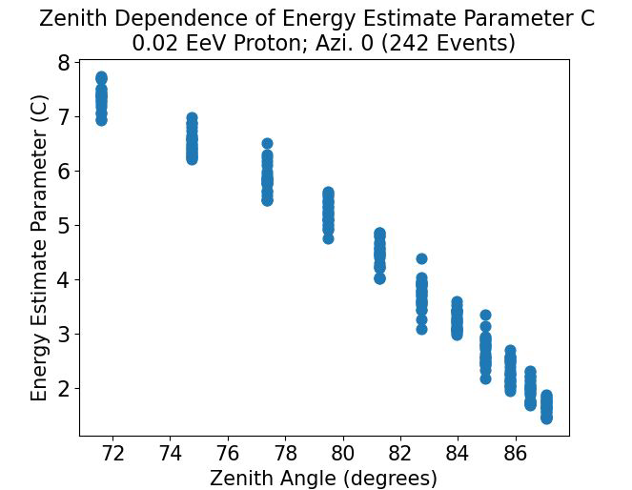
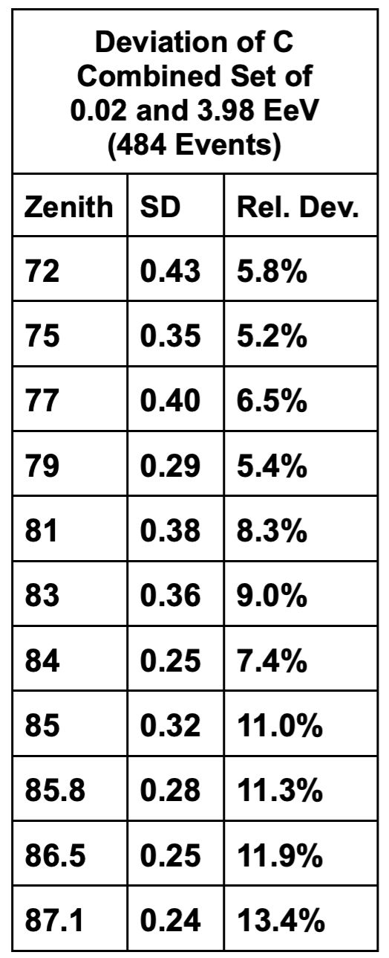
Reconstruction: Shower EM Energy
Master’s thesis Henk Brans

Slide 21
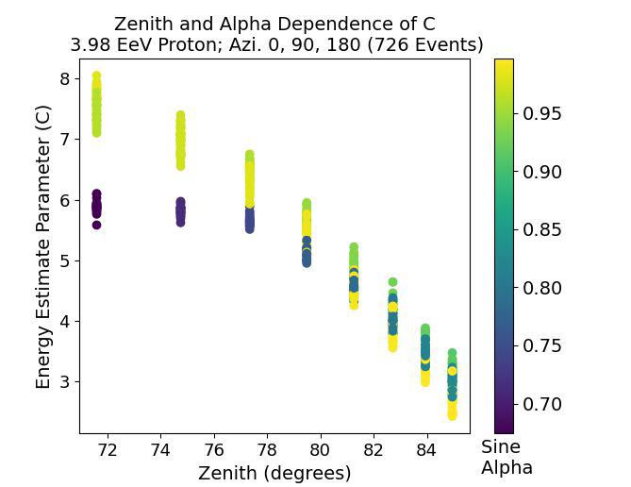
Reconstruction: Shower EM Energy
Master’s thesis Henk Brans
Unexpected behaviour: The dependence of the signal on the angle with the magnetic field is gone for horizontal showers

